Slide 1



How does EVM2 work?
Dan Brigden, WHO HQ

Slide 2
The EVM assessment framework
Notes:
I don’t see this as a separate deck.

Slide 3
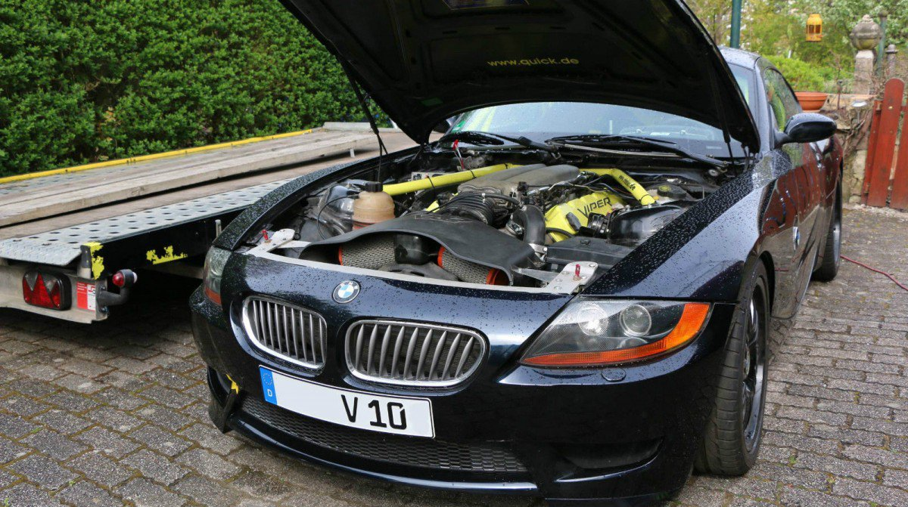

Slide 4
EVM > CRITERIA > CATEGORY > REQUIREMENT > QUESTION
The EVM assessment framework
INTRODUCTION TO DATA COLLECTION
How does EVM work?
Examples:
E2.2 Temperature management during transportation
E6.3 Inventory management
E8.1 The shake test
C1.2 Buildings & facilities
C4 Human resources
C2.1.1 Cold storage equipment
R221 Temperature sensors meet minimum standards.
R369 Responsible staff know how to condition ice-packs.
Q198 Is there 24 hour surveillance?
Q450 Is there a temperature mapping report available for the cold/freezer room?

Slide 5
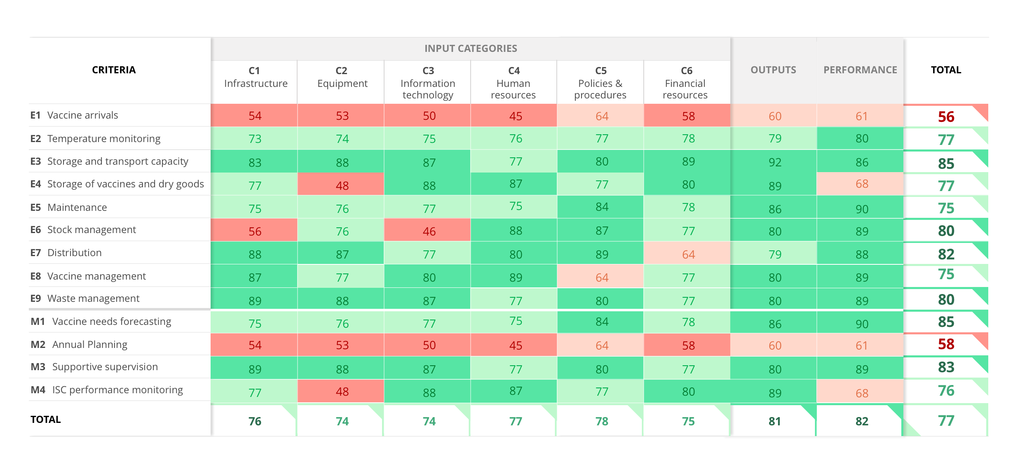
The EVM assessment framework
INTRODUCTION TO DATA COLLECTION

Slide 6
The EVM assessment framework
How did we get here?
77

Slide 7
EVM > CRITERIA > CATEGORY > REQUIREMENT > QUESTION
The EVM assessment framework
INTRODUCTION TO DATA COLLECTION
How does EVM work?

Slide 8
CRITERIA are functional areas (tasks) related to vaccine management. There are three groups.
E1-E9
Facility Operations Criteria
M1-M4
Management Criteria
P1-P6
Programme Management Criteria
EVM > CRITERIA > CATEGORY > REQUIREMENT > QUESTION
E
E1-E9
Facility operations
M
M1-M4
Facility management
R
R1-R6
Programme management

Slide 9

FACILITY OPERATIONS
For E1-9, suggest you refer back to the EVM1 criteria jigsaw – it might be nice to “quote” that here.
EVM > CRITERIA > CATEGORY > REQUIREMENT > QUESTION
E
E1 Vaccine arrivals
E2 Temperature management
E3 Storage and transport capacity
E4 Storage of vaccines and dry goods
E5 Maintenance
E6 Stock management
E7 Distribution of vaccines and dry goods
E8 Vaccine management
E9 Waste management
E9
Waste
Management
E8
Vaccine
management
E1
Pre-shipment
&
arrival
E2
Storage
temperature
E7
Distribution
E6
Stock
management
E5
Maintenance
E3
Capacity
E4
Buildings,
equipment,
transport
Notes:
A representative sample of sites is selected at each level of the supply chain.
Each of the 9 EVM Criteria is assessed at each supply chain level by observation, inspection of infrastructure and records, and by interview of staff.
Inputs, process and performance indicators are evaluated in each of the 9 areas at each level.
Indicator scores are combined to give criterion scores for each area at each level.
An area of vaccine management is considered “Effective” if its criterion score is greater than or equal to 80% - the EVM standard.

Slide 10
For E1-9, suggest you refer back to the EVM1 criteria jigsaw – it might be nice to “quote” that here.
EVM > CRITERIA > CATEGORY > REQUIREMENT > QUESTION
E
E1 Vaccine arrivals
E1.1 Inspection of shipments
E1.2 Custom clearance & transition facilities
E1.3 Transport from port of entry to primary store
E2 Temperature management
E2.1 Temperature management in storage
E2.2 Temperature management during transportation
E3 Storage and transport capacity
E3.1 Physical capacity of supply chain infrastructure is sufficient for maximum stock levels
E3.2 Safe and optimal utilisation of available capacity.
E4 Storage of vaccines and dry goods
E4.1 Storage of vaccines
E4.2 Storage of dry goods
E5 Maintenance
E5.1 Maintenance & repair of buildings
E5.2 Maintenance & repair of cold storage equipment
E5.3 Maintenance & repair of vehicles
E6 Stock management
E6.1 Replenishment
E6.2 Receipt and put-away
E6.3 Inventory management
E6.4 Release and dispatch
E6.5 Managing returns, damaged and expired stock
E7 Distribution of vaccines and dry goods
E7.1 Distribution planning
E7.2 Transportation of vaccines
E8 Vaccine management
E8.1 The shake test
E8.2 Use of freeze-dried vaccines
E8.3 Multi-dose vial policy
E9 Waste management
E9.1 Handling of syringes after use
E9.2 Storage of immunization waste
E9.3 Disposal of immunization waste
Notes:
A representative sample of sites is selected at each level of the supply chain.
Each of the 9 EVM Criteria is assessed at each supply chain level by observation, inspection of infrastructure and records, and by interview of staff.
Inputs, process and performance indicators are evaluated in each of the 9 areas at each level.
Indicator scores are combined to give criterion scores for each area at each level.
An area of vaccine management is considered “Effective” if its criterion score is greater than or equal to 80% - the EVM standard.

Slide 11
FACILITY MANAGEMENT
For E1-9, suggest you refer back to the EVM1 criteria jigsaw – it might be nice to “quote” that here.
M
EVM > CRITERIA > CATEGORY > REQUIREMENT > QUESTION
M1 Annual needs forecasting
M2 Annual work planning
M3 Supportive supervision
M4 iSC performance monitoring

Slide 12
PROGRAMME MANAGEMENT
For E1-9, suggest you refer back to the EVM1 criteria jigsaw – it might be nice to “quote” that here.
EVM > CRITERIA > CATEGORY > REQUIREMENT > QUESTION
R
R1 Infrastructure management
R2 Equipment management
R3 IT systems management
R4 Human resources management
R5 Knowledge management
R6 Financial resources management
Applicable at national programme level only. Not applicable at location level.

Slide 13
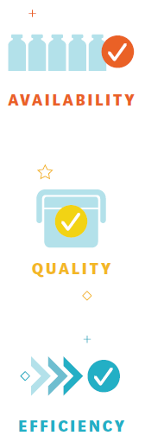
SYSTEM INDICATORS
For E1-9, suggest you refer back to the EVM1 criteria jigsaw – it might be nice to “quote” that here.
EVM > CRITERIA > CATEGORY > REQUIREMENT > QUESTION
AQE
SY1 Availability
SY1 Quality
SY1 Efficiency

Slide 14
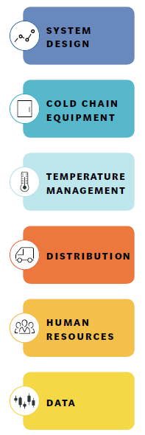
SUPPLY CHAIN ESSENTIALS
For E1-9, suggest you refer back to the EVM1 criteria jigsaw – it might be nice to “quote” that here.
EVM > CRITERIA > CATEGORY > REQUIREMENT > QUESTION
SCE
SCE1 System design
SCE2 Cold chain equipment
SCE3 Temperature management
SCE4 Distribution
SCE4 Human resources
SCE4 Data
Note: Not yet built.

Slide 15
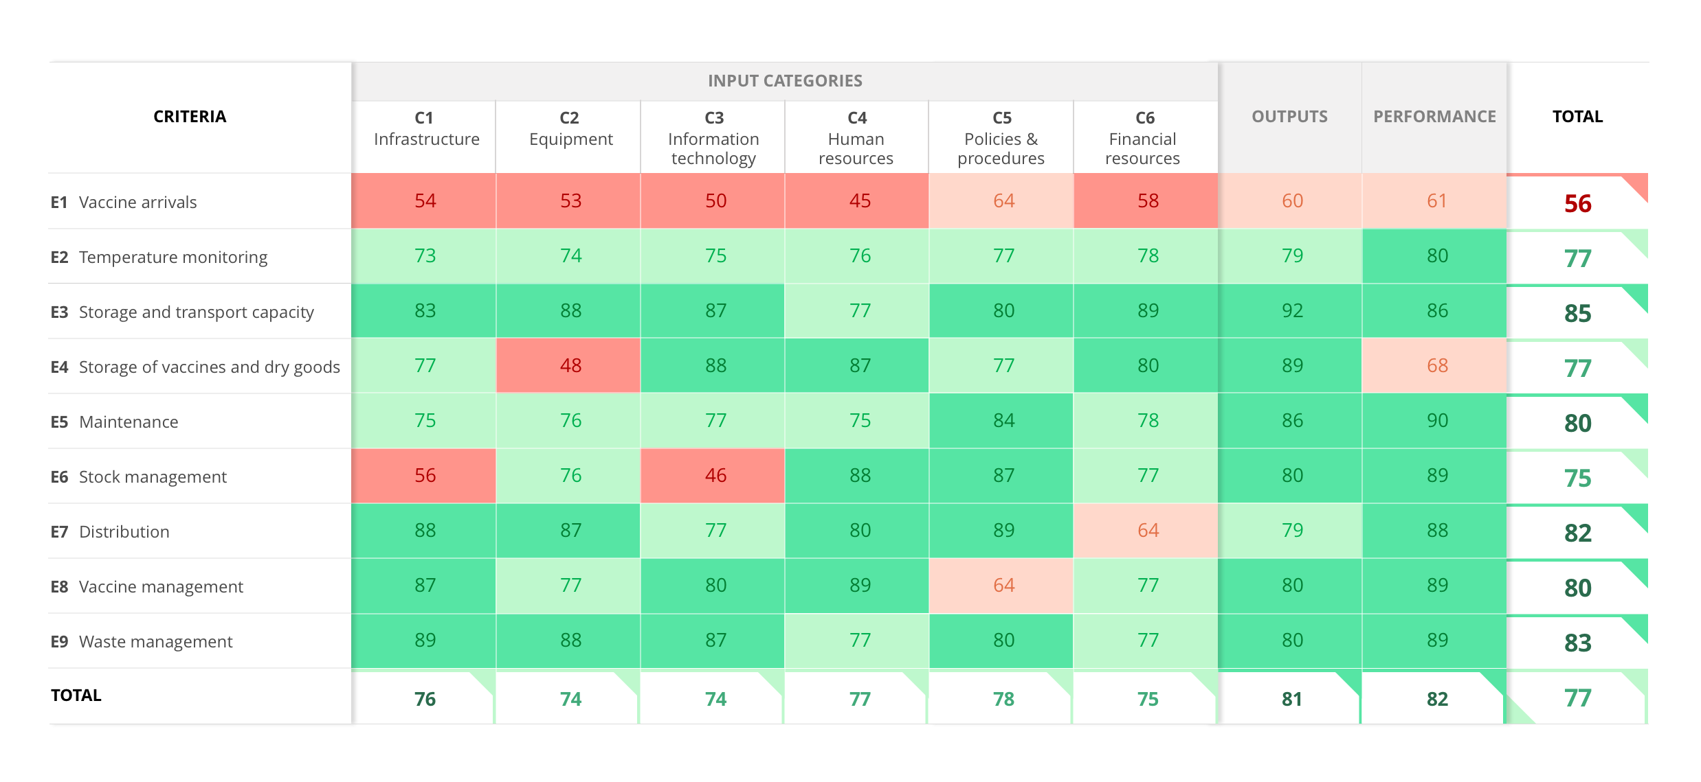
CRITERIA appear vertically across the matrix.
EVM > CRITERIA > CATEGORY > REQUIREMENT > QUESTION
E1-E9
Facility Operations
E
Notes:
This slide needs to show M1-4 under E1-9.

Slide 16
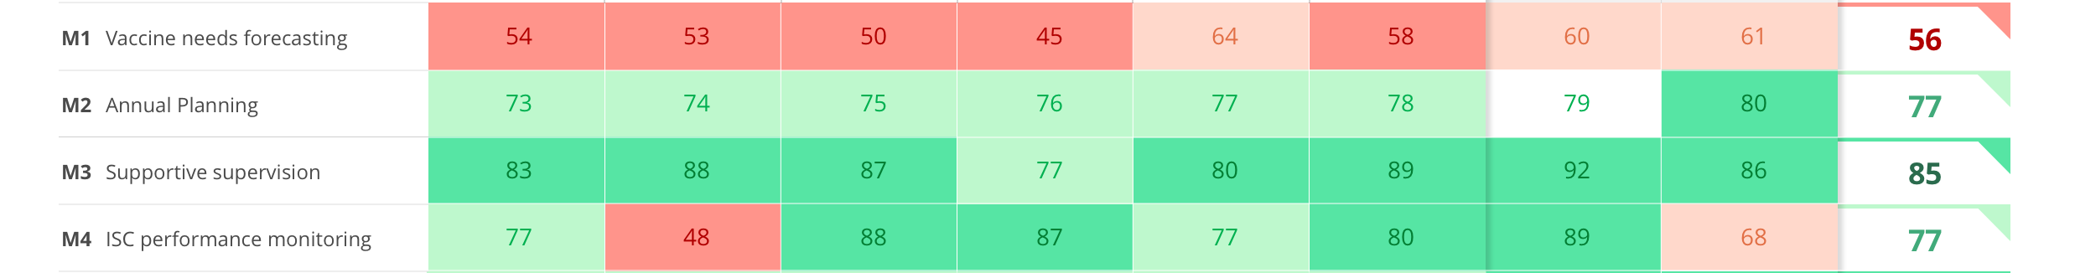
EVM > CRITERIA > CATEGORY > REQUIREMENT > QUESTION
M
M1-M4
Facility Management
Notes:
Add versions of this slide showing M1-4, AQE and R1-6.

Slide 17
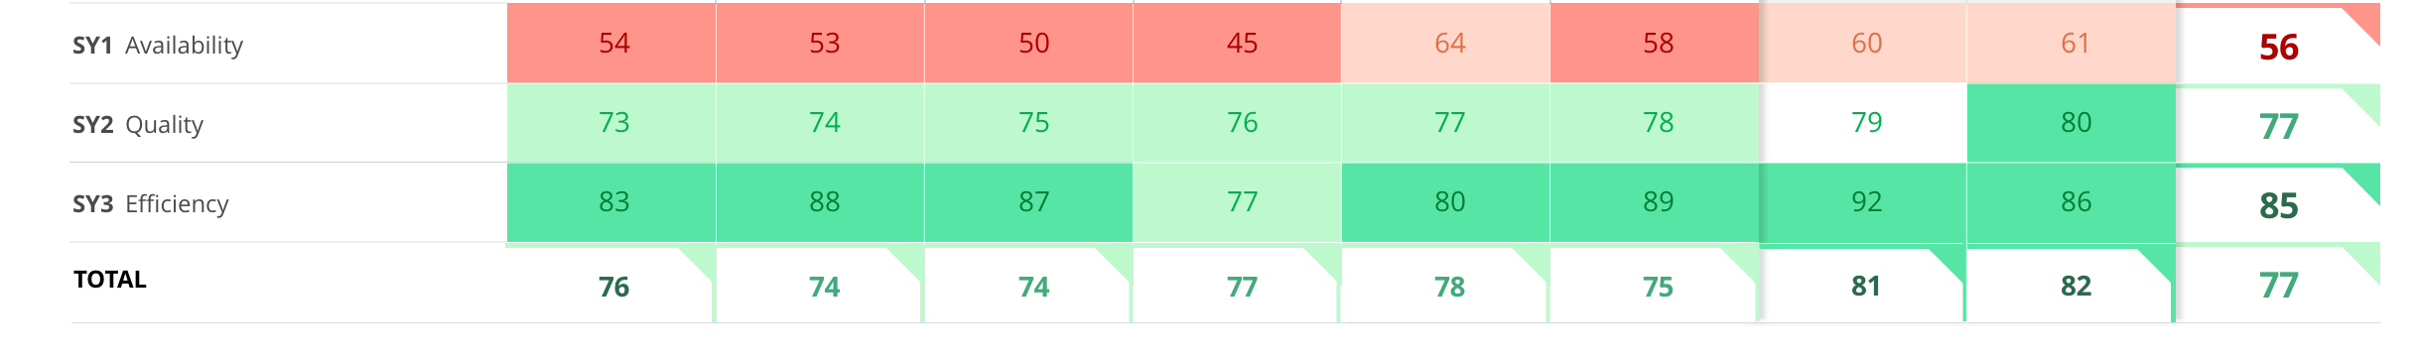
EVM > CRITERIA > CATEGORY > REQUIREMENT > QUESTION
AQE
SY1-SY3
System Indicators
Notes:
Add versions of this slide showing M1-4, AQE and R1-6.

Slide 18
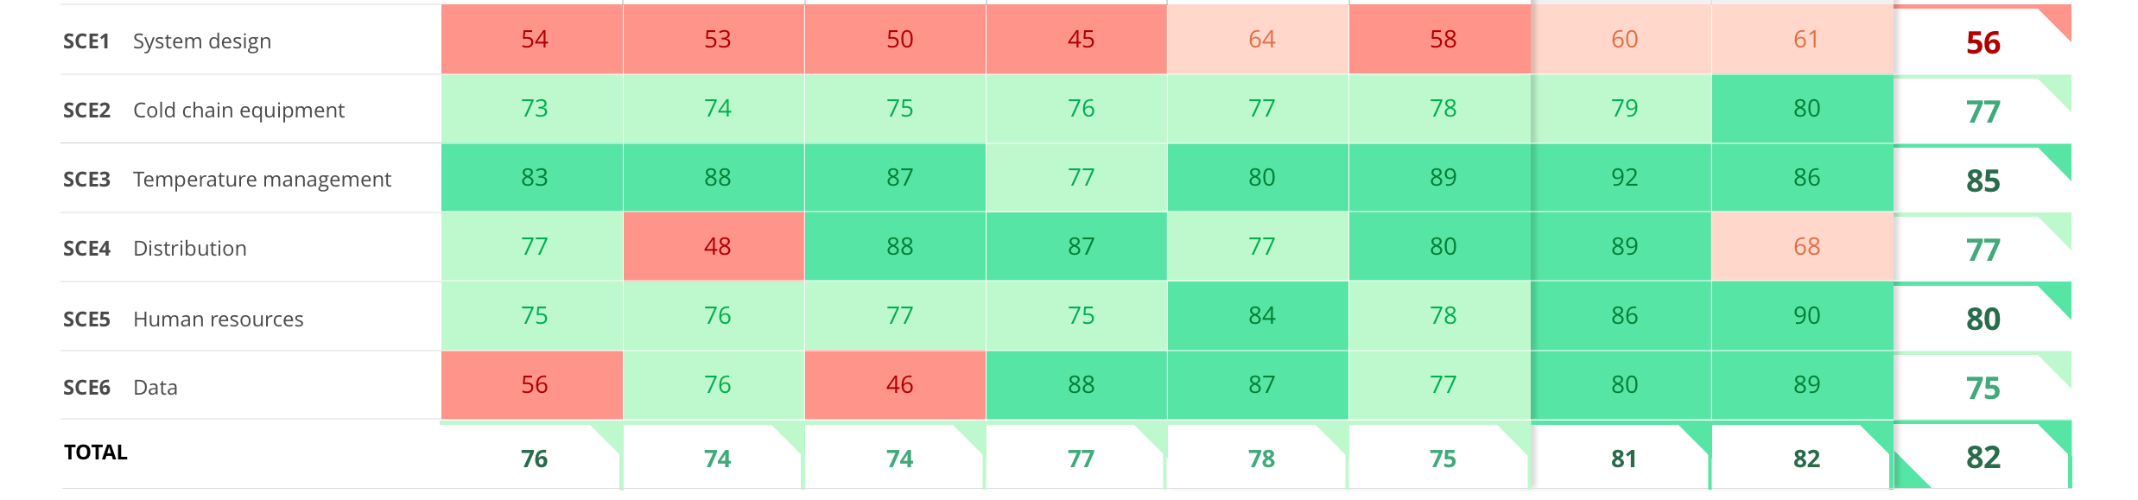
EVM > CRITERIA > CATEGORY > REQUIREMENT > QUESTION
SCE
SCE1-SCE6
Supply Chain Essentials
Notes:
Add versions of this slide showing M1-4, AQE and R1-6.

Slide 19
EVM > CRITERIA > CATEGORY > REQUIREMENT > QUESTION
The EVM assessment framework
INTRODUCTION TO DATA COLLECTION
How does EVM work?

Slide 20
EVM > CRITERIA > CATEGORY > REQUIREMENT > QUESTION
The EVM assessment framework
INTRODUCTION TO DATA COLLECTION
All functions (e.g. baking a cake, storing vaccines, flying a kite) require 6 different types of input.
EVM assesses the required inputs, the expected outputs and the performance of EVM functions.
Inputs, outputs and performance of functions are organized into categories.
EVM defines minimum requirements (standards) for categories.
Notes:
Need to add a slide after this with a good example.

Slide 21

K1 Kite-flying - a new EVM criterion?
Inputs?
Outputs?
Performance?

Slide 22
Input categories
EVM > CRITERIA > CATEGORY > REQUIREMENT > QUESTION
C1 | Infrastructure
C1.1 | Utilities & services
C1.2 | Buildings & facilities
C2 | Equipment
C2.1 | Storage equipment
C2.1.1 | Cold storage equipment
C2.1.2 | Other storage equipment
C2.2 | Transportation equipment
C2.2.1 | Vehicles
C2.2.2 | Insulated containers
C2.3 | Other equipment
C3 | Information technology
C3.1 | General IT equipment
C3.2 | Data management technology
C4 | Human resources
C4.1 | Staffing
C4.2 | Training
C4.3 | Knowledge & understanding
C5 | Policies & procedures
C5.1 | Evidence
C5.2 | Policy & strategy
C5.3 | SOPs
C5.4 | Contracts
C6 | Financial resources
C6.1 | Salaries
C6.2 | Funds for operations
C6.3 | Funds for development

Slide 23
EVM > CRITERIA > CATEGORY > REQUIREMENT > QUESTION
The EVM assessment framework
INTRODUCTION TO DATA COLLECTION
How does EVM work?

Slide 24
For each category, minimum standards are set. These requirements set the standard for immunization supply chains.
Requirements are organized by category and applicable to particular criteria. They are also given a weighting of 5,1, or 0.
EVM > CRITERIA > CATEGORY > REQUIREMENT > QUESTION
618
247
Requirements
Sub-requirements

Slide 25
R120 Refrigerated vehicles meet minimum standards.
EVM > CRITERIA > CATEGORY > REQUIREMENT > QUESTION
R121 Refrigeration units have a standby electric power system.
R122 Refrigeration units can operate for 24 hours autonomously.
R123 Refrigeration units have adjustable thermostats.
R124 Refrigeration units have low temperature protection.
R125 Refrigeration units have automatic defrosting.
R126 Refrigeration units use CFC-free refrigerant.
R127 Refrigerated compartment doors have plastic strip curtain.
R128 Refrigerated compartments have non-slip floors.
R129 Refrigerated compartments have suitable containers for holding the vaccine load.
R130 Refrigerated compartments have a mechanism for restraining the vaccine load.

Slide 26
EVM > CRITERIA > CATEGORY > REQUIREMENT > QUESTION
The EVM assessment framework
INTRODUCTION TO DATA COLLECTION
How does EVM work?

Slide 27
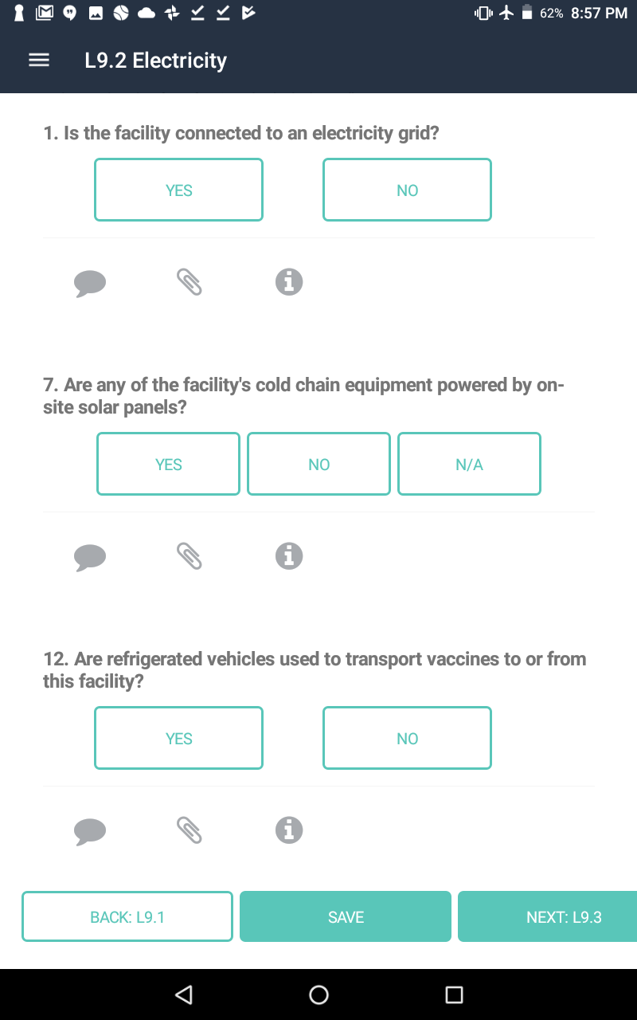

Each question is a tool to assess whether a requirement has been met.
EVM asks assessors to answer a question or questions by observation, inspection of infrastructure and records, and by interview of staff.
EVM > CRITERIA > CATEGORY > REQUIREMENT > QUESTION
EVM > CRITERIA > CATEGORY > REQUIREMENT > QUESTION
Notes:
Questions are asked to assess whether a requirement has been met. If you can you show the relevant question in the app, that would be great.

Slide 28
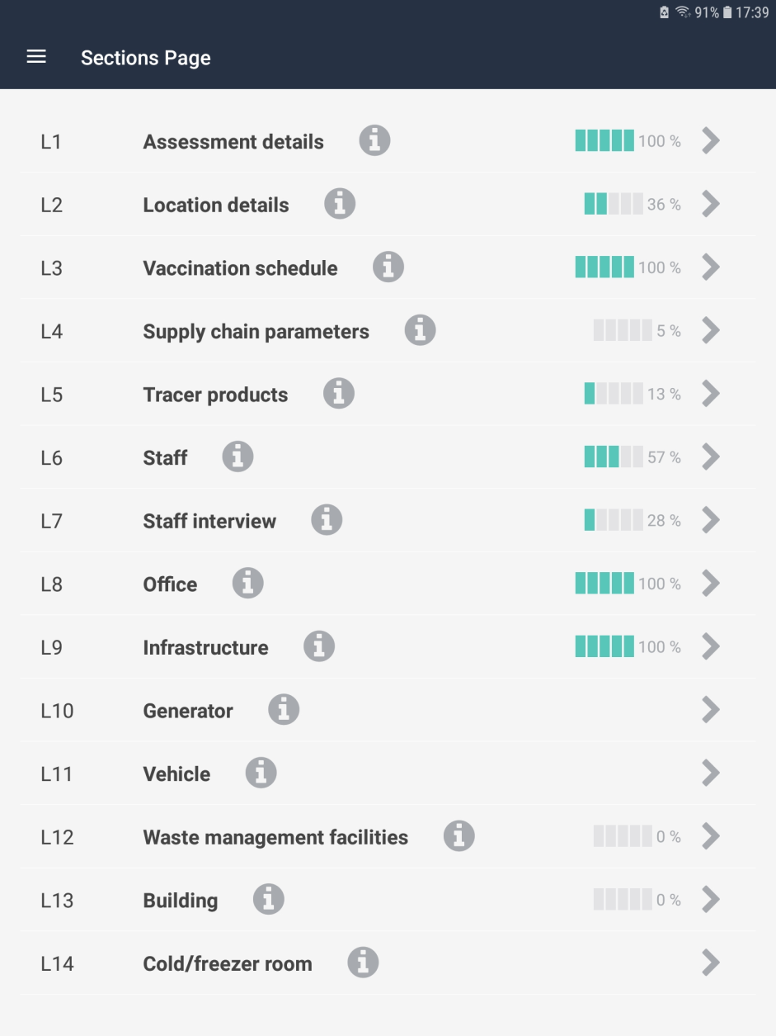
To enable assessors to collect data more efficiently, questions are organized into questionnaire sections. These are mostly related to physical locations.
There are 37 sections.
EVM > CRITERIA > CATEGORY > REQUIREMENT > QUESTION
EVM > CRITERIA > CATEGORY > REQUIREMENT > QUESTION

Slide 29
EVM assessment scores
Notes:
We need to go into much more detail here. I don’t have time to do this now.

Slide 30



Slide 31
The EVM assessment framework
INTRODUCTION TO DATA COLLECTION

Slide 32
EVM assessment scores
C1
Category scores
Requirement scores for C1 that are applicable to E4 are aggregated and presented in this cell.

Slide 33
EVM > CRITERIA > CATEGORY > REQUIREMENT > QUESTION
EVM assessment scores
E4
Criteria scores
Requirement scores for each category that are applicable to E4 are aggregated and presented in this cell.

Slide 34
All other criteria are also scored.
EVM assessment scores
The aggregate of E1-9 and M1-4 criteria scores is shown in this cell.

Slide 35
The EVM assessment framework
The EVM composite score
77
This is a single percentage score that:
For a location questionnaire is obtained by aggregating E1-9 and M1-4 criteria scores.
For an EVM assessment is obtained by aggregating E1-9, M1-4 and R1-6 criteria scores.
If you want a single indicator to reflect location or assessment performance, this is it.
Use with caution.

Slide 36


Slide 37
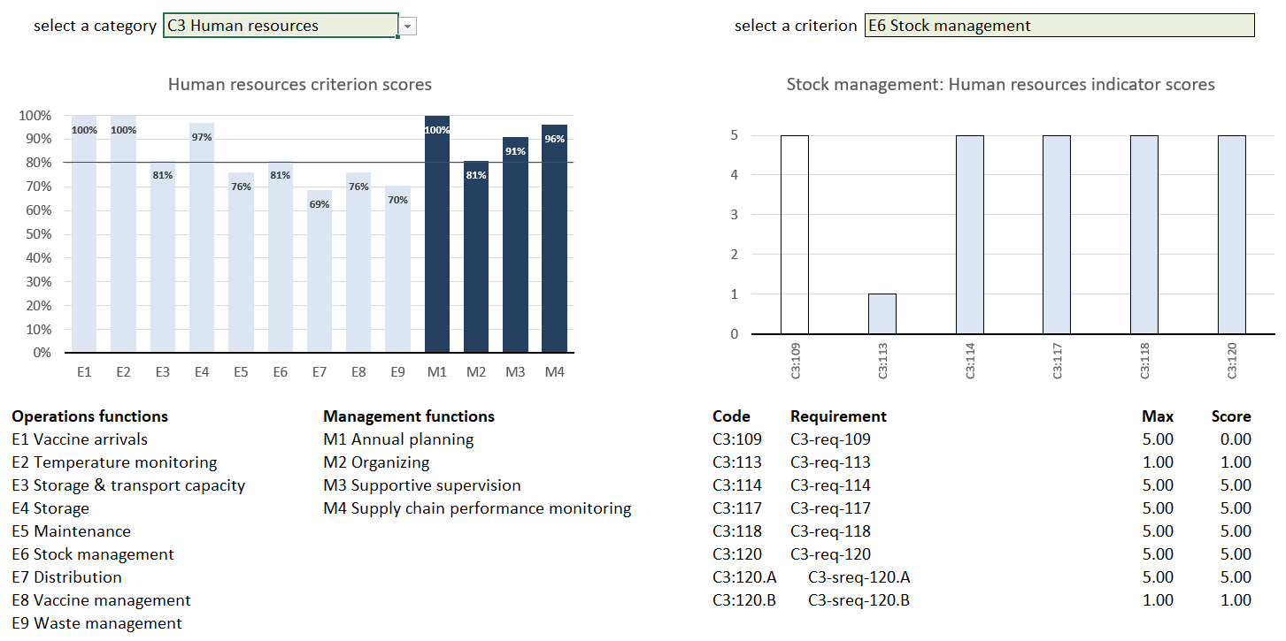
EVM assessment scores
Let’s take an example. In the graph opposite, the score for C3-E6 is 81%. How was this number calculated?
In the app, I can click the C3-E6 bar and I will see a second graph with more detailed information.
Notes:
Use screenshots from app of these graphs.

Slide 38
EVM assessment scores
This second graph shows the individual requirement scores for C3-E6.
In this instance, there are six requirements. The maximum possible score for each of the six requirements is 26. The score obtained is 21, which is 81% of 26 (the first requirement was not met).
Note:
The sixth requirement contains two sub-requirements. The requirement score is simply the average of the sub-requirement scores.
The second requirement is weighted 1, which means that this is the maximum score it can have.
Notes:
Use screenshots from app of these graphs.

Slide 39
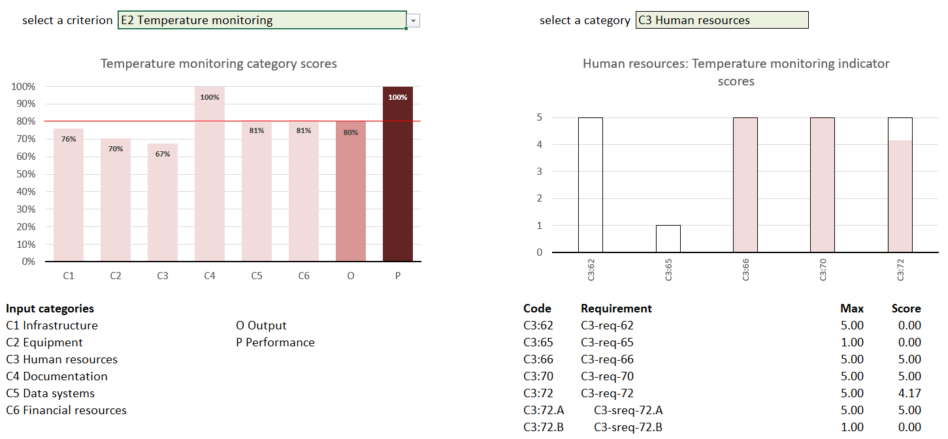
EVM assessment scores
Another example. In the graph opposite, the score for C3-E2 is 67%.
In the app, I can click the C3-E2 bar to see a second graph with more detailed information.
Notes:
Use screenshots from app of these graphs.

Slide 40
EVM assessment scores
This second graph shows the individual requirement scores for C3-E2.
In this instance, there are five requirements. The maximum possible score for each requirement is 21. The score obtained is 14.17, which is 67% of 21.
The fifth requirement is weighted 5 and contains two sub-requirements. The first is weighted 5 and the second 1. The maximum score for the two sub-requirements is therefore 6, and the score obtained is 5 out of 6 (83.3%). As the maximum for this requirement is 5, the score is 4.17 (83.3% of 5).
Notes:
Use screenshots from app of these graphs.

Slide 41
No more numbers, please. Just tell me how the software works

Slide 42
First assessment
EVMA2 is primarily an online solution (requires internet connection), although data-collection can operate both online and offline.
EVMA2 INTRODUCTION
COUNTRY SETUP
ASSESSMENT CREATION
DATA-COLLECTION
RESULTS ANALYSIS
Country Manager
Country Manager
Assessor
Country Manager
EPI Manager
EVM Assessment Manager
EVM Assessment Manager
Location assessment
EVM Assessment Manager
EVM Locations (app)
  Administrative units
  Locations
  Immunization schedule
  Supply chain parameters
  Tracer products
Identify locations
Define scope (full or partial)
Assign questionnaires to assessors
Programme assessment
EVM Assessment Manager

Slide 43
Second assessment
EVMA2 is primarily an online solution (requires internet connection), although data-collection can operate both online and offline.
EVMA2 INTRODUCTION
ASSESSMENT CREATION
DATA-COLLECTION
RESULTS ANALYSIS
Country Manager
Assessor
Country Manager
EPI Manager
EVM Assessment Manager
Location data-collection
EVM Assessment Manager
EVM Locations (app)
Identify locations
Define scope (full or partial)
Assign questionnaires to assessors
Programme assessment
EVM Assessment Manager

Slide 44
Subsequent assessments
EVMA2 is primarily an online solution (requires internet connection), although data-collection can operate both online and offline.
EVMA2 INTRODUCTION
National, full
ASSESSMENT CREATION
DATA-COLLECTION
RESULTS ANALYSIS
Region X only, SP level only, full
ASSESSMENT CREATION
DATA-COLLECTION
RESULTS ANALYSIS
Region X and Y only, E2 only
ASSESSMENT CREATION
DATA-COLLECTION
RESULTS ANALYSIS

Slide 45
COUNTRY SET-UP
COUNTRY SET-UP
ASSESSMENT CREATION
DATA COLLECTION
RESULTS ANALYSIS

Slide 46
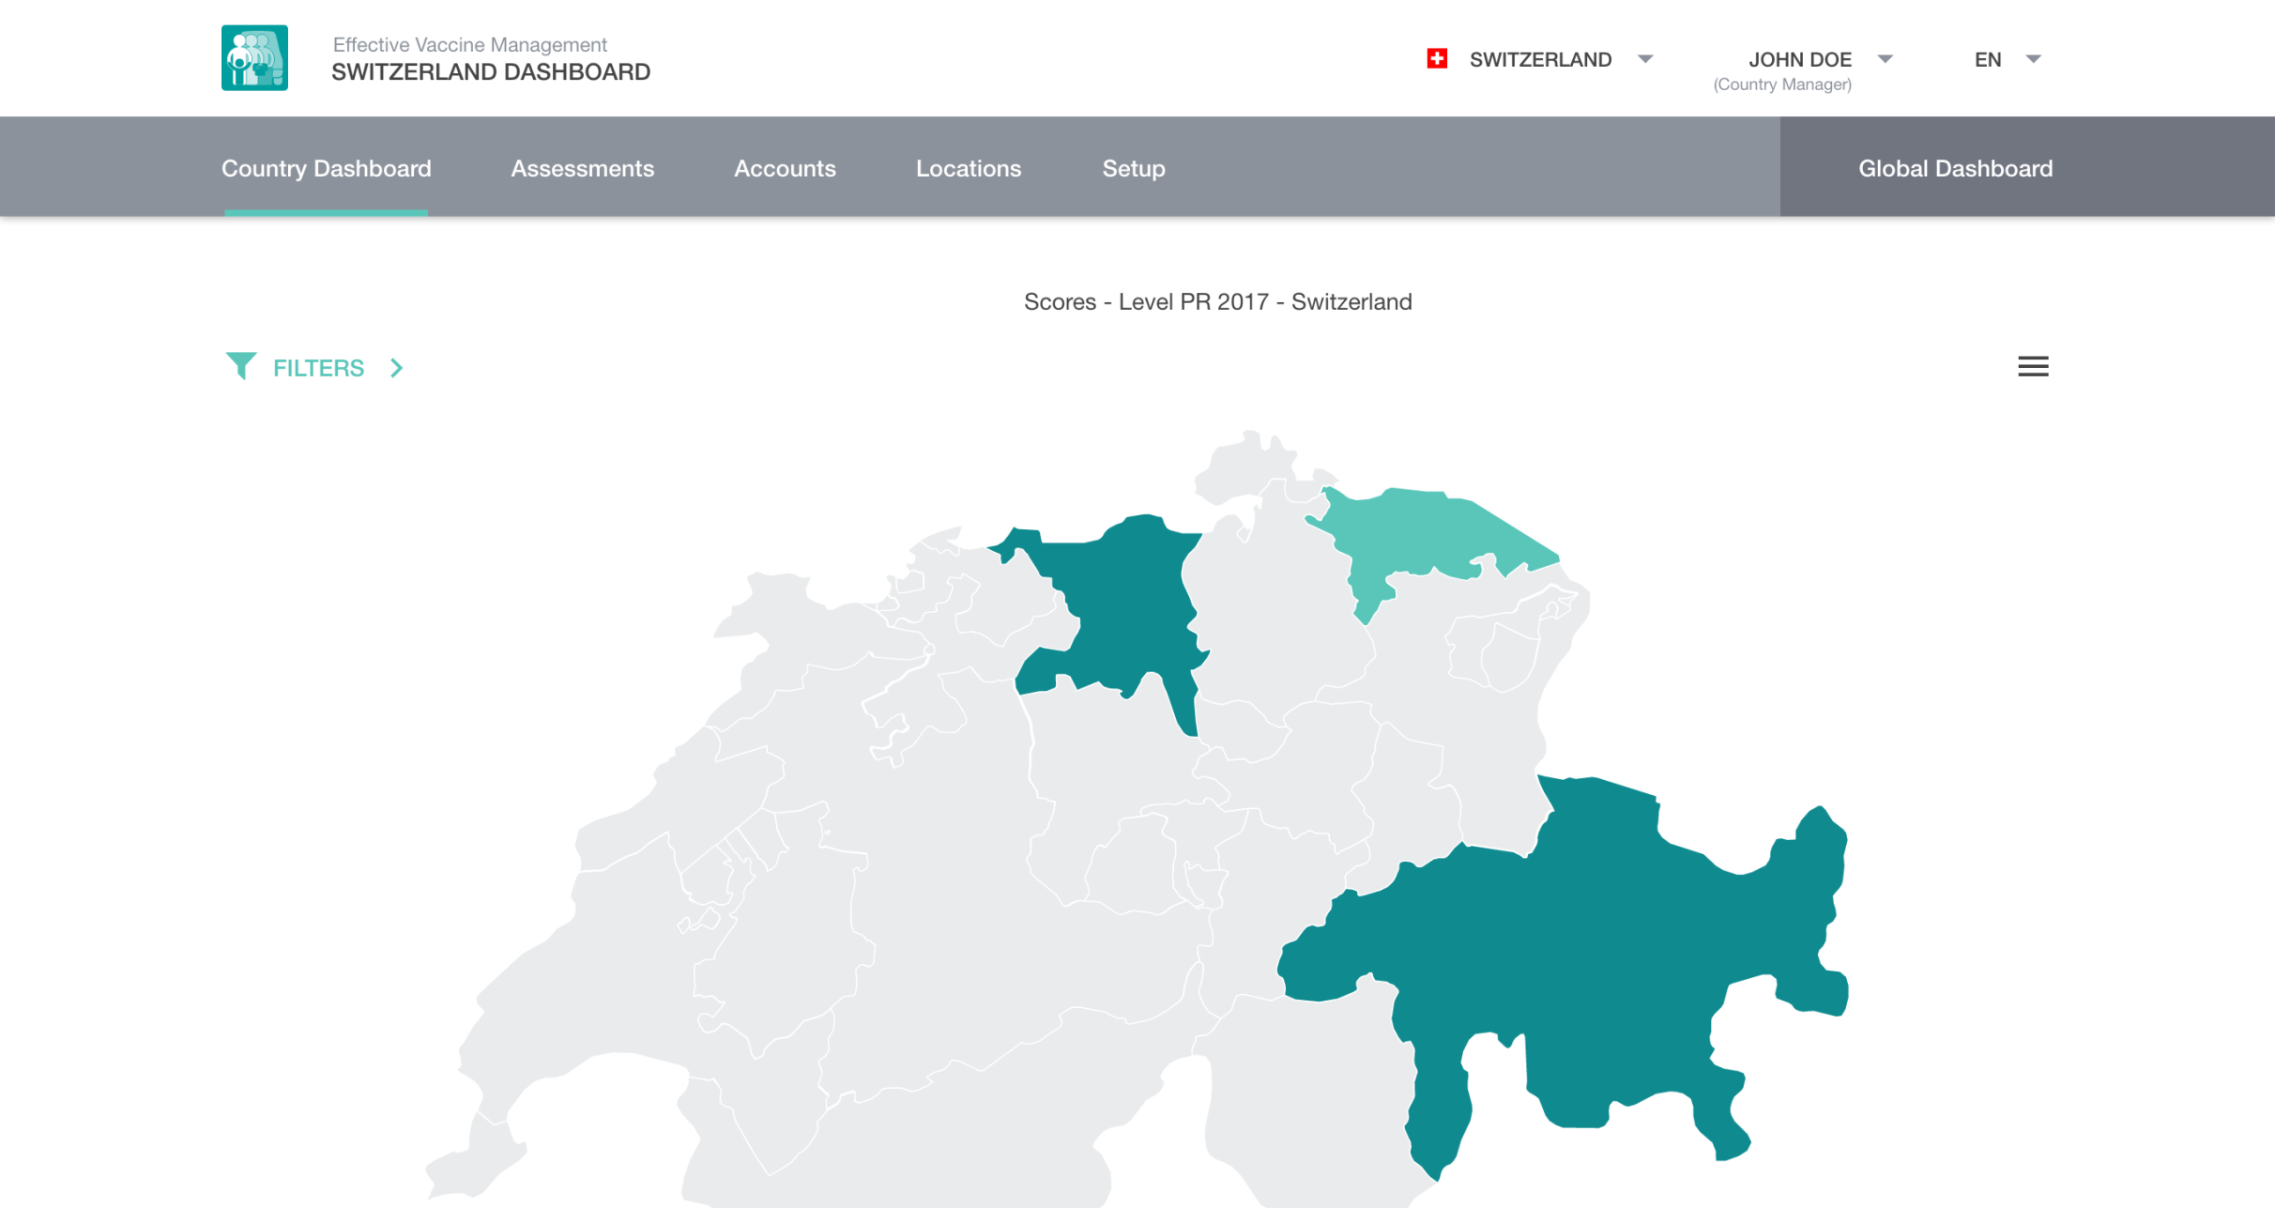
COUNTRY SET-UP
Administrative units (regions, districts, etc.)
Supply chain locations (vaccine stores and health facilities)
National vaccination schedule
Supply chain parameters (supply interval, safety stock, maximum stock)
Tracer products
User management

Slide 47
ASSESSMENT CREATION
COUNTRY SET-UP
ASSESSMENT CREATION
DATA COLLECTION
RESULTS ANALYSIS
Notes:
See earlier comment.

Slide 48
The country manager and management staff create an assessment
ASSESSMENT CREATION
  Complete the assessment wizard
  Create and assign location questionnaires to assessors
  Complete programme management questionnaire
  Once assessors have completed and submitted their questionnaires:
  Review and approve submitted questionnaires
  Finalize and publish assessment
  Generate a template EVM Report for an EVM assessment

Slide 49

ASSESSMENT CREATION

Slide 50
ASSESSMENT DATA COLLECTION
PROGRAMME
ASSESSMENT
COUNTRY SET-UP
ASSESSMENT CREATION
DATA COLLECTION
RESULTS ANALYSIS
LOCATION
ASSESSMENT
Notes:
See earlier comment.

Slide 51
Using the EVM Assessment Manager website, the assessor completes the program management questionnaire by interviewing the EPI manager
PROGRAMME ASSESSMENT
ST Strategic planning
R1 Infrastructure management
R2 Equipment management
R3 IT systems management
R4 Human resources management
R5 Knowledge management
R6 Financial resources management

Slide 52

The EVM Locations app is used to assess locations
LOCATION ASSESSMENT
  Free download. Once the app is installed and opened for the first time, no internet connection is necessary.
  No authentication necessary to use the app to create “standalone” (unassigned) questionnaires.
  Distribution and collection of questionnaires can be performed in online (upload) or offline (memory stick) mode.

Slide 53
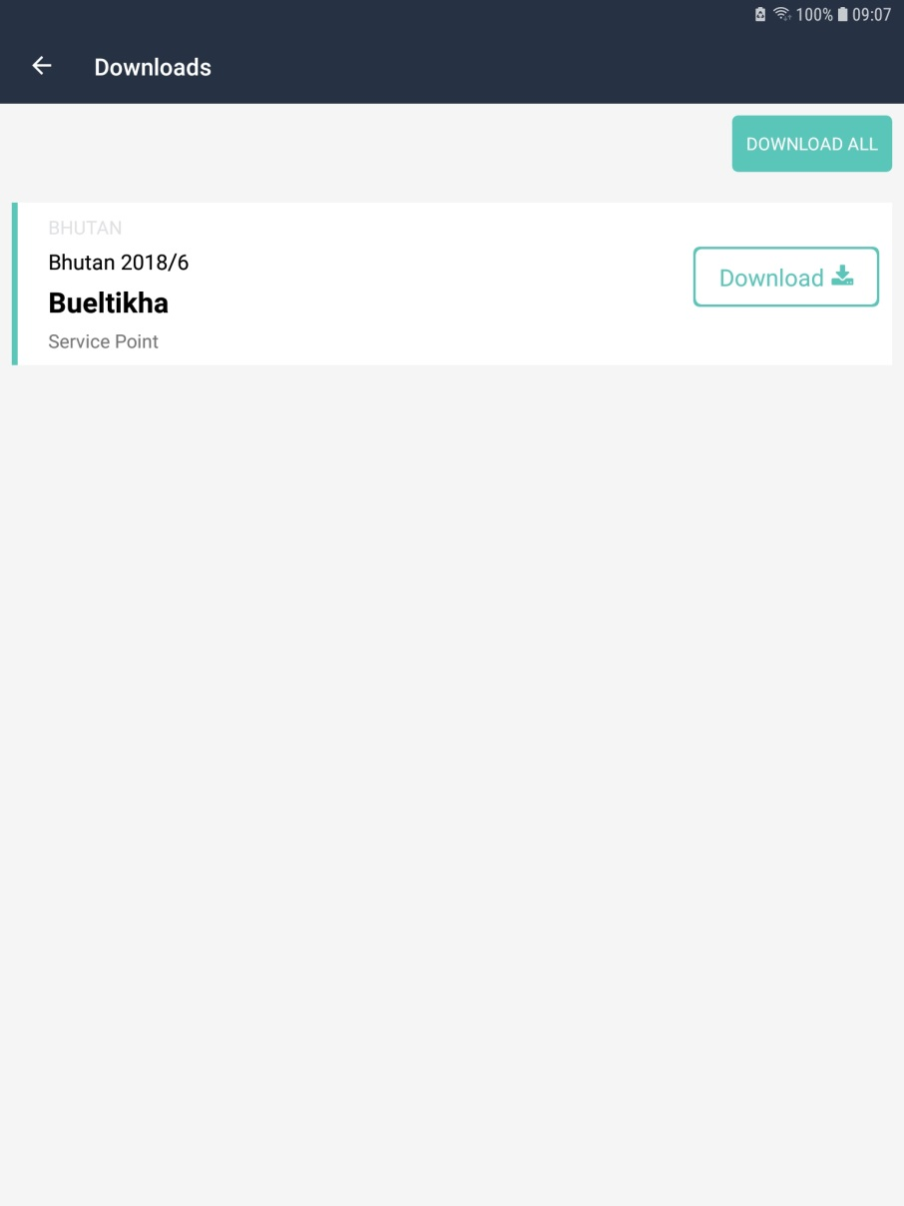
Assessors can download any questionnaire they have been assigned directly into the app
LOCATION ASSESSMENT
  Once they are authenticated, they see a list of assigned location questionnaires and can download them on to the app.
  When the questionnaire has been completed, it can be uploaded directly to EVM Assessment Manager.
  An internet connection is not required to use the app. It is only necessary to install the app, and download and upload questionnaires.

Slide 54
LOCATION ASSESSMENT

Slide 55
RESULTS ANALYSIS WORKFLOW
COUNTRY SET-UP
ASSESSMENT CREATION
DATA COLLECTION
RESULTS ANALYSIS
Notes:
See earlier comment.

Slide 56
Country dashboard
RESULTS ANALYSIS WORKFLOW
EVM Assessment Manager will provide managers with access to all the reports in the app, as well as several additional ones with comparison features. Can compare across status (published compared with unpublished or incomplete, etc.).

Slide 57

EVM Global Dashboard
RESULTS ANALYSIS WORKFLOW
Website hosted by WHO.
Provides a means of accessing and interpreting published EVM assessment scores at the global, regional and country level, basically an interactive version of the EVM Global Data Analysis PDF available on the WHO website.
Consists of dashboards that will enable visitors to generate live charts of published aggregated EVM assessment scores, using all assessment datasets uploaded and approved at that time.
Real-time data visibility for published EVM assessment data.

Slide 58
EVM Global Dashboard – data access
RESULTS ANALYSIS WORKFLOW
Unpublished EVM assessment data is not visible in the EVM Global Dashboard — only visible in the Assessment Manager for that country
Access to dashboards (for published EVM assessment scores only) is strictly determined by account permissions
  Aggregated (global/regional) dashboards - public access;
  Country-specific EVM assessment dashboards (EVM country scores) – country administrators only*
  Subnational EVM assessment dashboards - relevant country administrators only
Potentially also select country partners as requested.

Slide 59

Thanks

