Slide 1
A Platform to design a sound immunization waste management system
WEBINAR AUGUST 20
Adama Sawadogo

Slide 2
The Context
1
A real and shared concern
As countries expand their immunization schedules and increase immunization coverage, immunization activities generate infectious waste that must be safely managed to reduce health risk and environment pollution but in practice, the ‘after-injection’ (what happens after a vaccine is given to a child) is assumed as fine and the waste generated through immunization activities is generally not taken care of in a safe manner.
immunization delivery waste (e.g. injection waste) is dispersed in many health centers/sites, and in relatively smaller quantities in routine context; in the other hand, campaigns with injectable vaccines (Measles/MR, Yellow fever, ….), produce in a short period of time huge quantities of waste that must be adequately managed, and this presents a unique challenge.
“I just learned from TechNet about your session on waste disposal. I don't think I will join but I do want to share a concern about medical sharps waste disposal that I have not heard anyone yet raise -- and my back-of-the-envelope calculation.. I did the math many months ago: If 7 billion people indeed received just one shot, the syringes laid end to end would encircle the world at the equator 20 times. (alternatively they would go to the moon and back)”.
Robert Steinglass
His message on the webinar on waste management 07/31/2020

Slide 3
The objectives
The concept of the ADIW platform is based on 4 principles
2
Fortunately, the immunization/injection waste can be collected and transported to a safe treatment/disposal site.
The ADIW platform offers a practical guidance platform for stakeholders at district, province/regional or national level to consensually design how to cluster health centers where waste is generated to appropriate treatment and disposal sites (reference sites) where the waste can be adequately disposed.
The adequate clustering of HF around selected disposal sites
The good/practical combination of acceptable treatment and disposal options/facilities available locally
The necessary accountability: responsibilities and supervision clearly assigned at all the steps
The further improvement of the technologies for handling, treating and disposing wastes

Slide 4
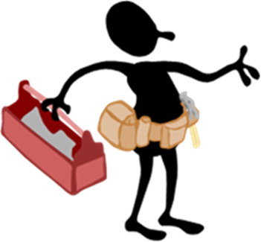
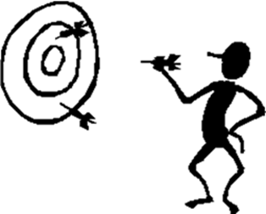
The ADIW critical requirements
3
ADIW is not a ready-made solution to fit all but rather a platform to design “your” solution in your context
The participation/involvement in the planning process of the concerned health facilities managers (e.g. district management team including health facilities’ focals) build a consensus and paves the way to accountability in order to ease the implementation.
The ADIW platform: A guidance for planning
Complement each other beyond the differences
A common objective
A joint planning
Responsibility and Accountability to succeed as a team

Slide 5
An overview of the ADIW platform features (link to the tool )

Slide 6
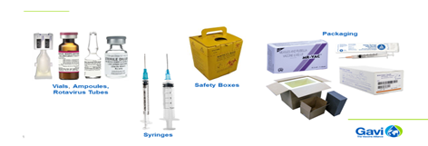
Immunization has always received high level of attention and support (i.e GAVI) but in practice, the ‘after-vaccination’ (what happens after a vaccine is given to a child) is assumed as fine and the waste generated through immunization delivery is generally not taken care of in a safe manner.
And what should be next ?
“When I was on the very first ICC for Gavi from 2000-2003, I encouraged Gavi without success that, when they were providing countries with HSS guidance, they should include medical sharps incineration or some other destruction in their illustrative examples to countries. It would have been good for both immunization programs as well as for the health system more broadly”.
Robert Steinglass
His message on the webinar on waste management 07/31/2020
Shouldn’t Countries and Partners think of earmarking at least 1/100 to 2/100 USD per syringe/vial purchased to contribute to its appropriate disposal !

Slide 7
HCWM is a system that must be planned and coordinated across multiple stakeholders and programs. Immunisation leaders must coordinate closely with the government entities responsible for waste management to best link resources and technologies and ensure implementation of best practices for managing health care waste. This guide was designed to help you to prepare and plan your HCWM system. Your system should be based on real needs and a vision of the future for growth, innovations, and opportunities for improvements across all areas of the system.

Slide 8
Questions?
THANK YOU

