Slide 1
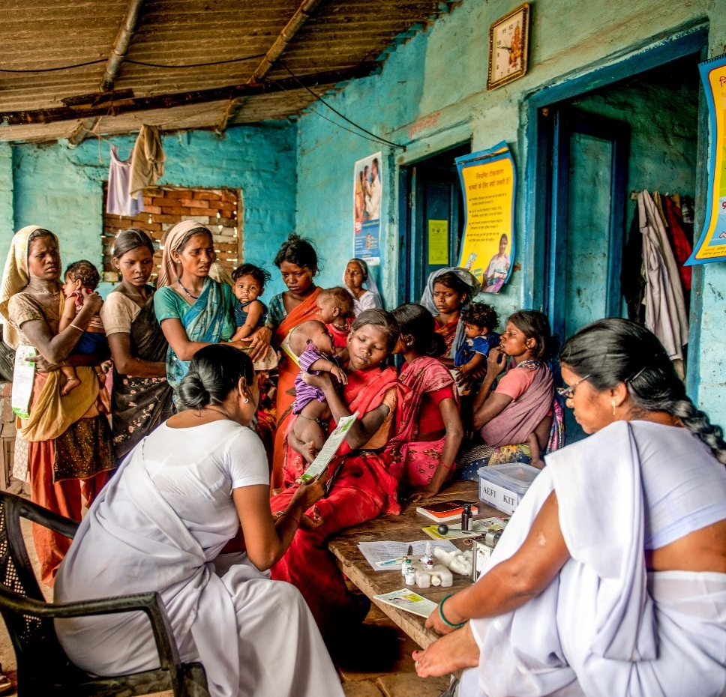
HEALTH CARE WASTE MANAGEMENT IN IMMUNISATION PROGRAMS: GUIDANCE FOR PROPOSAL PLANNING
Overview of Guidance Document
August 2020
Health Care Waste Management in Immunisation Programs: Guidance for Proposal Planning

Slide 2
Introduction
1

Slide 3
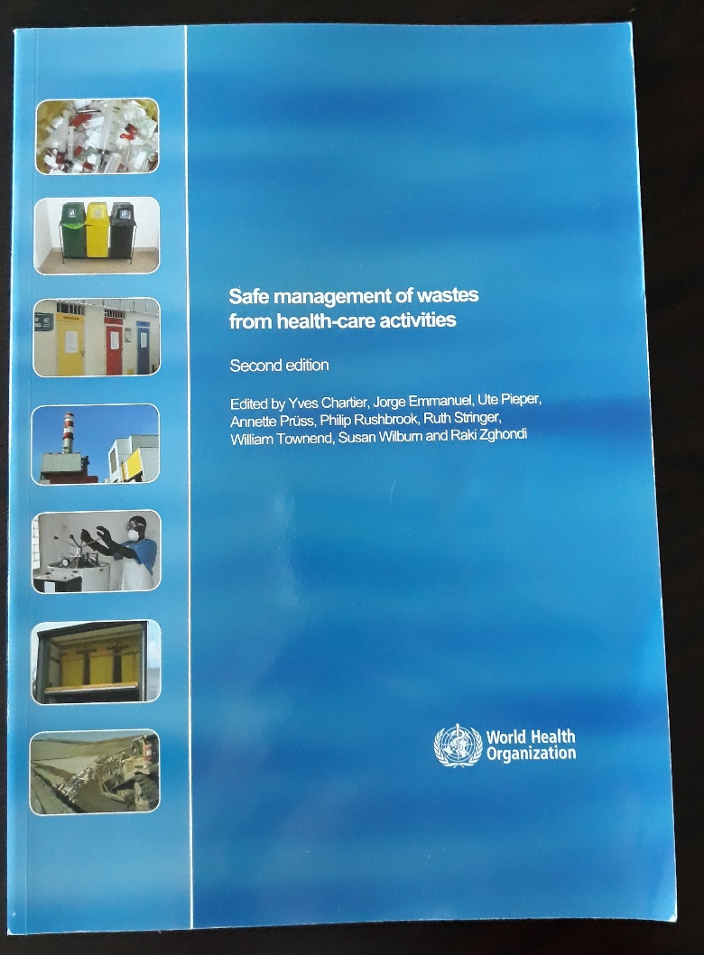
Introduction to the Guidance Document
Designed to help countries prepare and plan healthcare waste management systems
To clarify a country’s HCWM status to help develop proposals for funding and investment from an immunisation perspective
Includes:
  An overview of HCWM policy and practice.
  A HCWM maturity model to assist a country and partners in a strategic assessment to identify and plan activities for improvement.
  Examples of available tools and procedures for best and innovative practices, and promising technologies for improved HCWM.
  Recommendations for countries when preparing for applications for resource investment.
WHO Blue Book is an important reference

Slide 4
Understanding HCWM Policy and Practice
2

Slide 5
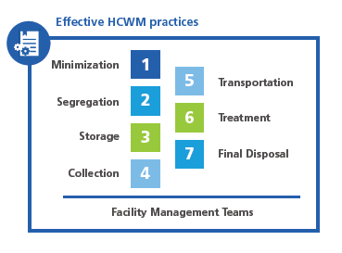
Effective HCWM practices and what needs attention
Segregating waste at the source (i.e., health facilities) can significant reduce costs for waste treatment and disposal; it requires color-coded bags but also knowledge, understanding and adherence to best practices
Outdated equipment and technologies (i.e., pit burning and low-burning incinerators) for treatment and disposal need to be replaced with new treatment technologies

Slide 6
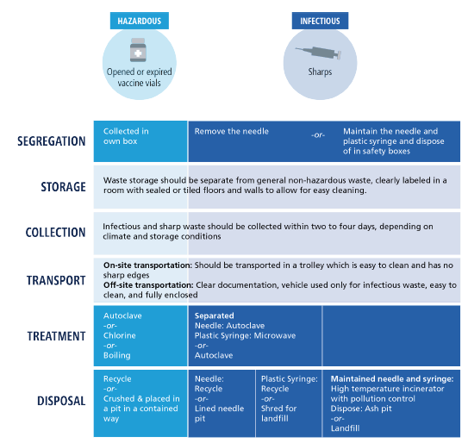
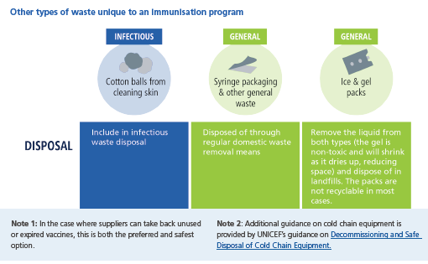
Waste generated by immunization activities

Slide 7

Common barriers and challenges to HCWM
» Constrained financial resources
» Complicated change management with new equipment, practices and technology
» Limited awareness or knowledge on best practices and HCW risk
» Obsolete technologies, equipment or practices
» Supportive supervision lacking HCWM
» Sharps management during campaigns
» Missing links to a systemic approach across all sectors for HCWM

Slide 8
Strategic Assessment of Your HCWM System
3
Using the Maturity Model to Determine First Steps of Investment

Slide 9



Defining your HCWM system: three main areas
Identify your PEOPLE (and expected core competencies of cadre of staff) and human resources needed to train staff and build awareness of the importance of HCWM; increase adherence to and understanding of policies and guidelines; and show commitment to high-quality
HCWM.
Identify what PROCESSES need to revised or updated, such as national policies, budget, guidance; map out the flow of HCW between clusters of facilities and to treatment and disposal sites; assess the effectiveness of supervision.
Identify the TECHNOLOGIES
that are available currently for the steps of HCWM, including segregation, potential links to private-sector resources; and clarify the priorities for the HCWM system overall.
HCWM must be considered from a systems perspective and use a broad approach to leverage resources, technologies, and capacity across ministries and government entities involved in WM.

Slide 10



Six areas to assess the maturity level of the HCWM system
PEOPLE | Awareness, training and supportive supervision Adherence and compliance
PROCESSES | National policy/strategic plans Budget and planning Practical guidance
TECHNOLOGY | 6. Technology and equipment availability and use

Slide 11
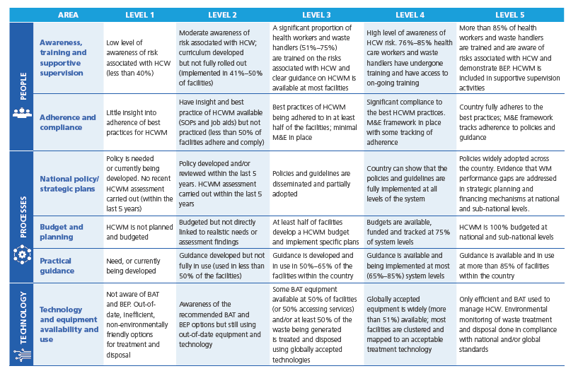
Using the HCWM Maturity Model….
Strongly desired to include as part of Gavi proposals

Slide 12
….and the Assessment Tool to rank your HCWM system
Participatory process with key stakeholders involved in HCWM (broader than immunization)
Guided by assessments, reports and understanding of context

Slide 13
The true outcome of a maturity model assessment is not to identify what level your system resides on, but rather to draft a preliminary list of realistic steps that you can then implement to improve your current HCWM system.

Slide 14
Identify Operational Level Gaps, Opportunities, and Scalable Innovations
4

Slide 15
Use the Assessment Tool to identify high level gaps and potential opportunities
A tool with questions to facilitate stakeholder engagement in planning for HCWM
  Review recent assessments
  Estimating waste quantities across all health areas
  High level update of inventory of treatment and disposal equipment
  Landscape private sector companies involved in WM
  Financial resources and opportunities for investment
  Prioritizes most immediate needs of people, processes and technology and identifies long-term strategic planning needs
Builds on the maturity model and system ranking

Slide 16
Opportunities, tools, and innovations are described to help identify where and how to fill the gaps
PEOPLE
PROCESSES
TECHNOLOGY
Lists more than 20 training modules, planning tools, guidance, technology guides, innovations and best practices identified with links for further information and details
New tool from UNICEF: Appropriate Disposal of Immunisation Waste Platform
https://www.technet-21.org/en/library/main/6388-appropriate-disposal-of-immunization-waste-(adiw)-platform

Slide 17
Designing and Implementing the HCWM System
5
Countries are encouraged to develop HCWM interventions that support or provide a catalyst for a systems approach. This may include implementing measures that address a single component of the system or those that address many components of the system.

Slide 18
Recommended steps for designing and implementing HCWM system
Conduct a high level strategic assessment (maturity model)
In proposals, to Gavi and other investors, plan for immediate actions to address common barriers
  i.e., design and plan system (UNICEF tool), reinforce knowledge and best practices, conduct inventory of existing technologies
  Illustrative indicators are provided
Identify and engage key stakeholders (broader than immunization)
Consider the preferred technology and equipment
Identify opportunities for other forms of investment and collaboration across sectors

Slide 19
Find the Guidance Document here: Health Care Waste Management in Immunisation Programs: Guidance for Proposal Planning

