Slide 1


Credit: PATH
January 14, 2021
Public – Private Partnership in Immunization Data Strengthening
Lessons learned from Vietnam Electronic Immunization Registry deployment
Dang Thi Thanh Huyen, M.D. - Deputy Director, National Expanded Program on Immunization, Vietnam​
Nguyen Tuyet Nga, M.D., PhD – Country Director, PATH, Vietnam
Dao Dinh Sang, MPH – IDEAL Team Lead, PATH, Vietnam
Nguyen Xuan Cam Tu, MsM – Program Officer, PATH, Vietnam

Slide 2
1
Vietnam Immunization System in context
2
MNO partnerships in Action for Health
3
Private Sector Engagement
4
Conclusion

Slide 3
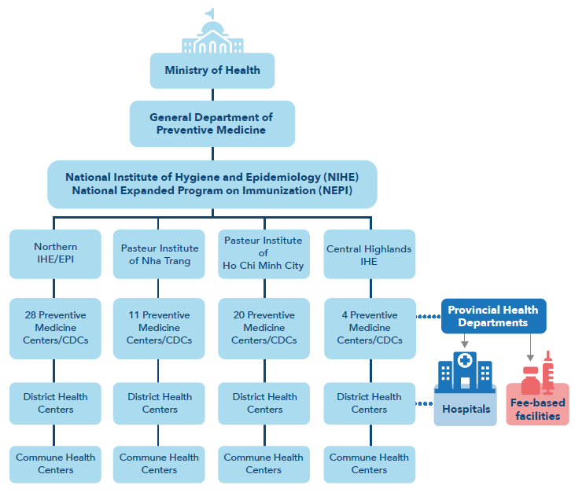
Vietnam Nationwide Immunization System
Since 1985, the Vietnam National Expanded Program on Immunization (NEPI) has successfully implemented a nationwide immunization system, which has achieved quasi-perfect coverage (93% full immunization coverage according to survey results) with a monthly session-based system.
In its earlier phases, NEPI relied entirely on paper-based methods for immunization record keeping and vaccine supply management and tracking.
With the growing of private sector in immunization service, the country currently operates a “dual system” of free-of-charge Expanded Program on Immunization (EPI) services and non-EPI fee-based immunization services, available in health facilities across the country in both the public and private sectors.

Slide 4
From paper-based records to a national digital database:
PPP in design, development, and deployment of NIIS
2010 – 2012:
PATH worked with small-sized IT companies to develop mobile applications: VaxTrack (ANZ Solution) and ImmReg (iBase)
2013 – 2015:
PATH in-house consultants/staff upgraded the application to web-based application and integrate ImmReg and Vaxtrak into one comprehensive system
VaxTrak module was scaled up nationwide, and ImmReg was scaled up to entire Ben Tre province
2016 – 2017:
PATH/NEPI worked with Viettel Business Solution Corps to develop new streamlined version called the National Immunization Information System (NIIS) based on the PATH previous version to scale up the whole nationwide.
2018 – 2020:
PATH supported pilot paperless reporting in 2 provinces under IDEAL Vietnam project, and expanded to 4 other provinces under GAVI funded project

Slide 5












System main functions: Immunization Registry Module
Commune Health Center
Barcode Scan
SMS Reminder
Immunization Tracker & Planning
Dashboard and reports
E-Immunization Card
Fee-based Immunization Facility
Hospital

Slide 6

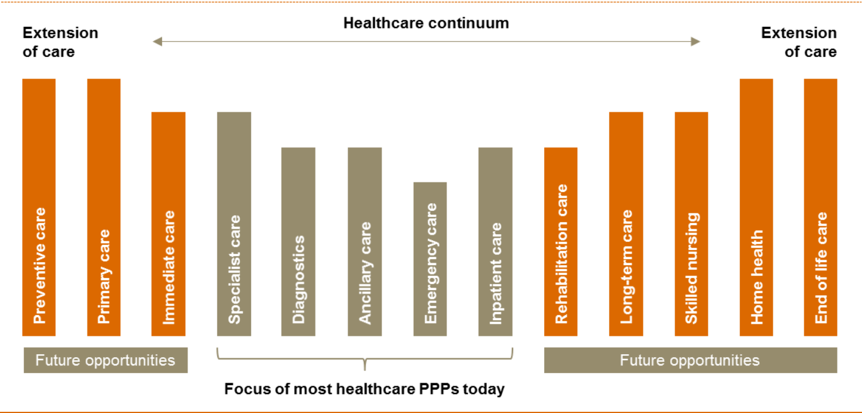
Public – Private Partnerships
Public-private partnership (PPP), that brings the two distinct sectors together to provide services and goods to the population, has been recognized as a multi-stakeholder governance which is a key target of United Nations Sustainable Development Goal 17.
Health care PPPs have been used widely in developed countries, as well as in lower-middle-income countries, and tend to bundles together multiple phases or functions, such as design, build, finance, maintain, operate of health care system infrastructure and service delivery.

Slide 7
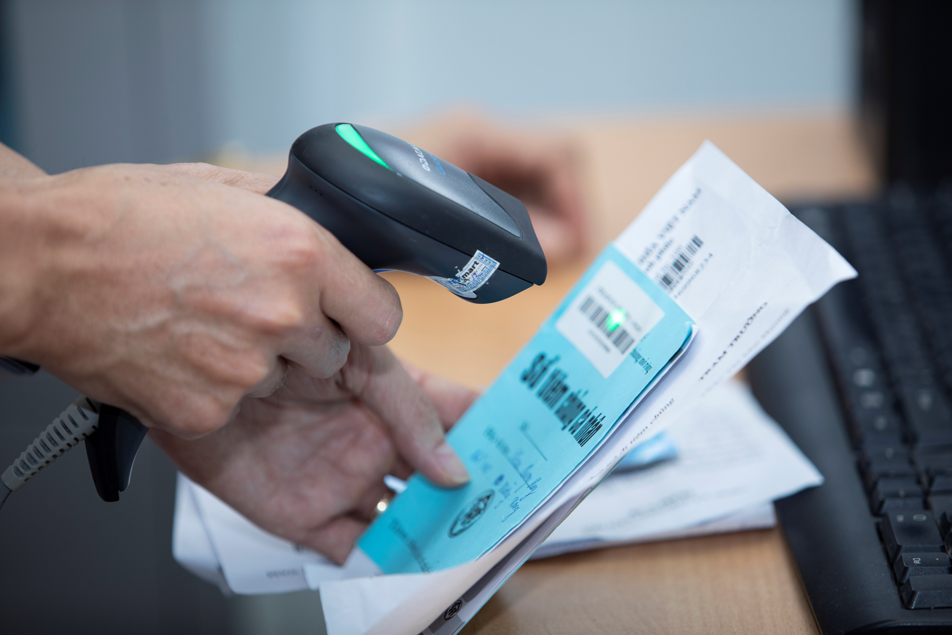
PPP in Immunization data strengthening| Public-Private Partnerships
Vietnam National Immunization Information System
Vietnam's National Immunization Information System (NIIS) is such a quintessential case, telling the ongoing story of a sustainably planned, government-run, nationwide electronic immunization registry (EIR) system that demonstrates the public-private partnership in both building/constructing infrastructure and service delivery. In a snapshot,
NIIS is a product of the partnership between Vietnam Ministry of Health (MOH) and the country largest mobile network operator (MNO) – Viettel Business Solutions Corps; and
NIIS nationwide implementation entails the essential engagement of fee-based immunization facilities that help expanding the reach of the immunization services to the population.

Slide 8
1
Vietnam Immunization System context
2
MNO partnerships in Action for Health
3
Private Sector Engagement
4
Conclusion

Slide 9
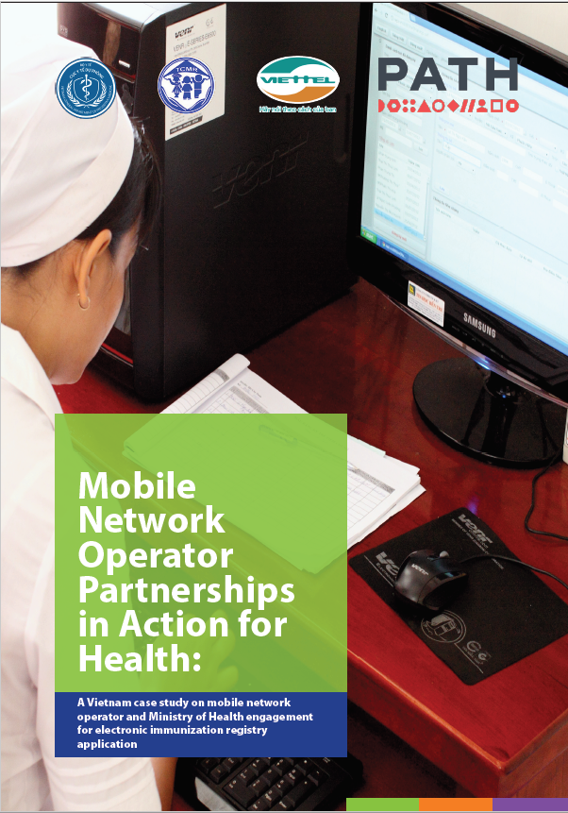

Slide 10
If you want to implement a system at this scale (NIIS), it is imperative to work with a big company like Viettel. The MNO [mobile network operator] of choice must have a large capacity and a large presence in the country, be financially secure, and be able to provide necessary human resources in both quality and quantity.
Choosing an MNO, it would be best to select the largest MNO with the longest history of success in the country of implementation
~ Dr. Dang Thi Thanh Huyen, NEPI ~

Slide 11
Choosing a Mobile Network Operator: Viettel Business Solution Corps.
Core connectivity: Viettel is the largest MNO in Vietnam, with a large network of mobile services and an expansive network range into rural areas and hard-to-reach populations
Core support infrastructure: Viettel also has an extensive support network, as they have large human resources capacity to support end users in every district nationwide. They provides consistent and frequent updates to their systems based on groundbreaking new technology, and their prowess for applying this to systems rapidly. Based on previous system operations, Viettel proved that they were capable of implementing large-scale projects rapidly and had the experience to sufficiently work with and maintain big data.
Business infrastructure: Viettel has a well-established business and name in Vietnam, as it is the largest mobile network provider. It is a popular brand for clients all over the country, and it has the capacity to reach and gain clients in very rural districts. Viettel also has a large capacity and a global presence, with services in ten countries in addition to Vietnam

Slide 12
Partnership benefits for stakeholders
Ministry of Health perspective
The NIIS requires significant capabilities from technology leaders for the technical robustness and maintenance of the system; high-capacity data storage, organization, and analysis. Partnership with MNO can provide the MOH with:
Large data capacities
Upkeep of organization
Financing to maintain capacity
Allocation of resources
Viettel perspective
The advantages of partnering with the health sector are obvious: It synergistically increases the value of the brand name. Specifically with NIIS, Viettel would expand their spectrum services in:
Content
Technology
Implementation experience
Relationship and credibility
Support and funding

Slide 13
Even though Viettel is a for-profit organization/business, we would like to support the Ministry of Health to develop applications for the health sector and contribute to society.
~ Mr. Khong Van Dong, Viettel ~

Slide 14
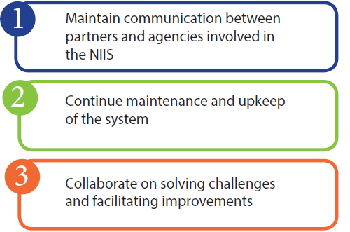
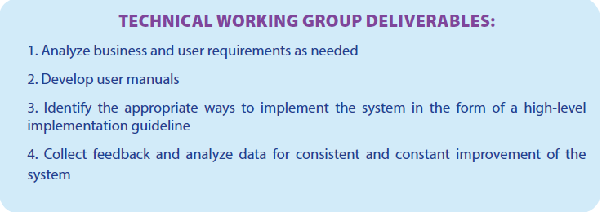
Partnership Development
The NIIS Technical Working Group (TWG) was formed to finalize and maintain the user-friendliness of the NIIS system, to collaborate on meeting end-user needs with regard to client and vaccine-tracking capabilities, and to generate reports for high-level decision-making.
The TWG contributes to the sustainability and technical implementation of the NIIS in Vietnam:
NEPI: (Immunization Expert) technical lead on business analysis and developer of user requirements, reporting systems and reporting mechanism. NEPI asks the question, “what do end users need?”
MOH/GDPM: (Health Expert) coordinator of connecting all stakeholders together, administration support and the push for provincial implementation and policy change
Viettel: (Technology Expert) system developer and maintainer
PATH: (Liasion and Support Expert) technical support and advisor for all stakeholders, serving as the connection between immunizations, general health and technology and the facilitator of communication between TWG members.

Slide 15

Challenges and Lessons Learned
Long-term vs. short term investment strategies
Financial constraints
Different business models
Security
Learning curve and ability to exchange and understand information among partners
Formal arrangement

Slide 16
The NIIS system is still not perfect. Viettel is committed to increasing data input and facilitating the automatic generation of reports for repository. The NIIS system now meets the requirements for tracking patients, but it needs to be improved. NEPI will continue working with Viettel to finalize the system, with PATH continuing as a technical advisor and GDPM facilitating policy change and mobilizing commitment at the provincial level. The system desperately needs to increase its end-user retention and improve data quality while reducing duplications.

Slide 17
1
Vietnam Immunization System Context
2
MNO partnership in Action for Health
3
Private sector engagement
4
Conclusion

Slide 18
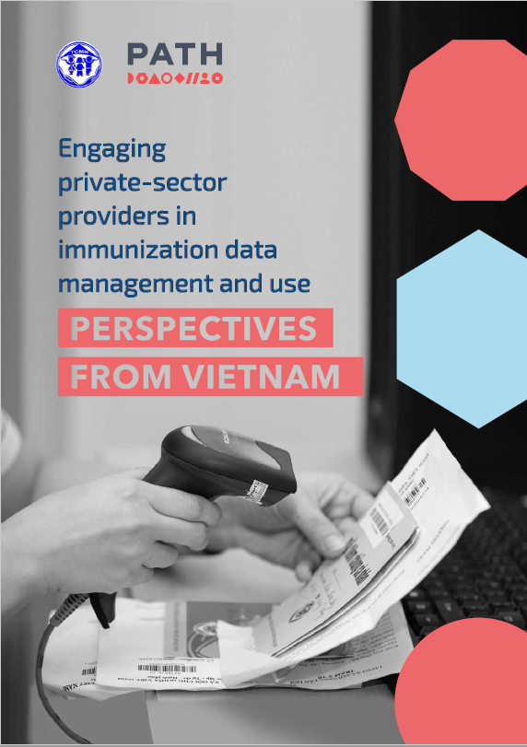

PATH/Gabe Bienczycki
Fee-based Immunization Facilities (FIFs) in Vietnam
Both EPI and fee-based immunization services have followed the same NEPI standards and guidelines on storage, management, and operation of vaccinations to ensure the same high quality, and the dual system offers different alternatives, thus making services more accessible for patients/caregivers:
FIFs are under the umbrella of the Provincial Health Departments (PHDs) and report directly to them. At the same time, for immunization services they also have to report to Provincial Centers for Disease and Control (CDCs), using particular forms created for FIF use only.
FIFs provide people with alternative non-EPI vaccine options that protect them from many vaccine-preventable diseases, including those diseases for which EPI vaccines provide protection.
While EPI public facilities have scheduled immunization days (usually 2 or 3 days in a month), FIFs operate daily, during regular office time. This provides more flexibility and convenience for parents in taking their children without missing workdays if vaccination is only available at fixed, limited times.

Slide 19
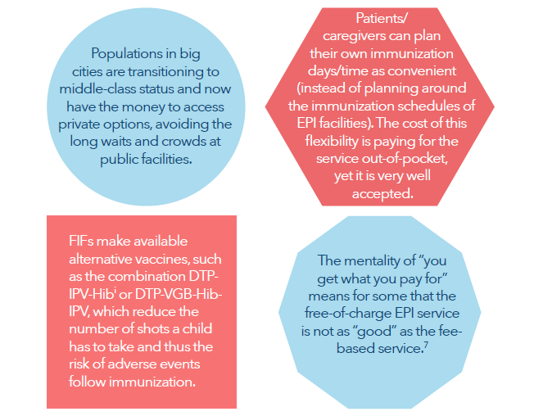
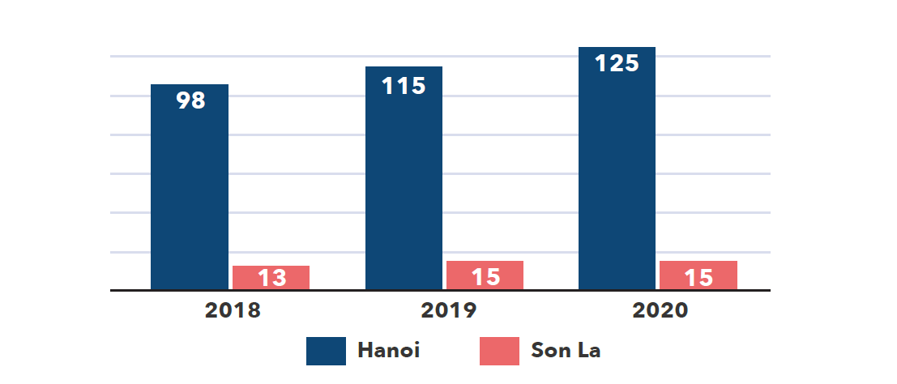
PPP in Immunization Data Strengthening| Engaging Private-Sector
Growing number of FIFs in Vietnam

Slide 20
PPP in Immunization Data Strengthening| Engaging Private-Sector
“The most obvious benefit of the NIIS is the ability to track clients who frequent[ly] move from place to place. They now can get vaccination at any facility. This is almost impossible with paper system. There are also more and more FIFs in our area, especially in the urban [area]. There are also trends to use more FIFs in the community. NIIS helps with following the vaccination history of the child.”
Immunization officer at district/provincial level

Slide 21
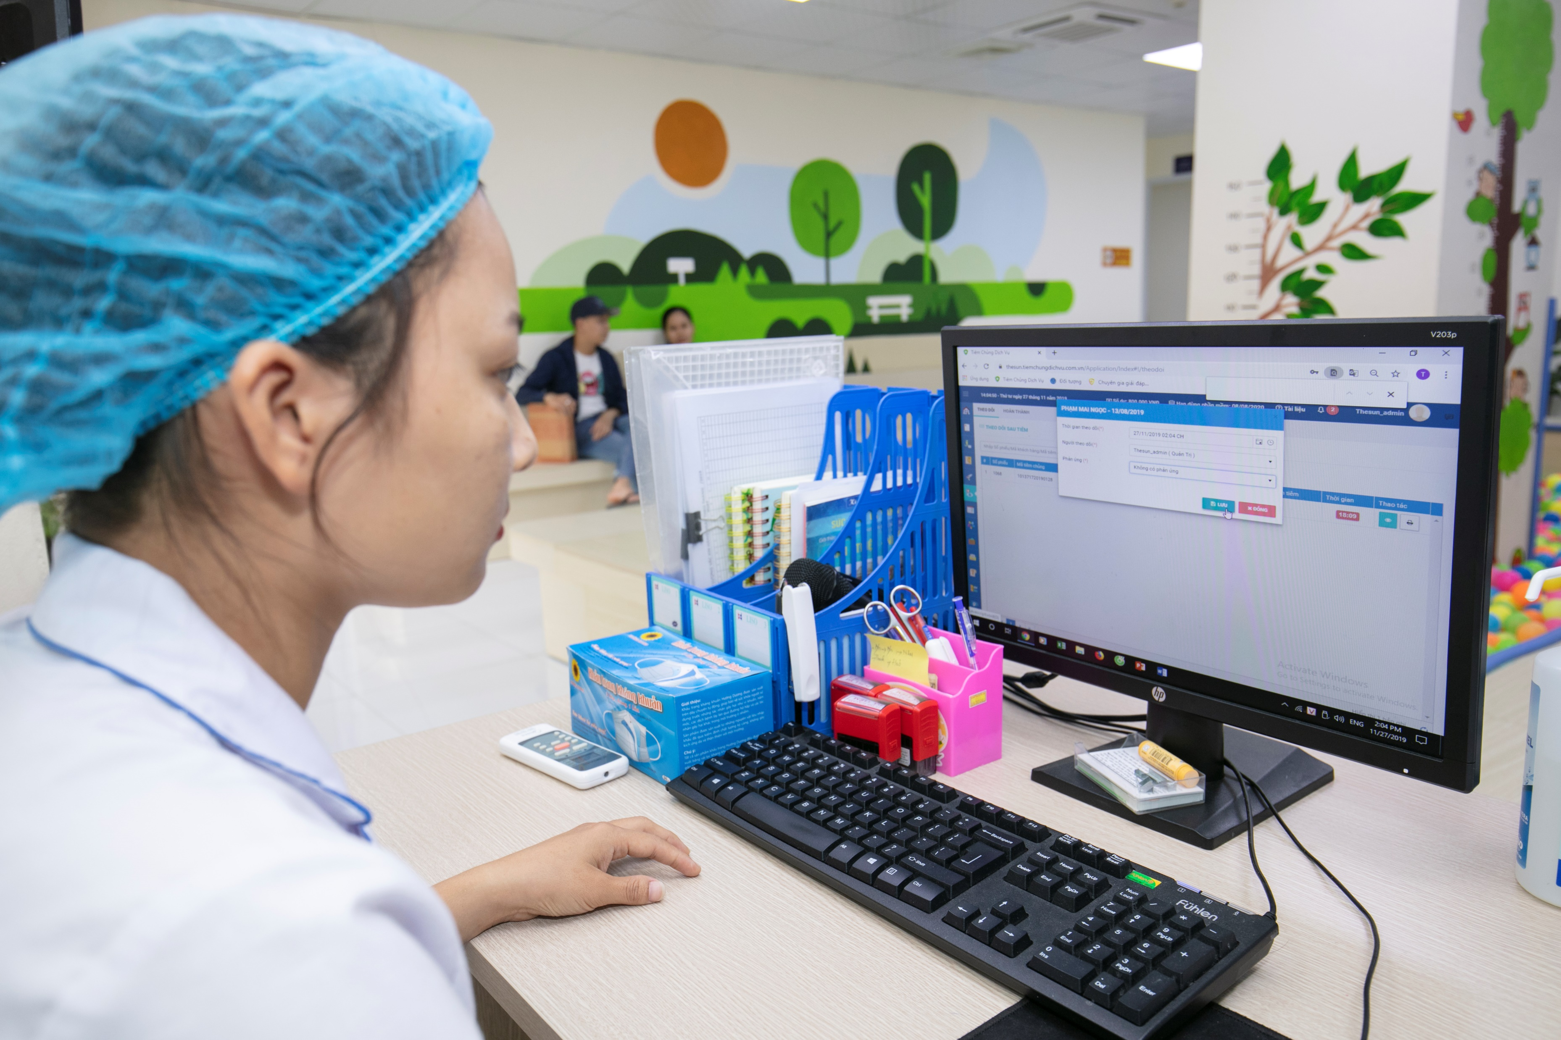
PPP in Immunization Data Strengthening| Engaging Private-Sector
Compliance with NIIS regulations by FIFs
Entering data into their own systems, then using an API to transfer data to the NIIS.
Entering data into both the NIIS and their own software

Slide 22
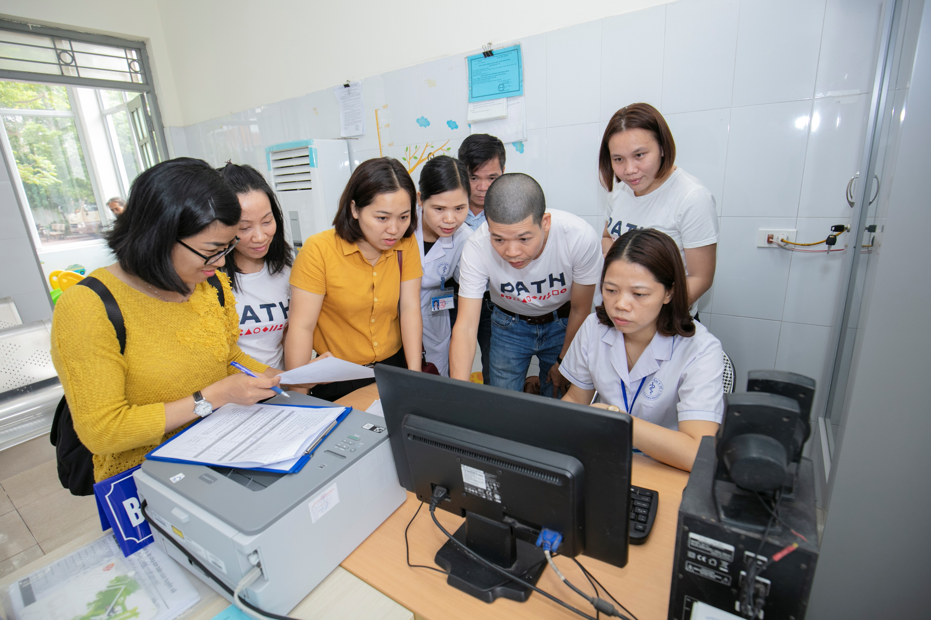
PPP in Immunization Data Strengthening| Engaging Private-Sector
Challenges and barriers
API data transfer
Double data entry
• Lack of guidance. During the establishment of an FIF there is neither official introduction to / instruction on using an API to transfer data nor a standard operating procedure (SOP) for developing an API and exchanging data between different systems.
• Lack of a communication mechanism. The system lacks a standard communication mechanism among the MOH, Viettel, and FIFs for requesting and providing an API and for providing feedback when the data exchange has failed or there is poor quality data synced from the FIFs’ systems.
• Cost burden. The additional cost for API development is not supported by the government, so FIFs need to bear the cost of working with their own software developers to create an API to connect with the NIIS.
• Privacy concerns. FIFs are afraid of private information being disclosed when using the API to exchange data since their internal data will be transferred to the NIIS, after which the use of these data would be beyond their control. End users argue that the fear is due to having not received clear guidance and definition on which part of information will be exchanged with the NIIS.
Workload burden. These facilities need to enter data into two systems, wasting a lot of time, especially in high-traffic facilities. Many of these facilities are understaffed and do not have the capacity to enter these data in a timely and accurate fashion.

Slide 23
PPP in Immunization Data Strengthening| Engaging Private-Sector
Moving forward…
Stronger legal framework for NIIS
E-Card implementation
Regular Supportive supervisions
SOPs and a standardized system for data quality monitoring of FIFs
Increase the cooperation between the EPI facilities and FIFs not only in data collection, but also in data quality assurance, data analysis, and data use.
Refresher training on data collection and data use, improving understanding of the importance of immunization data
Client data management should be tightly controlled at the district level on up in coordination with Viettel

Slide 24
Vietnam will have to develop a more coherent NIIS policy, with a particular focus on FIFs’ role and responsibility and on a mandatory mechanism to ensure compliance. At the same time, it is essential to create interoperability standards so that FIFs with internal software can exchange data with the NIIS. And finally, building the human resource capacity to understand and use the system is vital to supporting the daily work of immunization and to serving Vietnam’s population.

Slide 25
1
Vietnam Immunization System Context
2
MNO partnership in Action for Health
3
Private sector engagement
4
Conclusion

Slide 26
NIIS shows case the multiple public-private partnerships that Vietnam MOH has committed to in effort of:
Developing and Maintaining Information Technology Infrastructure for the Immunization Information System
Enhancing data quality and use with the engagement of the FIFs throughout the implementation process
Experiences from these partnerships with private sectors on NIIS in Vietnam hope to provide lessons learned for other countries with similar context and interest in EIR implementation

Slide 27

Q&A

Slide 28
Dr. Dang Thi Thanh Huyen
epi.huyen1@gmail.com
Mr. Dao Dinh Sang
sdao@path.org

