Slide 1


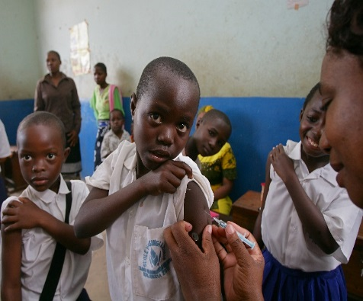
HPV and IPV introduction and Microplanning Workshop
MINISTRY OF HEALTH,COMMUNITY DEVELOPMENT, GENDER, ELDERLY AND CHILDREN
Objectives
January 2018

Slide 2

OBJECTIVES
Orient the regional facilitators (participants) on HPV and IPV introductions
Orient and train participants on the HPV micro planning process and tools to be used
Guide regional team in the development of macro plan
Orient the participants on their roles during and after micro planning and cascaded training in their regions
  Conduct actual training for their Districts and Health facilities
  Guide the Districts and Health facilities during micro planning process
  Monitor implementation of the micro-plans based on the plans developed

Slide 3
Expected outcome
RMOs, RIVOs, RRCHCOs and REOs oriented on HPV and IPV vaccines introduction
Participants oriented on micro plan process and tools
Regional macro plan for HPV introduction developed

Slide 4
Methods
Different approach will be used;
  Presentation
  Region group works
  Discussion

Slide 5
Thank You/
Asante Sana

Slide 7
HPV and IPV introduction and Microplanning Workshop
MINISTRY OF HEALTH,COMMUNITY DEVELOPMENT, GENDER, ELDERLY AND CHILDREN
HPV Infection, Cervical Cancer and HPV Vaccine
January 2018

Slide 8

Burden of Cervical cancer
Cervical cancer is the fourth most common cancer among women worldwide.
  It is estimated that each year there are approximately 528,000 new cases and more than 266,000 deaths from cervical cancer.
  More than 85% of all new cases and deaths occur in less developed countries, partly because routine cervical cancer screening and treatment are not widely available.
  Unless cervical cancer prevention and control measures are successfully implemented, it is estimated that by 2030, approximately 800,000 new cases of cervical cancer will be annually diagnosed.
  The vast majority of these cases will be in developing countries including Tanzania

Slide 9
Burden of Cervical cancer Cont
Tanzania has a population of 14.88 million women ages 15 years and older who are at risk of developing cervical cancer.
Current estimates indicate that every year 7304 women are diagnosed with cervical cancer and 4216 (58%) die from the disease.
Cervical cancer ranks as the 1st most frequent cancer among women in Tanzania and the 1st most frequent cancer among women between 15 and 44 years of age.
About 3.3% of women in the general population are estimated to harbor cervical HPV-16/18 infection at a given time, and 68% of invasive cervical cancers are attributed to HPVs 16 or 18¹

Slide 10
HPV Infection and Cervical cancer
Cervical cancer is caused by the human papillomavirus (HPV).
More than 100 HPV serotypes have been identified to date
Two high-risk types of HPV, serotypes 16 and 18, account for about 70% of all cervical cancer cases.
HPV can also cause other types of anogenital cancer (vagina, vulva, anus, and penis), head and neck cancers, and genital warts in both men and women.
Immunodeficiency is the strongest known cofactor for HPV in cervical.
  In people living with HIV compared to people who are not, HPV infections are more likely to occur, persist, and progress to cancer.
HPV is sexually transmitted and most people become infected sometime during their lifetime, usually soon after becoming sexually active.
Notes:
Types = serotypes

Slide 11
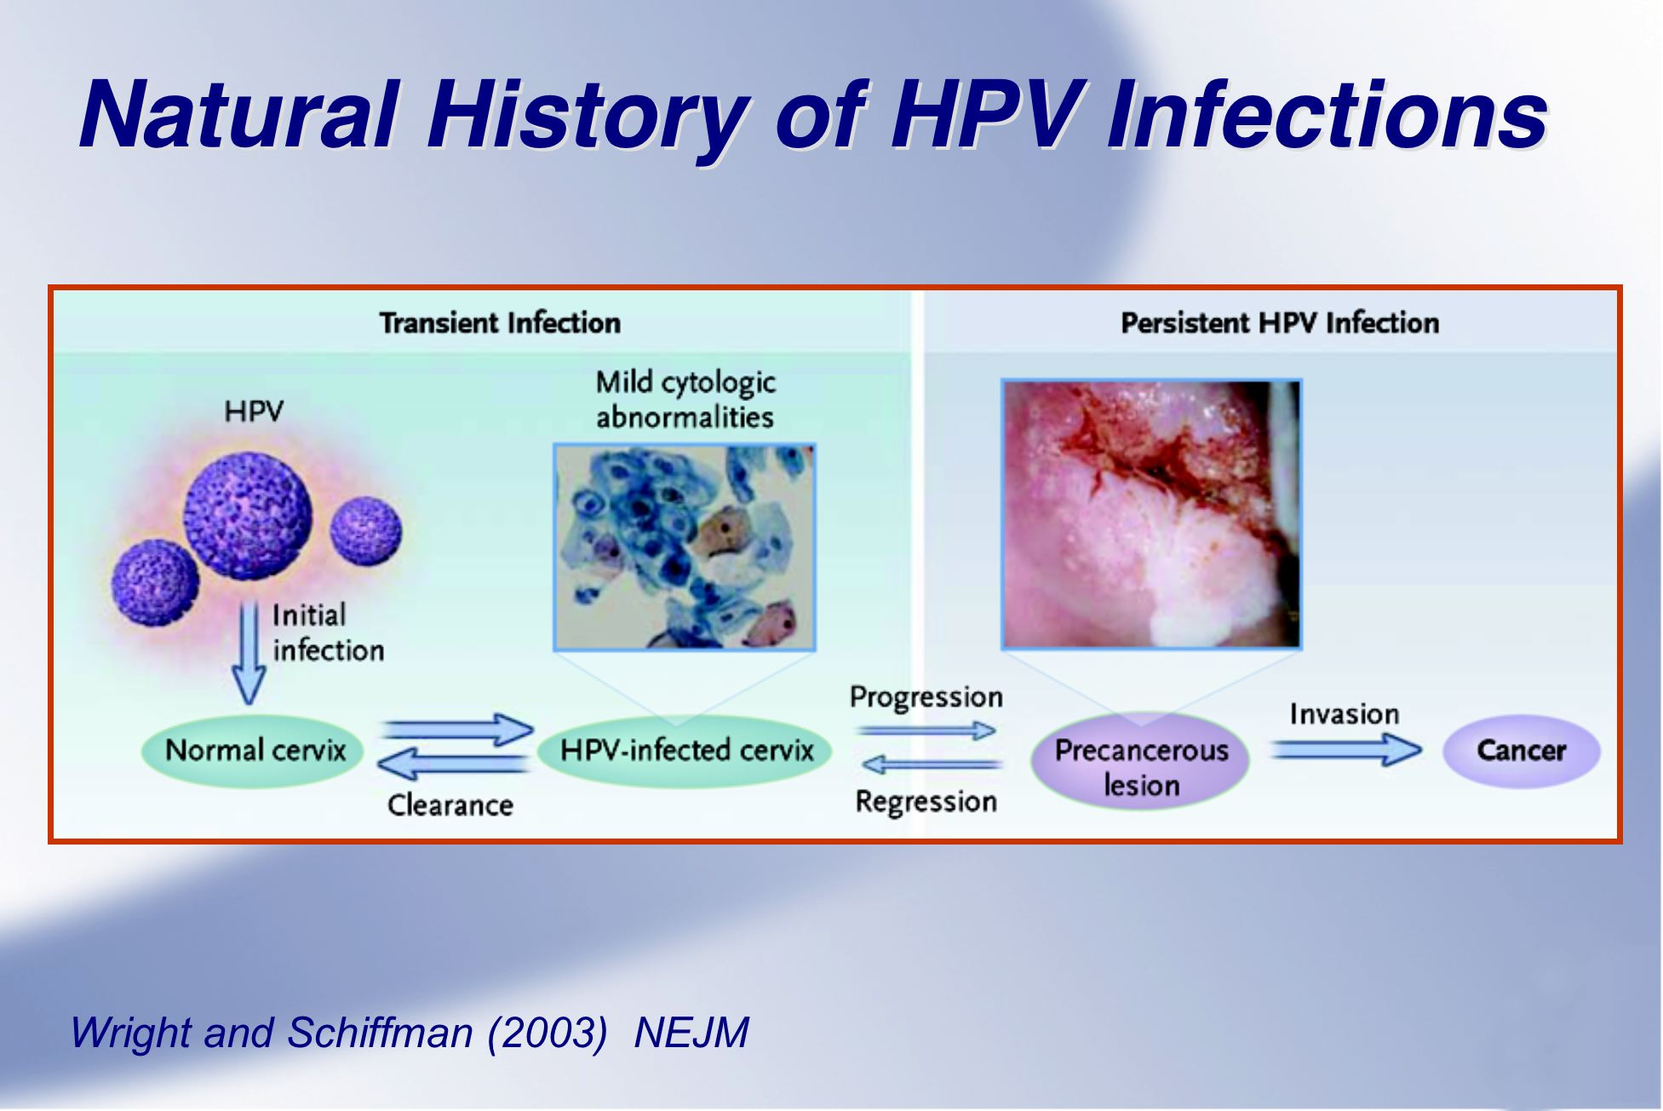

Timeframe following acute infection:
2 years
5-15 years
Notes:
The development of cervical cancer is very slow. It can take up to 20 years from infection with HPV to become cervical cancer. The initial infection of the cervix by HPV leads to a transient infection which can regress and be cleared or progress to a precancerous condition called dysplasia or Cervical Intraepthelial Neoplasia (CIN). While dysplasia itself does not cause health problems, left untreated, dysplasia sometimes progresses to an early form of cancer, and eventually There are many different types of HPV, and many do not cause problems. However, HPV types 16 and 18 cause over 70% of cervical cancer cases and other strains may cause genital warts. to invasive cervical cancer.

Slide 12
Signs and Symptoms, Diagnosis and Treatment
Symptoms of cervical cancer tend to appear only after the cancer has reached an advanced stage, and may include:
  Irregular, inter menstrual or abnormal vaginal bleeding, usually after sexual intercourse.
  Back, leg, and/or pelvic pain
  Fatigue, weight loss, loss of appetite
  Vaginal discomfort or odorous discharge which may be pale, watery, pink, brown, or bloody
  Single swollen leg
More severe symptoms may arise in the very advanced stages, including severe anaemia, renal failure, fistulae (rectal/vesico-vaginal), and lymphoedema.
Diagnosis of cervical cancer is not easy and must be done by a specially trained health worker.

Slide 13
Comprehensive approach to prevention of cervical cancer
WHO recommends inclusion of HPV vaccination into national immunization programmes
HPV vaccines do not protect against all HPV types that cause cervical cancer, so vaccine introduction should be part of a coordinated and comprehensive approach to cervical cancer control which includes:
  Prevention primarily through vaccination of 9-14-year-old girls prior to exposure and acquisition of HPV infection
    For men and women:
      Health information and warnings about tobacco use
      Condom promotion/provision for those engaged in sexual activity
      Male circumcision
  Secondary prevention through screening and treatment of adult women for pre-cancerous lesions
    For women >30 years of age screening and treatment as needed (with low cost technology VIA followed by cryotherapy) and HPV testing for high risk HPV types (e.g. serotypes 16, 18 and others)
  Tertiary and palliative care for women affected by cervical cancer.

Slide 14
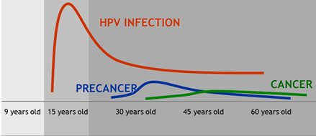

Natural history of cervical cancer
PRIMARY PREVENTION
SECONDARY PREVENTION
TERTIARY PREVENTION
Exposure to HPV infection early in adolescent life
Progression to cervical pre-cancer stage
Development of invasive cancer cells
Notes:
Luckily between HPV infection and the development of invasive cervical cancer, there is a critical stage known as pre-cancer stage. This stage is extremely important for prevention and control of cervical cancer. Intervention at this stage is a life saver. For comprehensive cervical cancer prevention and control, WHO recommends a three pronged approach: 1) Primary prevention through HPV vaccination and health information and education to reduce high-risk sexual behaviour to limit HPV transmission/acquisition; 2) Secondary prevention consisting of screening and treating for the presence of precancerous lesions and early diagnosis and treatment of early cancer while the chance of cure is still good; 3) Tertiary prevention when the cancer is at an invasive stage, dealing with Treatment and Palliative care. The 3 components need to be implemented within the context of countries’ health systems, benefitting from and contributing to the different health systems components such as human resources, information systems, etc.

Slide 15
HPV infection and interventions
2° and 3° Intervention: Screening/ Treatment
1°Intervention:
HPV Vaccination
2°Intervention:
Screening/Treatment
Immune
Acute
infection
Chronic
infection
Precancerous lesion
Susceptible
Cervical
cancer
Timeframe following acute infection:
2 years
5-15 years
20+ years
Notes:
World Health Organization
2 April, 2021
16
To consider comprehensive cervical cancer prevention and control, we need to briefly review the natural history of HPV infection.
Unlike most of the diseases that infant vaccines prevent (for example measles or rotavirus diarrhea), cervical cancer is not an acute or quick disease – it is a chronic disease that takes years to develop. Let us take a look at the diagram on this slide, going from left to right. A person who is susceptible gets exposed to human papillomavirus and first develops an acute infection. Most people are exposed and get infected by HPV soon after becoming sexually active. There are some 90 or so different HPV types. A handful of HPV types cause cervical cancer. HPV types 16 and 18 cause around 70% of cervical cancers throughout the world. HPV infection with the cervical cancer causing HPV types is asymptomatic. Most women who get infected are able to resolve the infection and are then immune to the HPV type with which they were infected. But some women have HPV infections that persist; they are chronically infected. Chronic infection with HPV 16, 18 or one of the other cancerous types will lead to precancerous lesions in around 5-15 years. At this point, cervical cancer screening offers the ability to detect the lesion. If a precancerous lesion is identified during screening, it can be removed as an outpatient and no cancer will develop. However, if there is no intervention, the precancerous lesion will progress over the coming years to cervical cancer. In these later years, if screening takes place and cervical cancer is detected, early cervical cancer lesions can also be readily treated, while later and larger cervical cancer lesions are more difficult to treat. Women who are immunocompromised, such as those living with HIV infection, have faster progression from chronic infection to precancerous and cancerous lesions. The shorter time intervals are typical timeframes for women who have impaired immune systems, while the longer time intervals you see on this timeline are for women with normal immune systems.
The 3 dotted lines on this figure depict the opportunities for prevention and control. HPV vaccination offers the earliest opportunity to prevent cervical cancer before a girl is even infected. The important message of this slide, however, is that cervical cancer is a slow disease over decades that is readily preventable – if options for prevention were in place, no woman should have to die of cervical cancer.

Slide 16
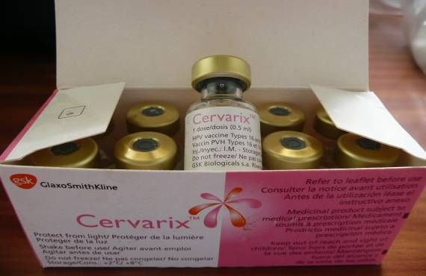
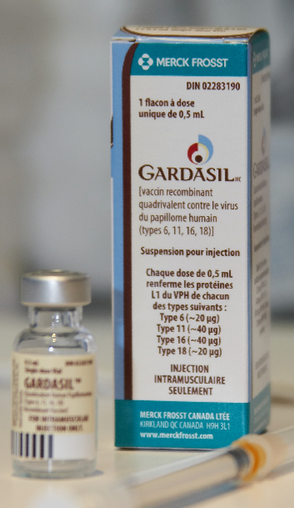
HPV Vaccine
Two vaccines currently available, widely licensed, and WHO prequalified:
  Gardasil®/Silgard® (quadrivalent): Prevents pre cancerous lesions from HPV serotypes 16 and 18 and ano genital warts from HPV serotypes 6 and 11
  Cervarix® (bivalent): Prevents precancerous lesions from HPV types 16 and 18
Both vaccines are most effective when administered to a person prior to exposure to HPV.
HPV vaccines used in Tanzania is Gardasil
The new HPV vaccine is 9-valent HPV vaccine which includes the additional five HPV types 31, 33, 45, 52 and 58 compared to the quadrivalent vaccine. This vaccine is currently undergoing WHO review for prequalification and might be available in the future.

Slide 17
HPV Vaccine
Both vaccines demonstrate best efficacy in individuals HPV-naïve to the vaccine types so best to vaccinate girls prior to initiation of sexual activity (target is 9-14 years old girls)
For both vaccines, younger girls have higher immune responses compare to those older than 15 years old females
There is no evidence of waning protection over time for either vaccine (post-vaccination follow-up period exists up to 9 years)

Slide 18
Recommended target age and vaccination schedule
Girls aged 9-14 years prior to becoming sexually active.
Two (2) doses with a 6-month interval.
  There is no maximum interval between the two (2) doses, however, an interval of not greater than 12-15 months is suggested to enable girls to complete the schedule promptly before becoming sexually active.
  A 3-dose schedule (i.e. at 0, 2, and 6 months) is recommended for those known to be immunocompromised and/or HIV-infected (regardless of whether they are receiving antiretroviral therapy or not).
It is not necessary to screen for HPV infection or HIV infection prior to HPV vaccination

Slide 19
Challenges
The introduction of HPV vaccine into the national immunization program has a number of special considerations that offer both challenges for immunization program as follow;
  No existing immunization contacts to access a target population of 9-14 year-old girls for the 2-dose schedule.
  Sensitivities around HPV vaccination, providing protection against a sexually transmitted infection (STI) and/or Pregnancies, offered for girls-only
  Requires robust ACSM to assist with acceptance, ensure completion of schedule, and to decrease costs related to tracking drop-outs. Additionally, preparedness for crisis communication is essential.
  Cost for both procurement and operational
  New technical or programmatic issues such as learning how to properly locate the target population and calculate its accurate size and denominator

Slide 20
Opportunity
HPV vaccination does not protect against all serotypes of HPV and cervical screening program has been there to use the platform for promotion of the vaccination
Integration of HPV vaccination with the delivery of other health services for 9-14-years old children, provides opportunities to establish primary care for new age group of children and health system strengthening.
Broadening of stakeholders and partners for immunization, including those from reproductive health, adolescent health, school health, cancer control, HIV prevention, and women’s health.

Slide 21
Thank you for Listening

Slide 23
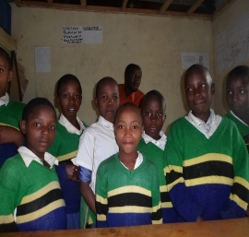
HPV and IPV introduction and Microplanning Workshop
MINISTRY OF HEALTH,COMMUNITY DEVELOPMENT, GENDER, ELDERLY AND CHILDREN
Experience of HPV Vaccination Demo project in Kilimanjaro
P

Slide 24
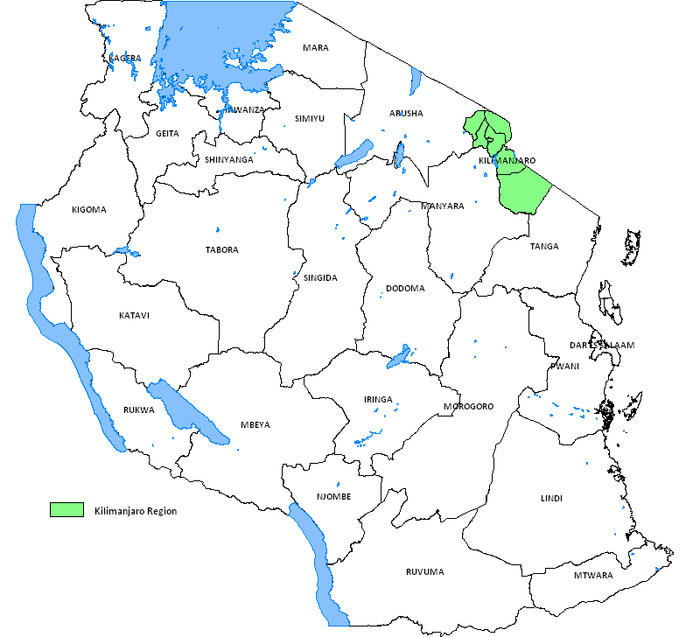
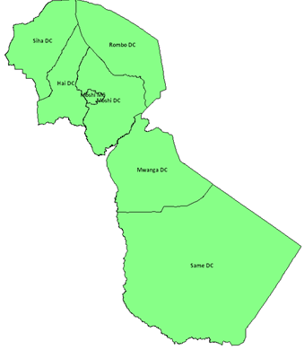
Basic Demographic data
Area: 945,050 Km²
Population: 48 m
Total Regions: 26
Total Districts: 185
Demo Region : 1 (Kilimanjaro)
Demo districts : 7

Slide 25
Delivery Strategy and Target
YEAR 1: CAMPAIGN MODE
School based strategy targeting class 4;
  who were above 9 years and above
Girls out of school who were 9 years
Annual target was 18,913
YEAR 2 : ROUTINE MODE
Routine vaccination at HF, 9 years old
Outreach session in School and community
Annual target was 20,535

Slide 26
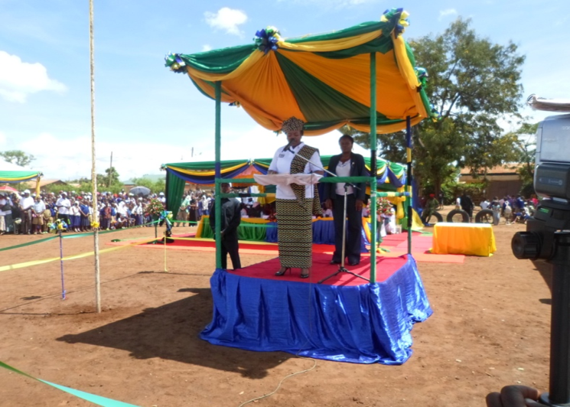
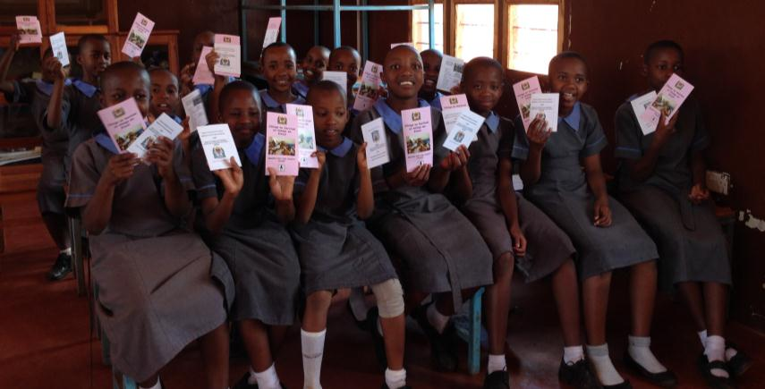
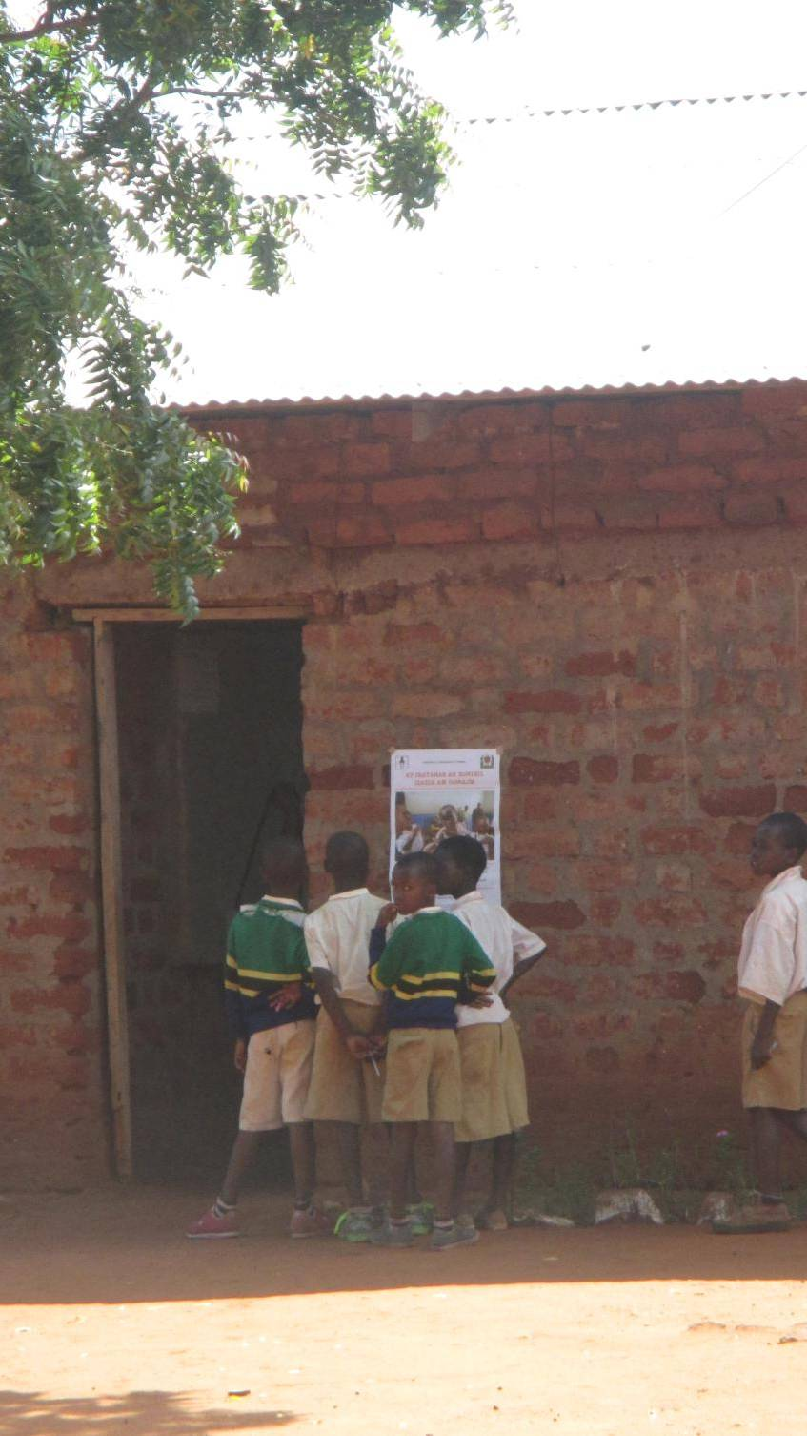
Pre Implementation Activities
Macro and micro plan development
Social mobilization at all level up to the community , girls and parent
Development of HPV guideline
Development of IEC materials
Training was conducted in cascade manner teachers, HW and CHW were also trained
Distribution of vaccines at all level before introduction

Slide 27
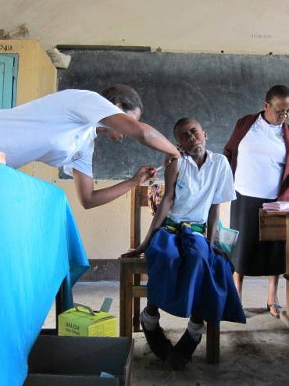
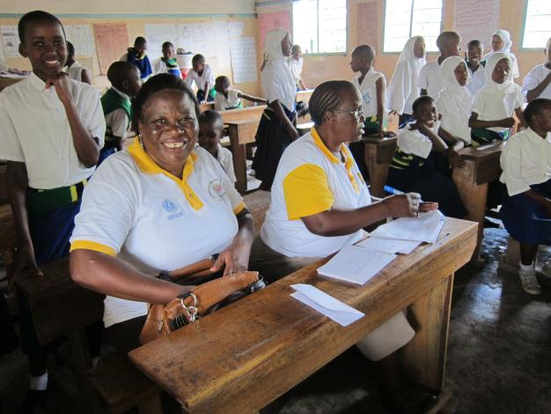
Delivery of HPV vaccine
Health workers (vaccinators) vaccinated the girls and made sure they have enough vaccine and supply based on their targets.
Teachers screened eligible girls, recorded on the tally sheet and provided vaccination cards after vaccination in the schools
CHW identify screened eligible girls, recorded in the tally sheet and provided vaccination cards out of schools

Slide 28
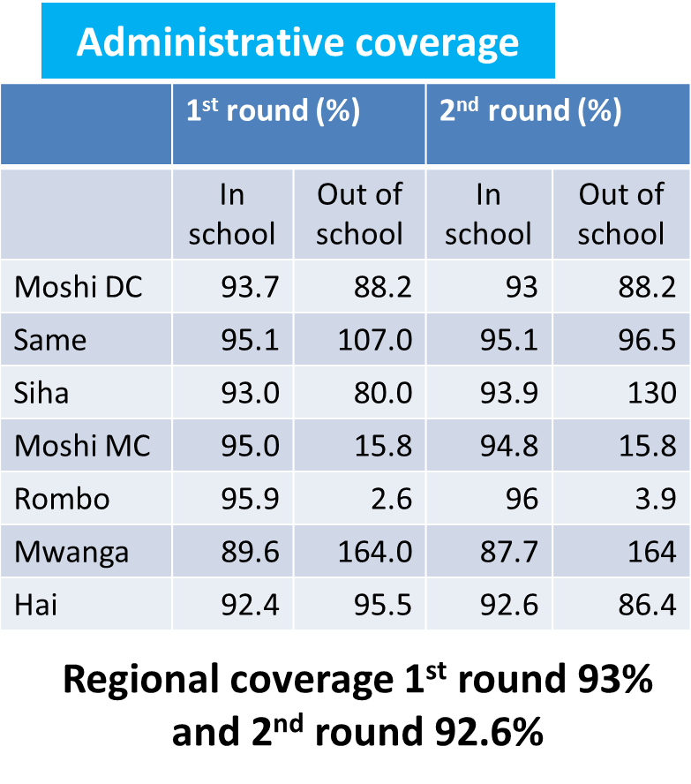
2014 Admintrative coverage

Slide 29
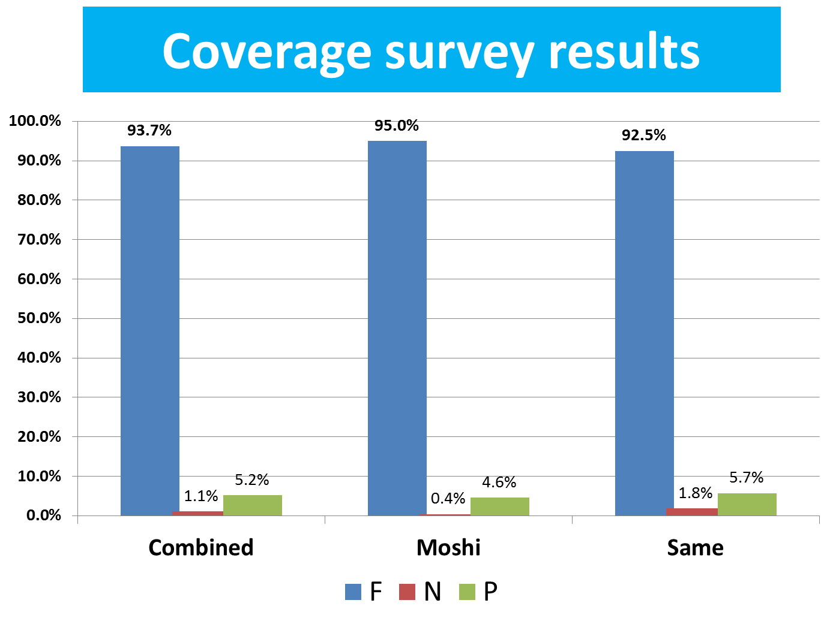
2014 Coverage Survey

Slide 30
2014 PIE
Key recommendations of post introduction evaluation
HPV vaccine data should be included in the monthly vaccine coverage reporting form for EPI vaccines
Ensure delivery strategy mix include vaccination in health facilities, outreach or community sites as well as schools
Seek synergies of HPV vaccine delivery with existing adolescent, school health interventions for the target age group (eg. TT, deworming, vision screening, dental health screening)

Slide 31
Administrative Coverage 2nd Year

Slide 32
Coverage Comparison 1st and 2nd year

Slide 33
2015 Coverage Survey

Slide 34
Challenges
Misconception of some parents/guardian
Eligible girls not in class 4 were not vaccinated ( 1st year)
During delivery some girls were absent in schools (Yr1)therefore plan was to revisit the school
Increase budget for outreach allowances
Stock out of vaccine due to delay receiving vaccine
Refusal because of religious belief in three religious schools

Slide 35
HPV Costing
 | Costs Per Full Immunized Girls (FIG) | Financial Costs ($) | Economic costs ($)
YEAR 1 | Include Vaccine Costs | 18 | 29
 | Without Vaccine Costs | 15 | 17
YEAR 2 | Include Vaccine Costs | 8 | 20
 | Without Vaccine Costs | 5 | 4
NATIONAL SCALE UP-CAMPAIGN 9 YEARS | Include Vaccine Costs | 13 | 18
 | Without Vaccine Costs | 11 | 6
NATIONAL SCALE UP- ROUTINE 9 YEARS | Include Vaccine Costs | 4 | 16
 | Without Vaccine Costs | 2 | 4

Slide 36
Lesson learnt ( Demo- project)
Delivery of HPV vaccine into routine immunization is possible
Continuous social mobilization and sensitization of community to create demand of HPV vaccine is mandatory for the success.
Community Health workers can be used as platform for reaching out of school girls and hard to reach girls.
Registration of girls before introduction of HPV vaccine made the delivery of vaccine easy and able to trace those who missed and also for second dose
High level political commitment is very crucial for the success of HPV vaccination.

Slide 37
Lesson learnt ( Demo- project)
Addition allowance is needed to conduct outreach in school and should be included in Council Comprehensive Health Plan.
HPV vaccine should be in cooperated in Routine Immunization reporting tools and be available at all level before introduction of HPV vaccine to avoid missing data
Girls were not coming to Health Facilities for HPV vaccination
HPV vaccination Cards must be distributed to health facilities before introduction of HPV vaccine
HPV vaccination increase task to H/F service provider to visit school

Slide 38
Lesson learnt ( Demo- project)
Distribution of HPV vaccines can be done with other antigens to the districts and health facilities using
  Normal distribution matrix and
  Vaccine should available in the country to avoid stock out of vaccine which lead to lower coverage.

Slide 39
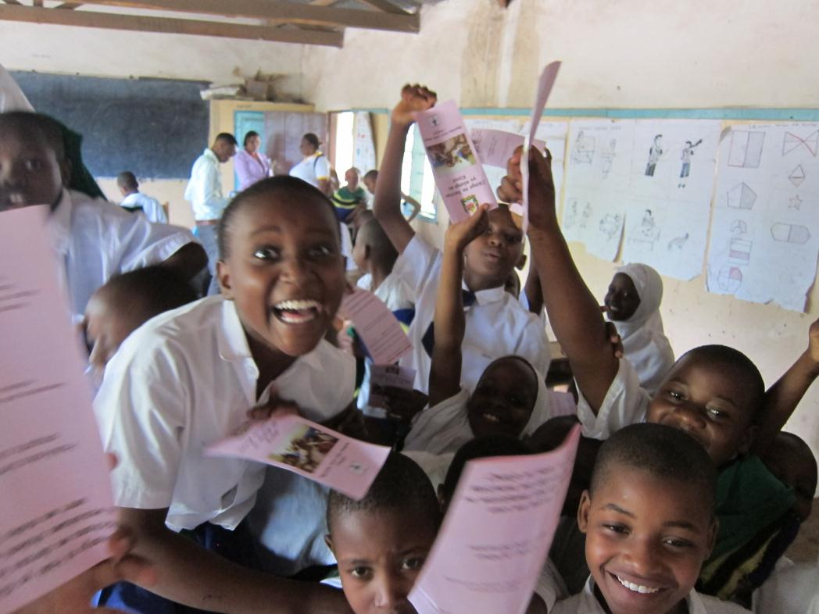
Thank you

Slide 41
HPV and IPV introduction and Microplanning Workshop
MINISTRY OF HEALTH,COMMUNITY DEVELOPMENT, GENDER, ELDERLY AND CHILDREN
HPV NATIONAL INTRODUCTION
22nd January 2018

Slide 42
HPV Introduction in Tanzania
Goal is to achieve coverage of 80% with 2 doses in 2018
Introduction will be done 2nd April 2018
First dose will be given April 2018
Second dose will be given after six months
Enrollment will start immediately to get a clear target

Slide 43
  HPV Delivery Strategy
Delivery will be THE ROUTINE IMMUNIZATION STRATEGY
Health Facilities will be the main point of provision of the vaccine
→ As other antigens in the routine immunization services
Vaccine will be available on a continuous basis every day of the year.
Eligible girls may be vaccinated either at health facility, outreach posts, mobile clinics or schools

Slide 44
  HPV Delivery Strategy
JOINT PLANNING between Health facilities, Schools and Communities within the catchment area is IMPORTANT.
Outreach services will be implemented as part of routine immunization services
Schools will be used as outreach posts to reach girls who are going to school.
Girls out of school will be reached by fixed session or community outreach

Slide 45
  Eligibility
In the first year and second year (2018 & 2019) of introduction upper age cohort – 14 years
Subsequent year eligible girls will be 9 to 14 years of age.
→ Pending Global Availability of vaccine
In subsequent years single age cohort of 9 years old girls will be vaccinated.
Girls will be vaccinated based on the age at the time of the first dose, using the DATE OF BIRTH OF THE GIRL – AT LEAST THE MONTH AND THE YEAR.

Slide 46
  Intensified routine immunization
Two months in the years will be specified as Intensified HPV routine Immunization.
The first month will be in the first half of the year and the second month will be second half of the year
Minimum interval is six months.
DECISION WILL BE DECIDED BY THE DISTRICT IN CONSULTATION WITH REGION DEPENDING ON THE SOCIAL ENVIRONMENT IN THE REGION.

Slide 47
  Pre implementation activities
Development of Introduction Guideline
Advocacy and sensitization (Important to start now)
Cascaded trainings
Health facilities micro plans
Registration of eligible girls
Parents/community meetings
Distribution of bundled vaccines

Slide 48
ISSUES TO CONSIDER DURING HPV INTRODUCTION

Slide 49
Responsibility
HPV vaccine introduction is responsibility of ALL;
Ministry of Health Community Development, Gender, Elderly and Children
President Office Regional Administration and Local Government Authority (PORALG)
    Health
    Education
    Immunization Partners in the country
    Private sectors
    Community

Slide 50
Advocacy and Social Mobilization
How do we reach the community??
  Possible champions to be reached
  Existing channels to deliver the message
  What message??
    Fact sheet – value expectation approach
    Questions and answers
  IP Skills of HCWs is Important
  C4D also need to be considered

Slide 51
Advocacy and Social Mobilization
Development of communication plan
Provide guidance on PHC meeting
Development mobile messages
Development of IEC material poster, leaflet, fact sheet
Radio and TV discussion, jingles, advertisement
Prepare national launching
Media seminar and media sessions
Crisis communication plan to deal with rumors, AEFI

Slide 52
Training
Training package will be available
Further training will be done to district level
→Health and Teachers workers training
What are the existing opportunities to be used to reach health workers soon as possible.

Slide 53
Service delivery
Micro plan will be developed
Integrated into existing Council (CCHP)
Registration of girls
Delivering of vaccine
  Health facilities
  Outreach school and community
  PIRI

Slide 54
Micro plans
Health facility level
Name of health facility
Villages
Name of village
Settlements
Name of settlement
Where are the girls born 2004??
Secondary school
Primary school
Community
Names and number of girls
List all schools and settlements: Each indicate number of girls

Slide 55
Registration- Rural
Rural - Have a session with School Health Teachers and VEO/CHW
Urban - Have a session with School Health Teachers and Mtendaji wa Mtaa (Complicated)
Register all girls born 2004
You may have several columns
Ensure the two columns are there
  Date 1st dose given
  Date 2nd dose given

Slide 56
Sessions plan
Review the health facility session micro plans
  Fixed sessions
  Outreaches
Identify of link the sessions with schools or settlements
  Some may be integrated in the existing outreaches
  Some may be brought to the health facility
  Few may need additional outreach

Slide 57
Micro plans summarizes
Number of girls in schools and community.
Sessions plan in the intensified month
Health facility micro plan summary
Council micro plan summary
Number of girls
Regional micro plan summary

Slide 58
Cold chain and Logistics
Review cold chain readiness/ cold chain capacity at all level
Ordering of vaccine
Clearing of vaccine
Forecast vaccine need by subnational level and bundle the supply
Distribution of vaccine

Slide 59
Data management
Ensure the availability of the vaccination card
Girl`s register
Other Vaccine monitoring tools

Slide 60
THANK YOU

Slide 62
IPV and HPV Safety Administration & Schedule.
Notes:
63
© 2012 IMG

Slide 63
Inactivated Polio Vaccine
Inactivated Polio Vaccine (IPV) was licensed in 1955 and underwent early reformulations to enhance potency and ensure safety in standalone and combination vaccines
IPV is one of the safest vaccines in humans, whether used alone or in combination vaccines
IPV is a very safe vaccine
Not associated with serious systemic AEFIs
Inactivated vaccine – therefore, no risk of vaccine-associate polio
The Polio Eradication and Endgame Plan calls for IPV introduction and OPV type 2 withdrawal.

Slide 64
Cont..
Can safely be administered with other recommended childhood vaccines, including OPV and other injectable vaccines like PCV 13.
Very few side effects have been reported and are mainly due to route of administration
swelling,
redness and pain at injection site,
fever and
discomfort

Slide 65
AT WHAT AGE SHOULD IPV BE ADMINISTERED?
IPV is given at or after age of 14 weeks, with OPV3 and DTP3/Penta3
IPV should be given in addition to OPV
OPV is still the primary vaccine to achieve eradication of polio in the World
Give one dose of IPV, together with other vaccines given at 14 weeks
Both IPV and bOPV vaccines provide the strongest polio immunity

Slide 66
How to prepare for vaccination
Prepare IPV at the same time you prepare other vaccines
IPV can be administered with any of the following routine childhood vaccines without interfering with their effectiveness:
    Pentavalent vaccine
    Pneumococcal vaccine
    Oral polio vaccine (OPV)
    Rotavirus vaccine
Never mix IPV with other vaccines in the same vial or syringe

Slide 67
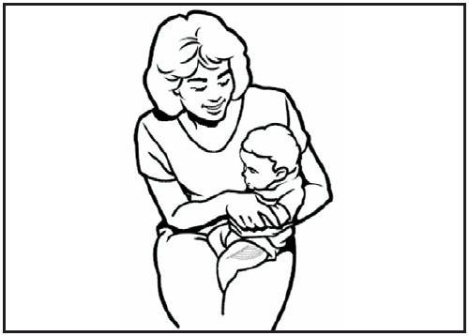
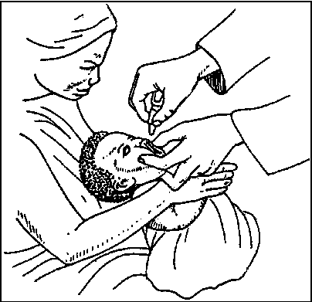

Sequence and injection site for IPV and other vaccines
Give bOPV vaccine first
Then;
  Give IPV and PCV in one thigh, separated by at least 2.5 cm
  Give Pentavalent in the other thigh because it can cause more swelling and redness
Step 1: OPV
Step 2: IPV
(right thigh)
Step 3: PCV
(right thigh separated by 2.5 cm)
Step 4: Penta
(left thigh)
Notes:
To the facilitator:
Explain to the participants that rotavirus vaccines can be given with routine childhood vaccines.
IPV can be given with any of the following routine childhood vaccines without interfering with their effectiveness, during the same visit.
• Diphtheria–tetanus–pertussis vaccine (DTP)
• Haemophilus influenzae type b vaccine (Hib)
• Pneumococcal vaccine
Oral polio vaccine
Rotavirus vaccine
Give the OPV vaccine first, then administer other injectable childhood vaccines. As a general rule its better to give oral vaccines first when the child is still calm and then give injectable vaccines.
When giving Penta and PCV:
give IPV and PCV in one thigh with injection sites separated by at least 2.5 centimeters
Give Pentavalent in the other thigh because Penta is more reactogenic – causes more redness and swelling
67

Slide 68
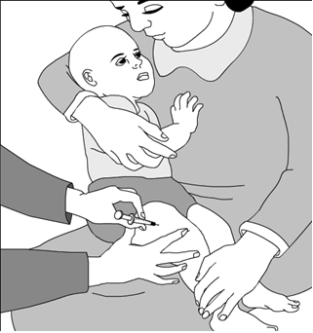
How to position the child for IPV vaccination
The child should be held in a upright position by the caregiver
The caregiver should hold the child’s arms and legs very firmly
The vaccine is injected into the thigh muscle at a 90⁰ angle by the health care provider
Notes:
To the facilitator:
Explain to the participants how to position the child before administering the vaccine.
The child should be held in a upright position by the caregiver
The caregiver should hold the arms and legs very firmly
The vaccine is injected into the thigh muscle at a 90°angle
68

Slide 69
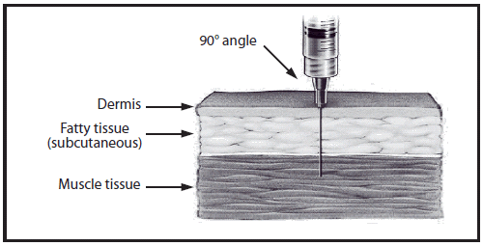
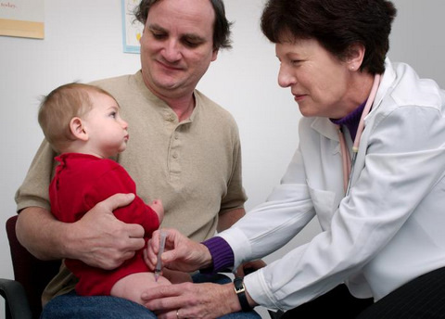
How to administer IPV
Location
  IPV is administered as a 0.5 ml dose into the muscle in the outer part of the thigh
Procedure
  Wash your hands well for 15 seconds
  Hold the muscle firmly between your thumb and index finger
  Hold the syringe like a pencil
  Quickly insert the needle through the skin at a 90-degree angle
  Depress the plunger
Notes:
To the facilitator:
Explain to the participants, how to administer the vaccine.
IPV is administered in a dose of 0.5 ml into the outer part of the thigh
Wash your hands well for 15 seconds.
Hold the muscle firmly between your thumb and index finger
Hold the syringe like a pencil. Quickly insert the needle through the skin at a 90-degree angle
69

Slide 70
Multi-dose vials of IPV
Open multi-dose vials of IPV may be used up to 28 days after opening, if all of the following WHO recommendations heve been fully met:
The vaccine is currently prequalified by WHO.
The vaccine is approved for use for up to 28 days after opening the vial, as determined by WHO.
The expiration date of the vaccine has not passed.
The vaccine vial has been, and will continue to be, stored at WHO- or manufacturer-recommended temperatures.
The cap of the vaccine has not been submerged in water.
Any vaccine vial missing a label, or attached with a label that cannot be read, should never be used.
The vials are handled with good hygienic practices.
The vaccine vial monitor is visible on the vaccine label and is not past its discard point
Notes:
To the facilitator:
Explain to the participants how to deal with multi-dose vials of IPV after they are opened.
The WHO prequalified presentations of stand-alone IPV are unpreserved or preserved with 2 phenoxy-ethanol, which does not pass WHO requirements to effectively preserve the vaccine for 28 days.
Therefore, for all current prequalified IPV presentations, opened vials must be discarded at the end of the immunization session or 6 hours after opening, whichever comes first.

Slide 71
ABSOLUTE CONTRAINDICATIONS TO IPV
Do not vaccinate if recipient has:-
Known or documented allergy to vaccine components, including:
  Streptomycin
  Neomycin
  Polymyxin B
History of an allergic reaction following a previous IPV injection
Thrombocytopenia (insufficient blood platelets, which play an important role in coagulation)
Other bleeding disorder

Slide 72
Cont..
Postpone vaccination if recipient is:-
Taking temporary treatment that suppresses the immune response
Treatment could reduce immune response to the vaccine
Postpone vaccination until the end of the treatment to make sure the infant is well protected by the vaccine

Slide 73
CAN IPV BE ADMINISTERED ON SCHEDULE TO IMMUNODEFICIENT INFANTS OR INFANTS BORN PREMATURELY?
Immunodeficiency does not prevent administration of IPV
Vaccination of infants with immunodeficiency, such as HIV infection, is recommended
Infants born prematurely should receive IPV on schedule (at or after 14 weeks of age)

Slide 74
CONTRAINDICATION CHECKLIST
Do I still give IPV if recipient has….? | Yes | No | Postpone
mild illness | √
Malnutrition | √
HIV | √
prematurity | √
allergy to streptomycin, neomycin or polymyxin B |  | √
bleeding disorder |  | √
had a previous reaction to IPV |  | √
taking treatment that suppresses immune response |  |  | √

Slide 75
HPV safety and administration
The continued use of safety boxes even when providing services out of the health facilities.
Given Intramuscular anterior-lateral aspect of left upper arm
Make sure there is enough 0.5ml syringes and safety boxes when going for outreach and at the facility
Bring back to the facilities all the used syringes in a safety boxes when immunizing out of the facility

Slide 76
HPV contraindications
Severe allergic reaction after a previous HPV vaccine dose, or to a component of the vaccine
Data on the safety of HPV vaccination in pregnancy are limited, and HPV vaccination of pregnant women should therefore be avoided
  The vaccines can be used in persons who are immunocompromised and/or HIV-infected.

Slide 77
Revised Immunization Schedule
Age | Vaccine | Dose | Route
At birth | BCG | 0.05 ml | Intradermal deltoid muscle right arm
 | OPV 0 | 2 drops | Oral
6 weeks | OPV 1 | 2 drops | Oral
 | Pentavalent 1 | 0.5 ml | Intramuscular anterior-lateral aspect of the left mid-thigh
 | PCV 1 | 0.5 ml | Intramuscular anterior-lateral aspect of the right mid- thigh
 | Rota 1 | 1.5 ml | Oral
10 weeks | OPV 2 | 2 Drops | Oral
 | Pentavalent 2 | 0.5 ml | Intramuscular anterior-lateral aspect of the left mid-thigh
 | PCV 2 | 0.5 ml | Intramuscular anterior-lateral aspect of the right mid- thigh
 | Rota 2 | 1.5 ml | Oral
14 weeks | OPV 3 | 2 Drops | Oral
 | Pentavalent 3 | 0.5 ml | Intramuscular anterior-lateral aspect of the left mid-thigh
 | PCV 3 | 0.5 ml | Intramuscular anterior-lateral aspect of the right mid- thigh
 | IPV | 0.5 ml | Intramuscular anterior-lateral aspect of the right mid- thigh
9 months | MR 1 | 0.5 ml | Subcutaneous anterior-lateral aspect of left upper arm
18 months | MR 2 | 0.5 ml | Subcutaneous anterior-lateral aspect of left upper arm
14 years | HPV1 | 0.5 ml | Intramuscular anterior-lateral aspect of left upper arm
At least 6 months after 1st dose | HPV 2 | 0.5 ml | Intramuscular anterior-lateral aspect of left upper arm

Slide 78

Thank you
for your attention!
Notes:
To the facilitator:

Slide 80
VACCINE MANAGEMENT
(HPV &IPV)
Dodoma

Slide 81
HPV VACCINE
The vaccines are most effective when administered to a person prior to exposure to HPV.
HPV vaccines are not therapeutic and cannot be used for treatment of cervical cancer or HPV infection.
HPV vaccines used in Tanzania under immunization programme protects against four HPV types of 6,11, 16 and 18 (quadrivalent vaccine).
HPV vaccine should be stored between +2° to +8°C.
Regular temperature monitoring procedures should be maintained in all cold storage equipment
Fridge tags and freeze tags should be used
NB: As of to date, the authorities in Tanzania have only approved quadrivalent to be used as HPV vaccine to prevent cervical cancer for all eligible girls in Tanzania

Slide 82
HPV vaccines
 | Quadrivalent | Bivalent
Manufacturer/ Name | Merck/ Gardasil | GSK/Cervarix
HPV Serotypes | 6,11, 16, 18 | 16,18
Schedule | ( Two doses) 0 and 6 months | 0, 1 month, 6 months
Target group | 9- 15 | 10-14
Storage Temperature | + 2 to 8 degree Celsius | + 2 to 8 degrees Celsius
Injection Site | 0.5 cc, IM, in deltoid region or exterior part of thigh | 0.5 cc, IM in deltoid region

Slide 83
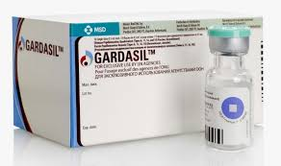
HPV Vaccine Vial Monitor (VVM)
HPV vaccine has VVM sticker at the top of the vial
VVM records cumulative heat exposure through a gradual change in color
The VVM status will hence decide which vaccines can safely be kept after a cold chain break occurs

Slide 84
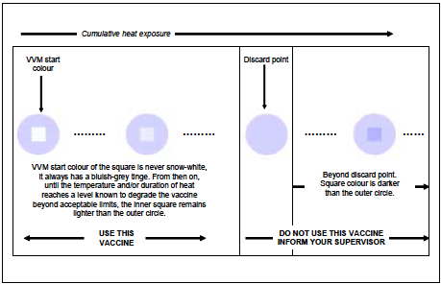
HPV VACCINE
Cumulative heat exposure

Slide 85
Forecast and quantification for HPV vaccine
HPV vaccine forecast and quantification follow the standard procedures for calculating vaccine supply of other vaccines
Will be integrated into existing mechanisms to order other vaccines
Doses required for the annual supply is based on target population, expected vaccine coverage of the first dose, and vaccine wastage.
$Vaccines needed=Target population∗Coverage∗Number of doses per schedule$* Wastage factor plus 25% buffer because is new vaccine

Slide 86
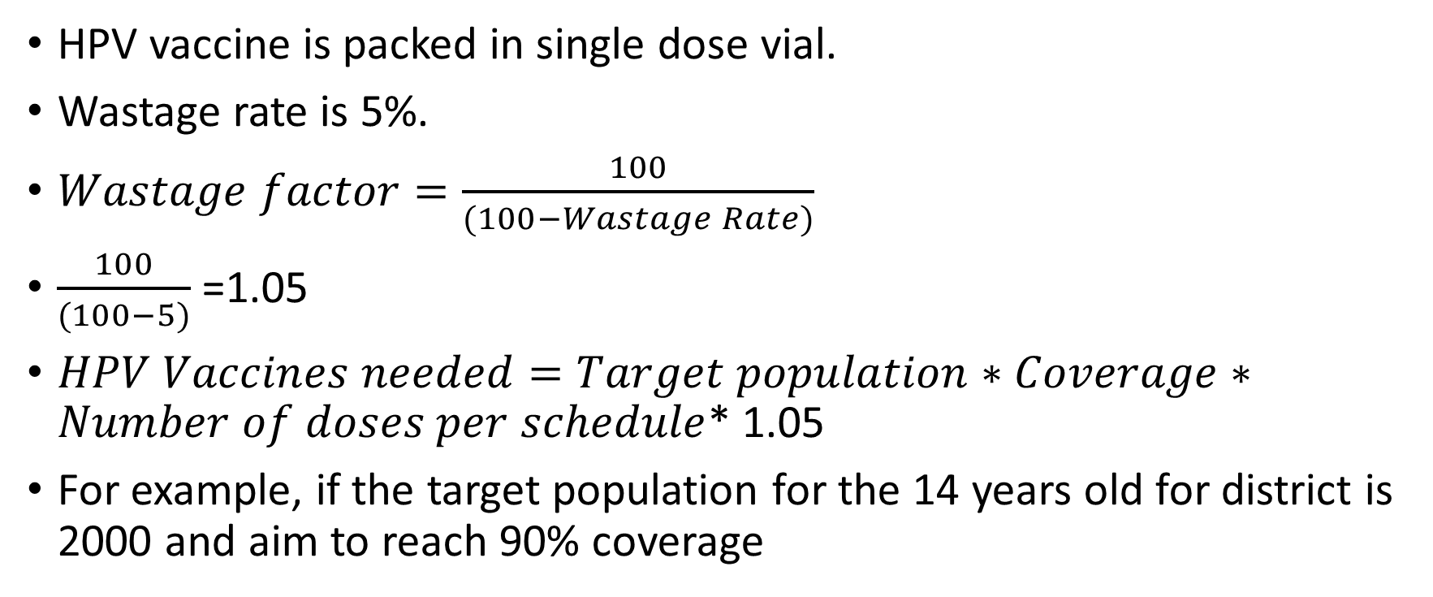
Forecast and quantification for HPV vaccine……….
HPV vaccine is packed in single dose vial.
Wastage rate is 5%.
$Wastage factor=\frac{100}{(100−Wastage Rate)}$
$\frac{100}{(100−5)}$ =1.05
$HPV Vaccines needed=Target population∗Coverage∗Number of doses per schedule$* 1.05
For example, if the target population for the 14 years old for district is 2000 and aim to reach 90% coverage

Slide 87
Forecast and quantification for HPV vaccine……….
$HPV Vaccines needed=2000∗0.9∗2$* 1.05 =3,780 doses
The first year of introduction add 25% buffer
3,780 *1.25= 4,725 doses.
Or =3780 doses + (3780 doses*0.25)
=3780+945=4725 doses

Slide 88
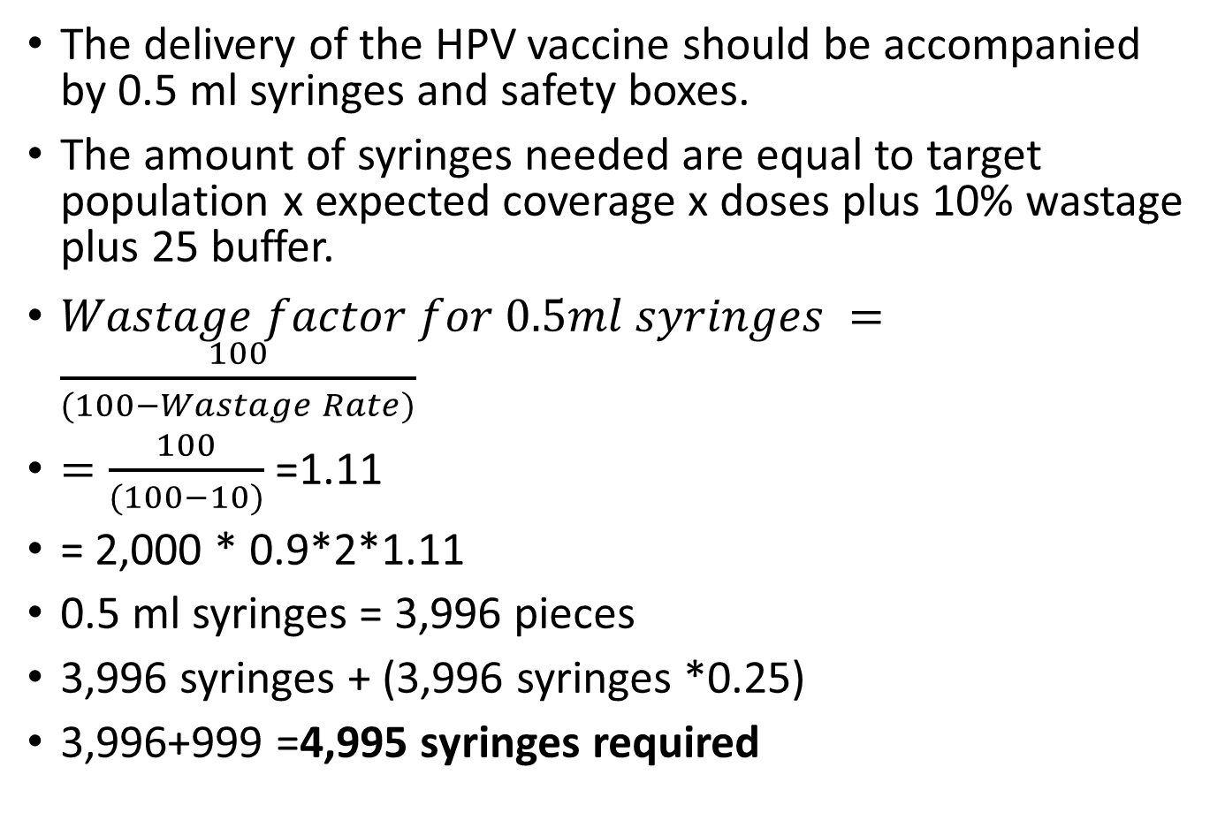
Syringes and safety boxes
The delivery of the HPV vaccine should be accompanied by 0.5 ml syringes and safety boxes.
The amount of syringes needed are equal to target population x expected coverage x doses plus 10% wastage plus 25 buffer.
$Wastage factor for 0.5ml syringes =\frac{100}{(100−Wastage Rate)}$
$=\frac{100}{(100−10)}$ =1.11
= 2,000 * 0.9*2*1.11
0.5 ml syringes = 3,996 pieces
3,996 syringes + (3,996 syringes *0.25)
3,996+999 =4,995 syringes required

Slide 89
Syringes and safety boxes…..
1 safety box can hold 100 used syringes and needles
$\frac{\text{4,995}}{100}=49.95 approx. 50 safety boxes$
Plus 10% wastage rate
50*1.11 = 55.6 approx. 56.
Safety boxes required are 56 pieces

Slide 90
Forecasting……….
3-6 months after introduction of the vaccine in the routine immunization the consumption can be reviewed at the health facility level and consumption method used in the computation of the quantity of vaccines to be ordered.

Slide 91
HPV Key messages
HPV is a liquid, injectable formulation
Store vaccines between +2⁰C and +8⁰C, never freeze
HPV vaccines SHOULD NOT BE FROZEN as they are exceptionally sensitive to temperatures lower than +2°C and lose efficacy if frozen
HPV vaccines are sensitive to light and should be stored in safe place.
Vaccine comes in: 1-dose vial
Use cool water packs for transportation of the vaccine.
Keep vaccines with early expiration dates in the front of the refrigerator and use first

Slide 92
IPV is freeze sensitive
IPV is freeze sensitive vaccine (unlike OPV)
  the “shake test” is not effective in determining whether IPV has been frozen (Because it does not contain an aluminum adjuvant).
  Therefore it is very important that if there is any suspicion that IPV has been frozen, the vial must be discarded

Slide 93
How do you store IPV vaccine?
Store IPV in a refrigerator, between +2⁰C and +8⁰C
Do not open the door frequently (no more than 3x/day)
Monitor and record the fridge temperature twice daily
Do not put IPV in the freezer

Slide 94
Best practices for storing IPV
Maintain the boxes in a neat row
Keep around 2 cm of space between rows for circulation of air
In front-opening refrigerators store IPV and other freeze-sensitive vaccines on the center shelves.
In top-opening refrigerators, store IPV and other freeze-sensitive vaccines on the upper shelves
During packing, use cooled water pack in the cold boxes and vaccine carriers.

Slide 95
Use of IPV during outreach
IPV can be used during outreach.
Provided that vaccines meet the below criteria, keep opened multi-dose vials for up to 28 days
  Should be protected from freezing and sunlight
  The expiry date of the vaccine has not passed
  The vaccine stored at WHO- or manufacturer-recommended temperatures.
  VVM not reached its discard point

Slide 96
Outreach ……2
The vaccine is currently prequalified by WHO.
The vaccine is approved for use for up to 28 days after opening the vial, as determined by WHO.

Slide 97
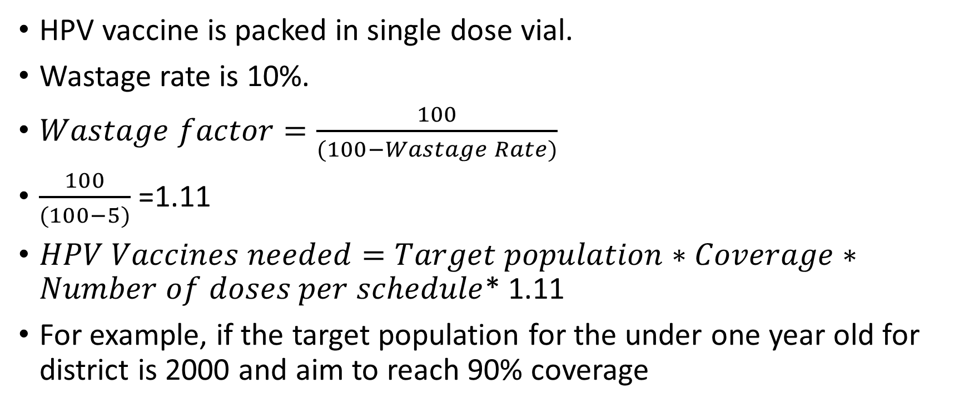
Forecast and quantification for IPV vaccine
HPV vaccine is packed in single dose vial.
Wastage rate is 10%.
$Wastage factor=\frac{100}{(100−Wastage Rate)}$
$\frac{100}{(100−5)}$ =1.11
$HPV Vaccines needed=Target population∗Coverage∗Number of doses per schedule$* 1.11
For example, if the target population for the under one year old for district is 2000 and aim to reach 90% coverage

Slide 98
Forecast and quantification for IPV vaccine……….
$HPV Vaccines needed=2000∗0.9∗$1* 1.11 =1,998 doses
The first year of introduction add 25% buffer
1,998 *1.25= 2,497.5 approx. 2,498 doses.
Or = 1,998 doses + (1,998 doses*0.25)
= 1,998+499.5= 2,497.5 approx. 2,498 doses

Slide 99
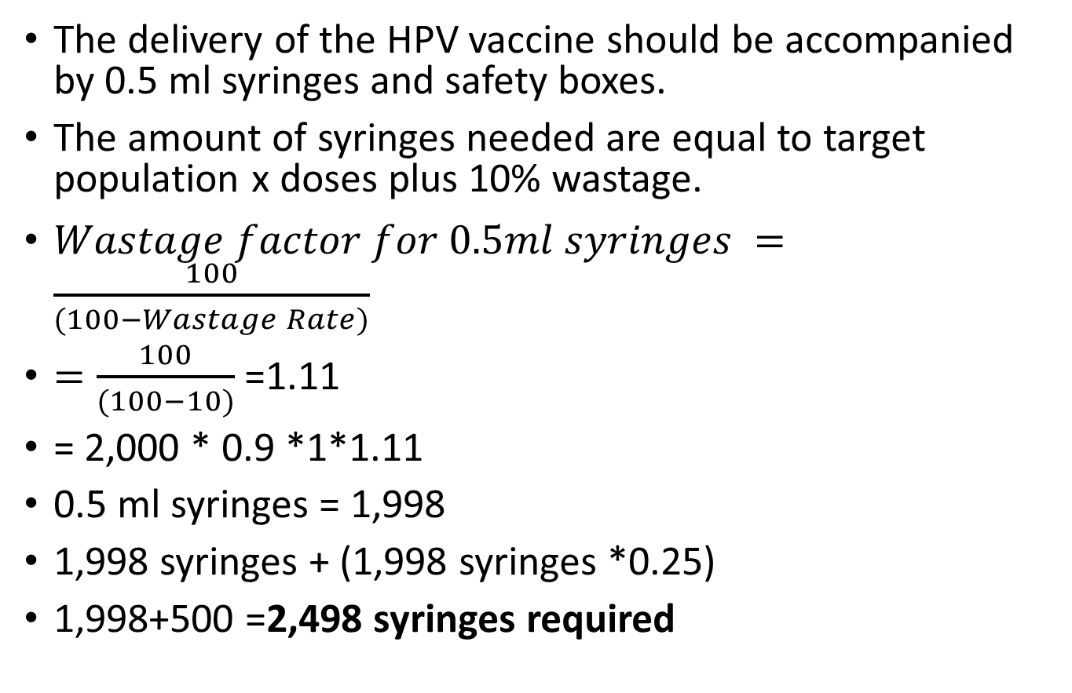
Syringes and safety boxes
The delivery of the HPV vaccine should be accompanied by 0.5 ml syringes and safety boxes.
The amount of syringes needed are equal to target population x doses plus 10% wastage.
$Wastage factor for 0.5ml syringes =\frac{100}{(100−Wastage Rate)}$
$=\frac{100}{(100−10)}$ =1.11
= 2,000 * 0.9 *1*1.11
0.5 ml syringes = 1,998
1,998 syringes + (1,998 syringes *0.25)
1,998+500 =2,498 syringes required

Slide 100
Syringes and safety boxes…..
1 safety box can hold 100 used syringes and needles
$\frac{\text{2,498}}{100}=24.98 approx. 25 safety boxes$
Plus 10% wastage
25 safety boxes+ (45 safety box.* 0.1) =
25+2.5 = 27.5 approx. 28
Safety boxes required are 28 pieces

Slide 101
IPV Key messages
IPV is a liquid, injectable formulation
IPV may be used for up to 28 days after opening the vial, if all WHO recommendations on vaccine-storage have been fully met.
Vaccine comes in: 1-dose, 5-dose, and 10-dose vials
Injection site soreness and fever are most common reactions
Store vaccines between +2⁰C and +8⁰C, never freeze
  “Shake Test” is ineffective in determining whether IPV has been frozen
Keep vaccines with early expiration dates in the front of the refrigerator and use first
Monitor the temperature of the refrigerator twice daily

Slide 102
Definition of MDVP
Use of opened multi-dose vaccine vials specifies the criteria under which opened multi-dose vials can be kept and used for up to 28 days after opening

Slide 103
Summary of the MDVP 2014
All opened WHO-prequalified multi-dose vials of vaccines should be discarded at the end of the immunization session, or within six hours of opening, whichever comes first, UNLESS the vaccine meets all four of the criteria listed below, the opened vial can be kept and used for up to 28 days after opening.

Slide 104
Appropriate handling of multi-dose open vials
Open multi-dose vials of this vaccine may be used up to 28 days after opening, if all of the following WHO recommendations are fully met:
The vaccine is currently prequalified by WHO.
The vaccine is approved for use for up to 28 days after opening the vial, as determined by WHO.
The expiration date of the vaccine has not passed.
The vaccine vial has been, and will continue to be, stored at WHO- or manufacturer-recommended temperatures.

Slide 105
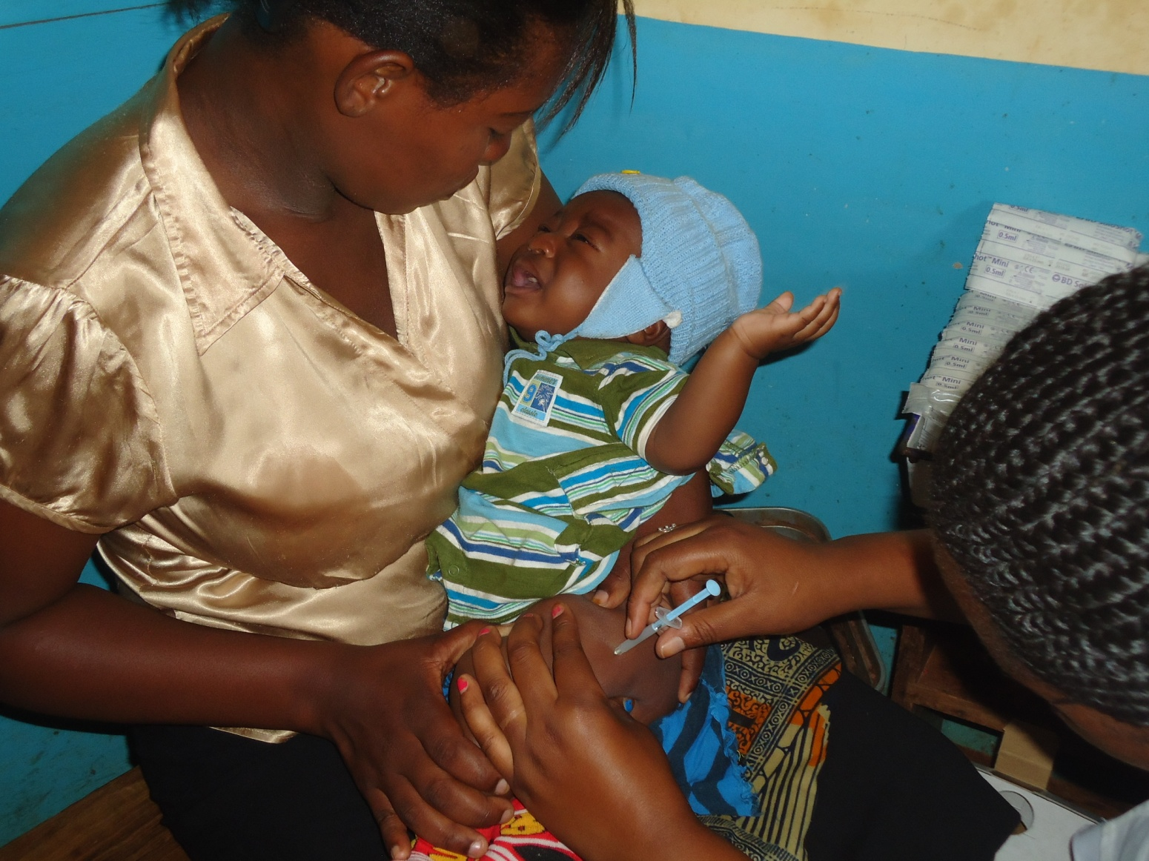
Ahsanteni !!!
Chanjo Ni Jukumu Letu Sote!

Slide 107
HPV vaccine Introduction
MINISTRY OF HEALTH,COMMUNITY DEVELOPMENT, GENDER, ELDERLY AND CHILDREN
Advocacy Communication and Social Mobilization(ACSM)

Slide 108
INTRODUCTION
To ensure that the Introduction of HPV vaccine is done smoothly and all eligible girls are reached, effective communication and advocacy strategies are very important before, during and after introduction.
Increasing community awareness through timely, complete and appropriate communication is the key to successful and sustainable HPV vaccine introduction.

Slide 109
INTRODUCTION..
In order to achieve this all potential stakeholders to enable a successful introduction and acceptance of HPV vaccine at National, Regional, Districts, Health facility and community level need to be reached with different approaches towards the introduction period.

Slide 110
INTRODUCTION..
Experience has shown that parents’ decisions are heavily influenced by receiving information from sources they trust - principally their families and close friends, local health workers, their teachers and religious leaders
Parents also like to receive information through interpersonal, direct communication and discussions

Slide 111
INTRODUCTION..
To ensure all local Personnel trusted sources of information are conversant and communicate accurately about cervical cancer, HPV vaccine and its benefits, local government authorities should ensure effective use of Local available forums and platforms to pass right messages at the right time before the introduction.

Slide 112
ADVOCACY AND SENSITIZATION MEETINGS
Advocacy and sensitization meetings have to be conducted at different levels
The first advocacy meeting will involve the MOHCDGEC Officials and Immunization and Vaccines Development (IVD) Partners where the IVD Program Manager will lead the meeting

Slide 113
ADVOCACY AND SENSITIZATION MEETINGS
The second National level advocacy meeting will involve all stakeholders i.e. MOHCDGEC,PORALG,MOEVT,MOF,WHO,UNICEF,JSI,CHAI,PATH,JHPIEGO,AMREF,MEWATA,AGOTA,PAT,RED –CROSS,LIONS CLUB,TCDC,JHU, Religious Leaders, Related NGOs with gender and women advocates, media groups and influential leaders including politician

Slide 114
ADVOCACY AND SENSITIZATION MEETINGS
Regions and Districts should conduct Extended PHC Meeting involving all Stakeholders including Religious Leaders and politicians should be utilized to advocate for HPV vaccination introduction.
Advocacy and IEC materials including PPT have to be used to inform members on cervical cancer, HPV Vaccine and support needed from them.

Slide 115
ADVOCACY AND SENSITIZATION MEETINGS
At health facilities, health facility workers should effectively pass messages to parents, caretakers and other clients at health facility on the introduction of HPV vaccine with clear explanations of benefits and beneficiaries of the Vaccine through interpersonal communication and developed IEC Materials.

Slide 116
ADVOCACY AND SENSITIZATION MEETINGS
At community levels, different message has to be communicated using existing structures. Ward Development Committees (WDC) and Village /Mtaa councils, Village Health Committees (VHC), Community Health Workers (CHWs)
Influential people and existing community groups have to be fully involved in planning, implementation, monitoring and evaluation of HPV vaccine introduction.

Slide 117
ADVOCACY AND SENSITIZATION MEETINGS
WEOs and VEOs in collaboration with health facilities should convene the meetings involving other local available bodies and structures to discuss and plan on how to have a successful introduction of HPV vaccine in their area of jurisdictions.

Slide 118
ADVOCACY AND SENSITIZATION MEETINGS
At schools, head teachers and school health teachers have to be part of planning and implementation for the successful introduction.
School Teachers, Parents and guardians sensitization meetings have to be convened by the Village/Mtaa chairperson through involvement of health facility Governing Committee (HFGC).

Slide 119
ADVOCACY AND SENSITIZATION MEETINGS
Eligible girls in schools and out of schools have to be sensitized on the importance and value of being vaccinated with HPV vaccine using the forum of Community Leaders and Religious Leader.
Health facilities should plan and send official letters and IEC Materials to religious leaders and request them to announce and communicate to their followers during congregations on the importance and benefits of young girls to be vaccinated with HPV Vaccine.

Slide 120
MASS MEDIA INVOLVEMENT
Across all levels, sensitization has to be done using available and affordable mass media including National and community TV and Radio, social media and folk media in respective Regions and Districts
IEC materials, TV and radio spots have to be developed at National level and get distributed to Regions and districts for mass consumption

Slide 121
MASS MEDIA INVOLVEMENT..
National, Regional and District personnel should arrange interviews and talk shows in TVs and radios to educate community on cervical cancer and mobilize them for utilization HPV vaccine
Officials at National, Regional and District levels should seek for free airtime in the media to broadcast messages related to HPV vaccine before, during and after the introduction.

Slide 122
LAUNCHING
Launching should be done at National and District levels in April 2018.
At National level, Launching ceremony will be done in Dodoma and will be officiated by Her Excellence Vice President of The United Republic of Tanzania Hon. Samia Suluhu Hassan

Slide 123
LAUNCHING..
Districts in Collaboration with Regions should prepare Launching events and at District level, the launching ceremony should be officiated by District Commissioners or Regional Commissioners depending on their availability and time.
Key messages related to cervical cancer and the importance and benefits of HPV vaccine should be passed clearly to the community through prepared speeches, songs, poems and IEC materials.

Slide 124
IDENTIFICATION OF AUDIENCE&MESSAGES
Because HPV vaccine will be new, targeting an age group not normally included in the EPI schedule, could have some potential sensitivity, it is important that communication messages reach every group that will have an interest in the vaccine
Each audience should be mapped out, and each will require specific messages – some requiring more information than others.

Slide 125
AUDIENCES&MESSAGES
AUDIENCE | MESSAGE CONTENTS | RESPONSIBLE PERSON/GROUP | ACTIVITIES | MATERIALS
Eligible girls (14 adolescent years girls) | Basic facts about cervical cancer Basic facts about the preventive HPV vaccine Benefits of being vaccinated Eligibility Their roles and responsibilities | Teachers Health workers Religious leaders Parents CHWs Community leaders | Sensitization meeting Distributing IEC materials Radio and TV message dissemination | HPV leaflet Formal letters Posters Radio and TV spots

Slide 126
AUDIENCES&MESSAGES..
AUDIENCE | MESSAGE CONTENTS | RESPONSIBLE PERSON/GROUP | ACTIVITIES | MATERIALS
Parents and Caretakers | Facts about cervical cancer and prevention strategies Availability of vaccine and eligibility Facts about the vaccine Their role & responsibility Other Primary preventive measures | Health workers Community Health Workers Teachers Religious leaders Community leaders | Orientation sessions Distributing materials Radio messages Publish information in local media Community film shows Cultural troupes performances PA Announcements | HPV leaflet Radio and TV messages Fact sheet Posters

Slide 127
AUDIENCES&MESSAGES..
AUDIENCE | MESSAGE CONTENTS | RESPONSIBLE PERSON/GROUP | ACTIVITIES | MATERIALS
Schools and School teachers | Facts about cervical cancer and prevention Availability of preventive vaccine Facts about the vaccine Age-appropriate approaches to addressing cervical cancer among adolescent girls Their roles & responsibilities | District education officers (primary and secondary) Ward education officer DIVO School health coordinators District community health coordinators Health workers CHWs | Orientation sessions Distributing materials Radio messages Publish information in local media Official letter | HPV leaflet HPV guidebook HPV fact sheets Radio and TV messages Posters

Slide 128
AUDIENCES&MESSAGES..
AUDIENCE | MESSAGE CONTENTS | RESPONSIBLE PERSON/GROUP | ACTIVITIES | MATERIALS
Community and religious leaders | Burden of disease (cervical cancer) Importance and benefits of prevention Availability of preventive vaccine and eligibility Facts about the vaccine Key messages to help dispel misinformation Their roles & responsibilities | Health workers Community Health Workers Teachers Religious leaders District/Council management team | Orientation sessions Distributing IEC materials Dissemination of Radio and TV messages Sending Official Letters Message dissemination through announcement in religious houses congregassions | HPV leaflet HPV guide Radio and TV messages Official letters

Slide 129
AUDIENCES&MESSAGES..
AUDIENCE | MESSAGE CONTENTS | RESPONSIBLE PERSON/GROUP | ACTIVITIES | MATERIALS
Members of Primary Health Care (PHC) committee at Region and District levels | Burden of disease Importance and benefits of prevention Availability of preventive vaccine and eligibility Facts about the vaccine Key messages to help dispel misinformation HPV vaccine introduction phases in Tanzania Their roles & responsibilities | IVD RIVO DIVO | PHC advocacy and sensitization meeting | PPT Fact sheet Leaflets FAQs

Slide 130
AUDIENCES&MESSAGES..
AUDIENCE | MESSAGE CONTENTS | RESPONSIBLE PERSON/GROUP | ACTIVITIES | MATERIALS
MOHCDGEC officials and partners | Burden of disease Importance and benefits of prevention Availability of preventive vaccine Facts about the vaccine Key messages to help dispel misinformation HPV vaccine introduction phases in Tanzania Their roles & responsibilities | Permanent Secretary CMO IVD Program Manager | MOHCDGEC officials and partners meeting | PPT Fact sheet Leaflets FAQs

Slide 131
AUDIENCES&MESSAGES..
AUDIENCE | MESSAGE CONTENTS | RESPONSIBLE PERSON/GROUP | ACTIVITIES | MATERIALS
Members of Extended high level advocacy meeting | Burden of disease Importance and benefits of prevention Availability of preventive vaccine and eligibility Facts about the vaccine Modalities of HPV vaccine introduction in Tanzania Key messages to help dispel misinformation Their roles & responsibilities | Permanent Secretary CMO IVD Program Manager | Extended high level advocacy meeting | PPT Fact sheet Leaflets FAQs

Slide 132
RUMORS COMM.PLAN
CHW, VEO, WEO, Influential people and religious leaders to detect crisis and magnitude in the community and report to health facility level for technical clarification and assistance.
At health facility level the HF in charge should assist CHW, VEO, WEO, Influential people and religious leaders to clarify crisis if manageable at that level.
Health facility should report crisis to District management for information sharing and further actions if needed
If the crisis persist the DMO should arrange for Extended PHC Meetings involving RHMT and Region secretariat in order to reach consensus on the way forward
After investigation of the crisis a press release should be arranged in collaboration between the District and Regional management team to inform the community
At this level information should be shared to the National team, If crisis still exist and continues to spread, the National level should intervene through conducting thorough investigations and provide timely response through appropriate channels
If the crisis is AEFI related, it should be thoroughly dealt with using the available AEFI protocol and information shared appropriately to the appropriate levels

Slide 133
CRISIS COMM. AND INFORMATION MANAG. FLOW

Slide 134
HPV COMMUNICATION FACTS
HPV vaccine for young girls protects them from cervical cancer later in life when they are grown women with families of their own.
Cervical cancer affects the reproductive organs of women and is a leading cause of death among women of child bearing age.
Girls should be vaccinated when they are young before exposure to HPV
You can protect your daughter and her future by getting her vaccinated
The vaccine is safe, causes no major side-effects, and will not harm a girl’s ability to have children in the future
HPV vaccine is available free-of-charge at all immunizing health facilities and during planned outreaches in community and at schools.
Most girls should be vaccinated twice, with 6 months between doses
The government supports HPV vaccination and has added it to the national immunization programme.

Slide 135
Thank You/
Asante Sana

Slide 137
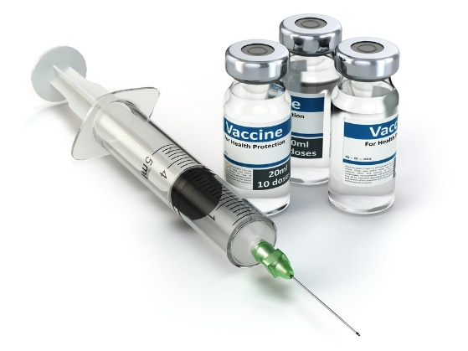
Monitoring and Evaluation
HPV|IPV Vaccine Introduction

Slide 138


PRESENTATION OUTLINE
Introduction
Monitoring Tools
Evaluation Tools

Slide 139
Introduction
Monitoring
  Involves the systematic collection of routine data that measure progress toward achieving program objectives
  It is used to track changes in program performance over time
Evaluation
  Measures how well the program activities have met expected objectives and/or the extent to which changes in outcomes can be attributed to the program or intervention

Slide 140
Monitoring Tools
Immunization register (HPV and MTUHA register)
Tally sheet
Immunization card (Home-based Record) – HPV and Child health card
Monthly summary Report
Electronic Tools (DVD-MT and EIS)

Slide 141
Immunization register
Record doses given to an individual
Helps health workers keep track of each dose that has been administered and the completion of the vaccination series
The basis for tracking individual immunization status (should for example, the vaccination card be lost) and for tracking defaulters
MTUHA register will be used for IPV Vaccine
HPV specific immunization register will be used for HPV Vaccine

Slide 142
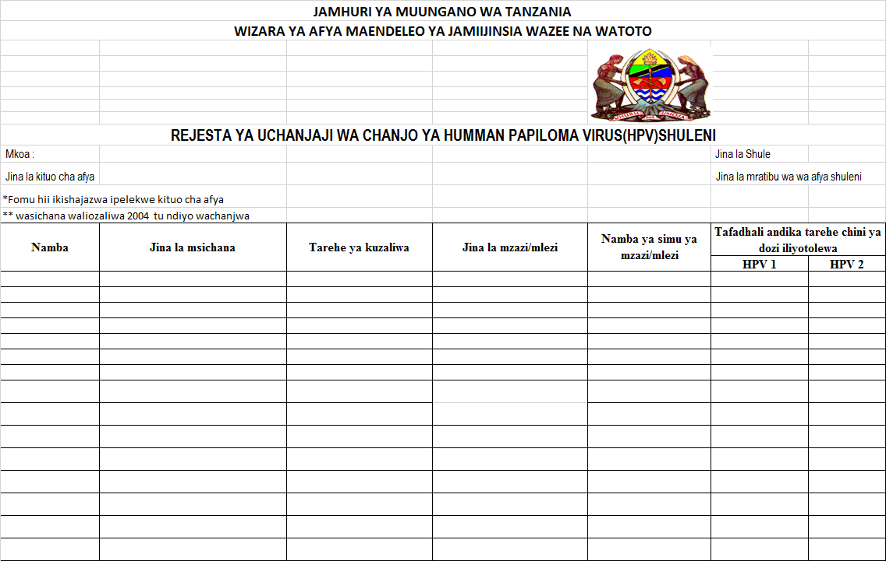
HPV Immunization register - School

Slide 143
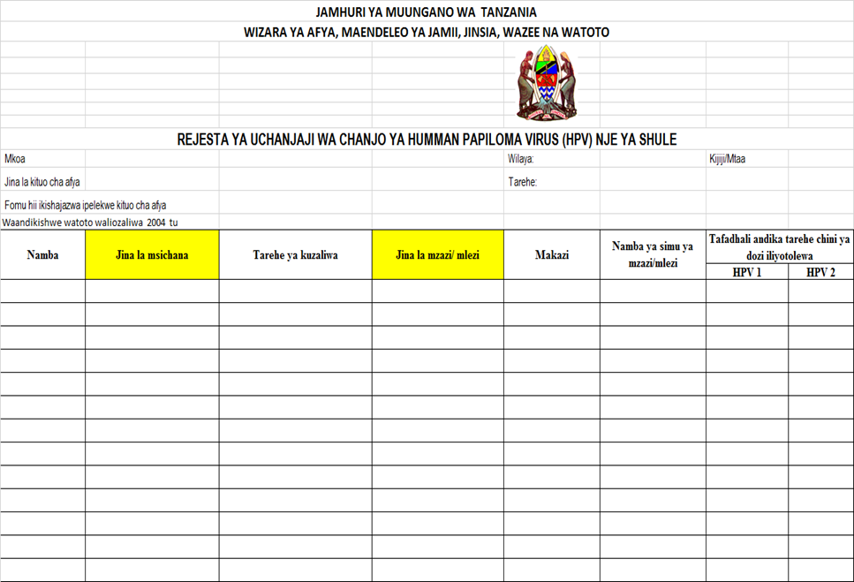
HPV Immunization register - Community
Notes:
Each dose of HPV vaccine delivered to every eligible girl should be recorded against their name in the register

Slide 144
Tally Sheet
Forms that HCWs use to document an immunization session by making a record for every dose of vaccine given
Should be used at all vaccination sessions whether at the H/F, fixed outreach, school, or conducted by mobile teams
Also useful in tracking both doses delivered and any vaccine doses wasted
Supportive supervision visits should monitor appropriate use and completion of the tally sheet to improve the quality of data reporting

Slide 145
Immunization Cards
An essential tool to track immunization history
Enable health workers to determine which doses are due
Serve as a reminder for the next visit/dose
Facilitate coverage surveys

Slide 146
Tracking Doses and Defaulters
It is important to follow-up eligible clients who fail to present for either dose of vaccine
  Girls who missed either First or second dose of HPV Vaccine
  Children who missed IPV vaccine
Possible reasons for high levels of defaulting include
  Lack of confidence or trust in the vaccine
  Issues in service delivery, such as stock outs
A system to track drop-outs is an integral part of the Reaching Every Children (REC) strategy.
  The REC approach should be used to ensure high vaccination coverage
Notes:
High levels of defaulting could be an indication of more systemic problems in the community, such as lack of confidence or trust in the vaccine, or in service delivery, such as stock outs.
The Reaching Every Children Strategy should be used to ensure high vaccination coverage and reduce drop-outs

Slide 147
Common ways of monitoring and follow-up of defaulters
Using the immunization register
  Regularly review the immunization register to identify clients who may have failed to receive their subsequent dose of vaccine when due
Reminder cards
Electronic immunization registries (EIRs)

Slide 148
Monthly Summary Report
Valuable tool for management of the programme’s achievements and to monitor progress throughout the year
Immunization data should be collected on a monthly basis at each level of the health system
HPV and IPV vaccines have been adapted on IVD monthly summary report

Slide 149
Coverage Monitoring
Calculating HPV and IPV vaccine coverage is necessary for monitoring the impact of these vaccines on a population
Useful for evaluating the performance of a vaccine programme toward meeting objectives
For HPV vaccine, coverage monitoring requires collection of coverage data by dose (i.e. HPV1 and HPV2 )
A performance monitoring chart for HPV vaccination should be maintained and displayed in the health facility
This chart should include the target population of girls at the health facility and record the number of girls vaccinated per month, per dose and over time

Slide 150
Electronic Tools
DVD-MT
  The tool has been adapted to include both HPV and IPV Vaccine
  The team is finalizing the tool to ensure that the vaccination coverage for vaccines given in the second year of life or above (e.g. MR2 and HPV) are generated smoothly
EIS (VIMS and Timr)
  The system architecture is very flexible
  Easy to adapt and include any new vaccine introduced

Slide 151
EVALUATION TOOLS
POST-INTRODUCTION EVALUATION (PIE)
  Could be done within 6-12 months following national introduction
  However, WHO no longer recommends this to be done rather than to combine the assessment with the next scheduled EPI Programme Review or other evaluation opportunity
EPI PROGRAMME REVIEWS
  Undertaken every three to five years and should be adapted to include HPV and IPV vaccine once it has been introduced
VACCINATION COVERAGE SURVEYS
  Useful to validate administrative data reported throughout the year
  Allow for comparisons with coverage achieved in other countries

Slide 152
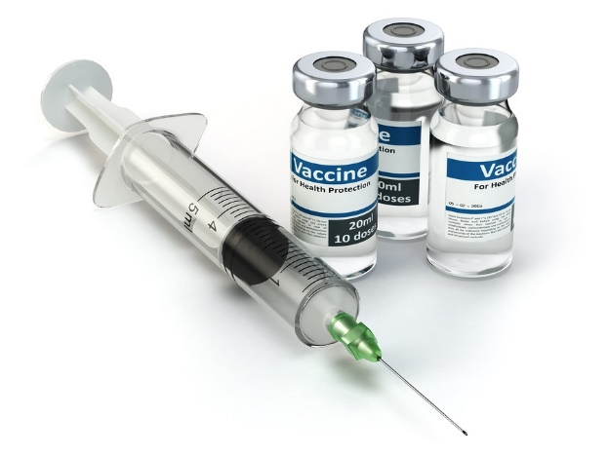
Thank you

Slide 154
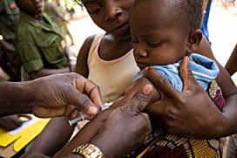
HPV and IPV introduction and Microplanning Workshop
MINISTRY OF HEALTH,COMMUNITY DEVELOPMENT, GENDER, ELDERLY AND CHILDREN
Planning for HPV Vaccination Introduction
January 23rd 2018

Slide 155
PLANNING AT REGIONAL, DISTRICT AND HEALTH FACILITY LEVEL
Introduction:
Tanzania has planned to introduce HPV vaccine countrywide in April 2018.
In order to have successful introduction, a detailed planning process will need to be conducted.
  The target population, delivery strategy, vaccination schedule, and logistics need to be carefully considered.
In this session, we will provide step-by-step guidance in micro planning process for HPV vaccination introduction at both Regional, Council and health facility level

Slide 156
National level Planning
The process of National level planning started with updating the cMYP to include HPV vaccine particularly on the dates of introduction.
A detailed introduction plan was developed.
  The plan outline all activities and steps required for a successful introduction by programme component, identify government departments, institutions or external partners that are responsible for each activity, and include a timeline and detailed budget.
The planned activities included but not limited to:
Develop and disseminate HPV vaccine introduction plans Develop and share fact sheet Develop and share Microplanning and data tools Develop and disseminate Guidelines and IEC materials (ToT) Develop minimum checklist for HPV vaccine activities within RI Print training guidelines materials and Vaccination cards Share micro planning tools with subnational Develop budget for orientation and micro planning exercise l level | Orient Subnational level trainers (RHMT/CHMTs/Education) on how to conduct cascade orientation for lower level Disseminate operational plan and budget to subnational level Conduct readiness assessment Introduction of HPV vaccine Countrywide Communicate with subnational levels to ensure engagement of education sector and other stakeholders Intra introduction assessment Post introduction Evaluation

Slide 157
Regional and Council Level Planning
Identifying the target population for HPV vaccination?
The target population for 2018 is 14 years old girls
These girls can be found in two main areas:
  At primary or secondary schools (for those in school), and
  At the community (for out of school girls)
The micro plan template shared earlier will be used to identify the target population for HPV vaccination. This will help to identify total number of target population for HPV vaccination
Other issues to be considered in planning HPV vaccinations includes:
  Vaccines and Supplies requirement for HPV vaccination
  Data management for HPV vaccination
  Waste management
  Advocacy, Communication and Social mobilization
In completing micro planning tool, all relevant personnel must be involved at regional and council levels such as; Immunization and Vaccine Officers, Reproductive health Coordinators, Education Officer, Community/Village leaders, CHWs and Health care workers.

Slide 158
Facility Level Planning
Health facilities is the primary delivery point of HPV vaccination.
Detailed micro planning is essential particularly linking with schools and communities.
Health facility micro-plans should include:
  What: Activities to be done (sensitization, mobilization, registration of target girls, vaccination, mapping)
  When: Dates of vaccination, schedule for community and school sensitization/mobilization, immunization
  Where: List of schools, facility or outreach post
    Not all the schools will be used as outreach posts (distance matters a lot)
  Who: Health worker, VHW, teacher, targeted girls, contacts of school authorities
This should feed into the district and sub country micro plan
The health facility micro plan template provided see mwongozo wa mchanjaji page 28-34 will be used to identify the target population for HPV during health facility micro plans.it contain the following information that has to be filled
  1a Shule za Msingi na Sekondari
  1b Vijiji
  1c Walengwa
  1d Idadi ya Chanjo
  1e Taarifa za taka (West management)
  1f Uhamasishaji
Since majority of the targeted population are at schools, each targeted school should be visited for the purpose of:
Sensitization of teachers and girls
Display posters and share flyers
Scheduling the dates for immunization in schools
Scheduling the dates for immunization in communities (for non-school going girls

Slide 159
Facility Level Planning Cont…
The health facility micro plan template provided will be used to identify the target population for HPV vaccination during health facility micro plans.
It contain the following information that has to be filled
  1a Shule za Msingi na Sekondari
  1b Vijiji
  1c Walengwa
  1d Idadi ya Chanjo
  1e Taarifa za taka (West management)
  1f Uhamasishaji
Since majority of the targeted population are at schools, each targeted school should be visited for the purpose of:
  Sensitization of teachers and girls
  Display posters and share flyers
  Scheduling the dates for immunization in schools
  Scheduling the dates for immunization in communities (for out of school girls)

Slide 160
Determining the age of girls who are eligible for HPV vaccination
The target age of 14 years’ old girls will be determined using an approach of “year of birth” that is, all girls born in the year 2004 will be 14 years old in 2018
  This approach determines that all girls born in 2004 are eligible in 2018 because they all will have turned 14 years of age by the end of calendar year
In this scenario, when the HPV vaccine is introduced it is announced that all girls born in 2004 should receive HPV vaccination in this year
Regardless of when the vaccine doses are offered or administered, the eligible cohort will receive the vaccination.
Additionally, in places with limited knowledge or records for exact date of birth, girls, parents, health workers, and teachers may be more likely to know or determine a year of birth using significant events

Slide 161
Estimation of the number of girls to be vaccinated with HPV Vaccine
In order to plan, forecast vaccine supply, and be able to calculate coverage, an accurate estimate of the number of girls in the target age group is required.
Each council/HF should make this calculation using up-to-date national or local population data obtained from national bureau of statistics (NBS) offices.

Slide 162
Where to identify targeted girls for HPV vaccination
Once the target population and its size has been determined, it is necessary to understand where the girls may be located in order to plan and reach them for vaccination.
School girls may be found at schools.
  It is important to remember that eligible girls can be found in both Primary and/or Secondary schools.
It is also important to note that not all eligible girls are in school.
  Out of school girls may be dispersed and difficult to locate.
  They may be in the formal or informal labor market, assisting families with agriculture, household chores, tending livestock, or other activities in the community. Reaching girls who are members of pastoralist communities or live in remote locations may require specific strategies.
Councils and Health facilities are encouraged to work with education, census, labour, school health, communities and other sectors to map the situation in their council/HF, including estimations of the proportion of girls attending/not attending schools.

Slide 163
Microplanning Exercise
Instruction:

Slide 164
Thank you for Listening

