Slide 1
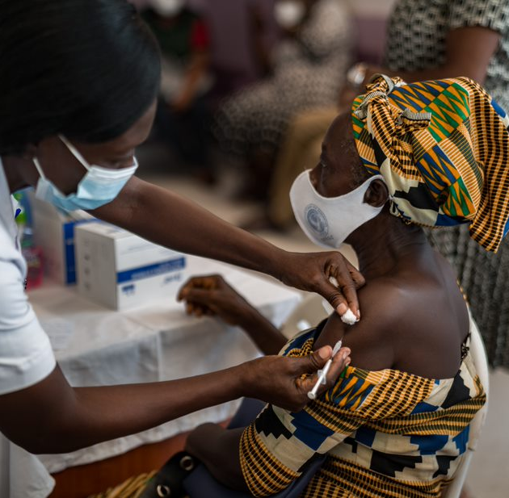


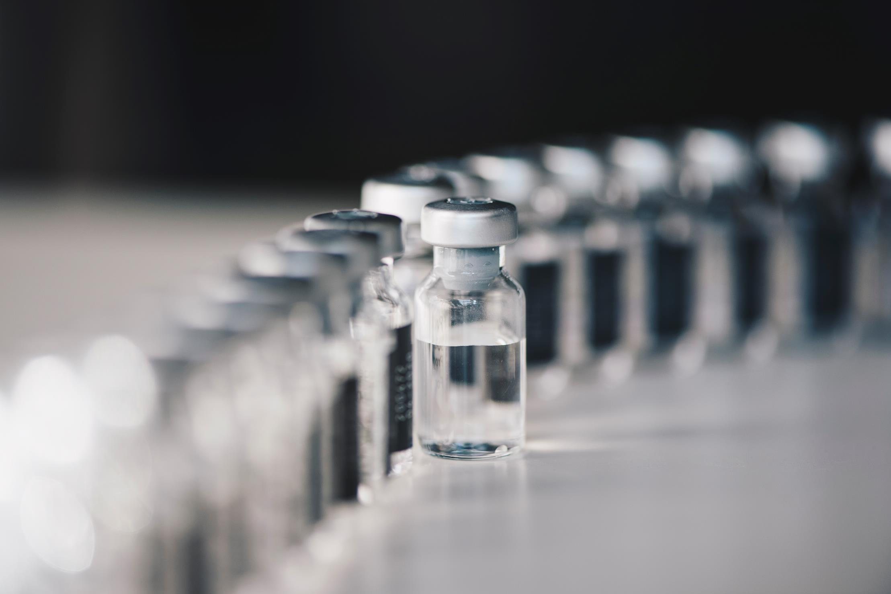
COVID VACCINE DELIVERY PARTNERSHIP
Considerations for choosing COVID-19 vaccine products
Version as of 18 March 2022
WHO HQ | IVB

Slide 2
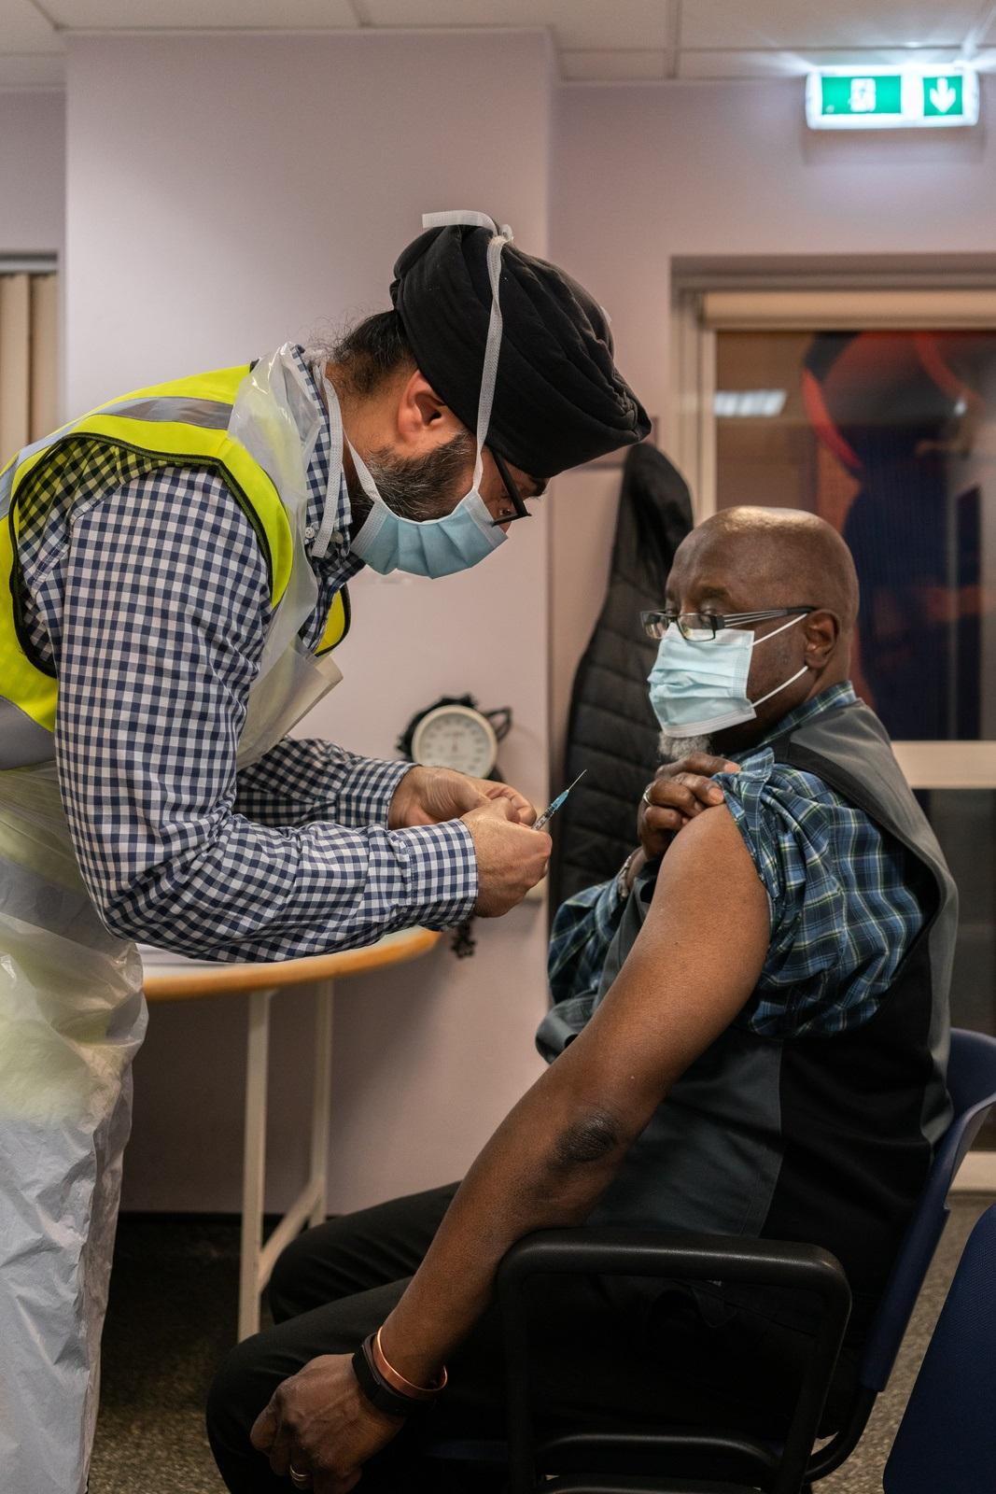
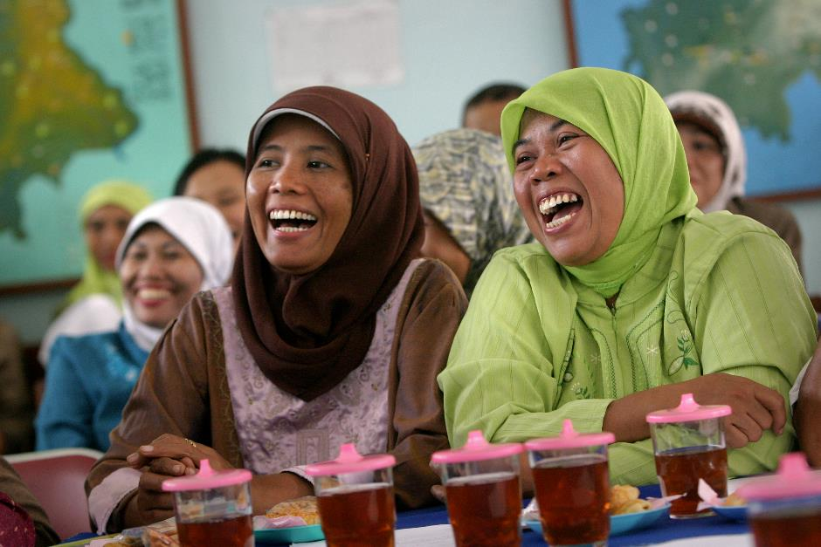
Purpose of this slide set
Content: This slide set summarizes WHO latest recommendations and considerations for choosing COVID-19 vaccine products with WHO Emergency Use List (EUL) (currently available under COVAX).
Target audience: WHO and UNICEF country officers.
Objective: To help orient the Ministry of Health (MoH) and National Immunization Advisory Committee Group (NITAG) in their COVID-19 vaccine product choices to optimize their portfolio.
The information contained in this slide set is current as of 18 March 2022. It has been developed based on WHO Interim guidance documents, technical documents, briefs, and webpages. This slide set will be periodically updated.

Slide 3
Table of contents
Rationale for planning the COVID-19 vaccine country portfolio
Considerations for optimizing the COVID-19 vaccine country portfolio
Additional information to support choosing COVID-19 vaccine products
COVAX demand planning (forecast) process

Slide 4
1. Rationale for planning the COVID-19 vaccine country portfolio

Slide 5
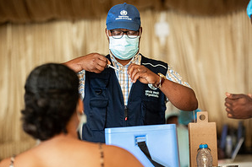
Rationale for planning the COVID-19 vaccine country portfolio
While access to COVID-19 vaccine products has improved, countries may not be able to access all required doses through a single product. COVID-19 vaccines available have different characteristics: presentations, handling and storage requirements, shelf life (or expiry dates), wastage factor, dose schedule, recommendations for specific groups, options for heterologous schedules for primary series and boosters, and available supply of COVID-19 vaccine products, syringes and other ancillaries.
To optimize the programme and achieve the coverage targets, countries will need to consider multiple factors when making a choice of COVID-19 vaccine products and the size of the portfolio of the various products according to their comparative advantage for different uses.
In 2022, COVAX allocation is demand driven, building on the country choices of coverage targets, priority populations, and COVID-19 vaccine products to meet those targets. COVAX has therefore started a process of monthly demand planning where countries can express their needs for the next 6 months.
Intentional planning of the portfolio of COVID-19 vaccine products is essential to the success of country achievement of timebound targets and goals. Hopefully this slide deck can help these decisions.

Slide 6
2. Considerations for optimizing the COVID-19 country vaccine portfolio

Slide 7
All COVID-19 vaccines with WHO EUL are recommended by WHO SAGE and most of them are included in the COVAX portfolio
Platform / Vaccine / Manufacturer | WHO EUL Date ¹ | Latest WHO SAGE recommendations | Links | COVAX Portfolio
Messenger Ribonucleic Acid (mRNA)
COMIRNATY ® (Pfizer BioNTech)² | 31 Dec 2020 | 21 Jan 2022 | WHO SAGE Interim Recommendation; WHO Vaccine Explainer | Yes | Yes
SPIKEVAX ® (Moderna) | 30 Apr 2021 | 23 Feb 2022 | WHO SAGE Interim Recommendation; WHO Vaccine Explainer | Yes | Yes
Recombinant viral vector
COVISHIELD ® (Serum Institute of India) ³ | 15 Feb 2021 | 15 Mar 2022 | WHO SAGE Interim Recommendation; WHO Vaccine Explainer | Yes | Yes
VAXZEVRIA ® (AstraZeneca) ³ | 16 Apr 2021
Ad26.COV 2-S ® (Janssen) | 12 Mar 2021 | 9 Dec 2021 | WHO SAGE Interim Recommendation; WHO Vaccine Explainer | Yes | Yes
Inactivated virus
Inactivated SARS-CoV-2 vaccine ® (BIBP/Sinopharm) | 7 May 2021 | 15 Mar 2022 | WHO SAGE Interim Recommendation; WHO Vaccine Explainer | Yes | Yes
CORONAVAC ® (Sinovac Life Sciences) | 1 Jun 2021 | 15 Mar 2022 | WHO SAGE Interim Recommendation; WHO Vaccine Explainer | Yes | Yes
COVAXIN ® (Bharat Biotech) | 3 Nov 2021 | 15 Mar 2022 | WHO SAGE Interim Recommendation; WHO Vaccine Explainer |  | -
Recombinant spike protein nanoparticle
COVOVAX ® (Serum Institute of India) ⁴ | 17 Dec 2021 | 20 Dec 2021 | WHO SAGE Interim Recommendation; WHO Vaccine Explainer | Yes | Yes
NUVAXOVID ® (Novavax, Inc.) ⁴ | 20 Dec 2021
https://www.who.int/teams/regulation-prequalification/eul/covid-19
EUL recommendation also for booster.
Same vaccine products produced in different manufacturing sites or having different registered names can be used interchangeably
Same vaccine products produced in different manufacturing sites or having different registered names can be used interchangeably Due to the interchangeability, the rest of the presentation refers to these vaccine products as Novavax. In COVAX, these two vaccine products are referred as “Novavax, NVX-2373”.

Slide 8
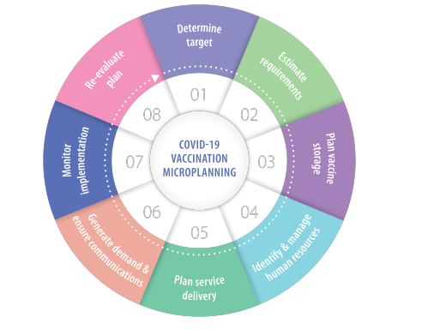
Considerations for optimizing the COVID-19 vaccine country portfolio (1/4)
The following slides present considerations considering the WHO eight-step process for COVID-19 vaccine operational microplanning.
Eight-step process for COVID-19 vaccination operational microplanning¹
  Define country goals and targets for 2022 and beyond⁴, to vaccinate a certain number of persons in the higher priority-use groups OR certain percentage of the population
  In alignment with:
    National Deployment and Vaccination Plan for COVID-19 vaccines (NDVP)
    National Immunization Strategy (NIS)
  Considering:
    Global Vaccination Strategy² goal to vaccinate 70% of the global population against COVID-19 by mid-2022
      National targets may need to be adjusted based on age demographics and national objectives⁴
    Updated WHO SAGE roadmap³: primary series and boosters for higher risk priority-use groups before offering vaccine doses to lower risk priority-use groups.
    Highest priority-use: health workers, older adults, immunocompromised persons
    High priority-use: adults with comorbidities, pregnant women, teachers and other essential workers, disadvantaged socio-demographic populations at higher risk of severe COVID-19)
1. WHO, 16 November 2021: Guidance on operational microplanning for COVID-19 vaccination. https://www.who.int/publications/i/item/WHO-2019-nCoV-vaccination-microplanning-2021.1
2, WHO, 6 October 2021: Strategy to achieve global Covid-19 vaccination by mid-2022. https://cdn.who.int/media/docs/default-source/immunization/covid-19/strategy-to-achieve-global-covid-19-vaccination-by-mid-2022.pdf
3. WHO, 21 January 2022. Updated SAGE roadmap for prioritizing uses of COVID-19 vaccines. https://www.who.int/news/item/21-01-2022-updated-who-sage-roadmap-for-prioritizing-uses-of-covid-19-vaccines
4. WHO IVB. Setting national strategies to achieve optimal COVID-19 vaccination targets. An implementation tool. In publication.

Slide 9
Considerations for optimizing the COVID-19 vaccine country portfolio (2/4)
  Estimate requirements, plan vaccine storage, identify & manage human resources:
  SUPPLY AVAILABLE by product through COVAX and other sources (IMF/WHO supply projections)
  COST & BUDGET: vaccines price range (when relevant), surge in human resources & per diems, transportation for outreach, social mobilization and cold chain (CVIC tool and macroeconomic outlook dashboard)
  REGULATORY REQUIREMENTS
  STORAGE & SHELF LIFE:
    Ultra cold chain requirements for distribution and storage (e.g. Pfizer) might pose challenges in some national or subnational settings (e.g. rural, conflict, migrant)
    Depending on the cold chain storage capacity, products requiring standard refrigeration (+2 to +8°C) may be preferred (e.g. AstraZeneca/SII, Sinopharm, Sinovac, Bharat, Novavax)
  PRESENTATION & WASTAGE:
    While single / small dose (e.g. Sinopharm, Sinovac, Bharat, Novavax²) may reduce vaccine wastage specially in low population density settings, multi dose vials reduce requirement of cold chain space (e.g. Pfizer, Moderna, AstraZeneca/SII, Janssen, Sinopharm, Sinovac, Bharat, Novavax)
    Liquid vaccines that do not require reconstitution may be simpler to administer (e.g. Pfizer -ready-to-use formulation- , Moderna, AstraZeneca/SII, Janssen, Sinopharm, Sinovac, Bharat, Novavax)
  DOSE-SCHEDULE & REQUIREMENTS BY POPULATION GROUP:
    For most of the products, primary series is 2 doses.
    One-dose schedule product (Janssen) may be preferred for use in hard-to-reach populations (however 2 doses has higher efficacy for all clinical endpoints compared to a single dose)³
    For Sinovac and Sinopharm, third dose needed for ≥60 years (+3-6m):
    For all products:
      Additional dose for immunocompromised persons (+1-3 months)
      Booster (+4-6 months)
    Consider either HOMOLOGOUS or HETEROLOGOUS SCHEDULES for primary series and boosters
Eight-step process for COVID-19 vaccination operational microplanning¹
WHO, 16 November 2021: Guidance on operational microplanning for COVID-19 vaccination. https://www.who.int/publications/i/item/WHO-2019-nCoV-vaccination-microplanning-2021.1
The single dose presentation is not available through COVAX.
WHO SAGE. 9 December 2021: https://www.who.int/publications/i/item/WHO-2019-nCoV-vaccines-SAGE-recommendation-Ad26.COV2.S-2021.1

Slide 10

Heterologous schedules (use of different vaccines) for primary vaccination series and booster doses
WHO considers two doses of ANY EUL vaccines, homologous or heterologous, to constitute a complete primary series. Likewise, any EUL vaccine can be used for the booster dose regardless of what was used for the primary doses, with one exception regarding inactivated vaccines.
Some heterologous schedules have been shown to have superior immune response and effectiveness compared to homologous schedules(i.e., when the same vaccine is used for all doses)⁶.
Heterologous schedules also have an acceptable level of local reactions and no serious adverse events have been reported so far⁶.
If heterologous are considered, WHO recommends¹ the following sequence²:
Initial dose or second dose³ of primary series | Subsequent doses (to finalize primary series³) or booster | Recommendations
Inactivated vaccine⁴ (Sinopharm BBIP, Sinovac) | Viral vector vaccine (AstraZeneca/SII, Janssen) | Inactivated vaccines are not considered for a second dose unless they were administered as a first dose. Inactivated vaccines are not considered for a booster (unless they were used for the primary series) Countries implementing inactivated vaccines for initial doses may consider using vectored or mRNA vaccines for subsequent doses.
 | mRNA vaccine (Pfizer, Moderna)
Viral vector (Vv) vaccine (AstraZeneca/SII, Janssen) | mRNA vaccine (Pfizer, Moderna) | Countries implementing vectored vaccines for initial doses may consider using mRNA vaccines or protein subunit vaccine for subsequent doses.
 | Protein subunit vaccine⁵(Novavax)
mRNA vaccine (Pfizer, Moderna) | Viral vector vaccine (AstraZeneca/SII, Janssen) | mRNA vaccines may be considered in all cases to complete primary series and/or booster. Countries implementing mRNA vaccines for initial doses may consider using viral vector vaccines or protein subunit vaccine* for subsequent doses.
 | Recombinant protein subunit vaccine*
 | Protein subunit vaccine⁵ (Novavax)
1. WHO SAGE. Interim recommendations for heterologous COVID-19 vaccine schedules. 16 December 2021. https://www.who.int/publications/i/item/WHO-2019-nCoV-vaccines-SAGE-recommendation-heterologous-schedules
2. With heterologous schedules, the order of the vaccines administered may affect the immune response. 3. The subsequent doses to finalize primary series could be the second dose, or the third dose in immunocompromised persons and adults ≥60 years who received 2 doses of Sinovac or Sinopharm. 4. Refers only to inactivated BIBP/Sinopharm and Coronavac COVID-19 vaccines. 5. Evidence limited to one study assessing the use of Novavax in primary heterologous vaccination, and to one study assessing the use of Novavax as a booster dose. 6. Parker EPK, et al. Emerging evidence on heterologous COVID-19 vaccine schedules-To mix or not to mix? Lancet Infect Dis. 2022 Mar 9:S1473-3099(22)00178-5. doi: 10.1016/S1473-3099(22)00178-5

Slide 11
Considerations for optimizing the COVID-19 vaccine country portfolio (3/4)
  Plan service delivery, generate demand & ensure communications, and monitor implementation:
  DELIVERY STRATEGIES:
    Vaccine-specific characteristics, such as dosage and cold chain requirements should be considered when defining delivery strategies to reach adults (health facility based / community-based outreach sites/mobile teams/mass vaccination)
    Where possible, integration with routine immunization and other primary health services (e.g. ANC for vaccination of pregnant women) should be explored
  HEALTH WORKERS TRAINING:
    Training on use of multiples vaccines and heterologous schedules
    Job aids/FAQs to prevent programmatic errors due to use of multiple vaccines and address population questions on use of multiple vaccines
  COST & BUDGET: ensure availability and accessibility on time for delivery strategies and training
  ACCEPTANCE:
    Explore if the community has hesitancy or preference for a specific vaccine (e.g. for new products using platforms of other existing routine vaccines: Novavax)
  MONITORING:
    Define how vaccinators will register new COVID-19 vaccine products and reminder systems for future doses (to prevent delays in administering subsequent doses and boosters)
  AEFI SURVEILLANCE:
    Identify how AEFI will be monitored, reported by product and cases assessed
Eight-step process for COVID-19 vaccination operational microplanning¹
1. WHO, 16 November 2021: Guidance on operational microplanning for COVID-19 vaccination. https://www.who.int/publications/i/item/WHO-2019-nCoV-vaccination-microplanning-2021.1

Slide 12
Considerations for optimizing the COVID-19 vaccine country portfolio (4/4)
Eight-step process for COVID-19 vaccination operational microplanning¹
  Re-evaluate plan:
  If vaccination targets are not being met or as monitoring detects additional needs for resource delivery and improving vaccine uptake among high-risk groups and vulnerable individuals
  If new COVID-19 vaccine products become available
1. WHO, 16 November 2021: Guidance on operational microplanning for COVID-19 vaccination. https://www.who.int/publications/i/item/WHO-2019-nCoV-vaccination-microplanning-2021.1

Slide 13
3. Additional information to support choosing COVID-19 vaccine products
Glossary of definitions
Vaccine effectiveness against Omicron and impact
Platform description of the COVID-19 vaccine products
Summary of WHO SAGE Interim recommendations by COVID-19 vaccine
Number of doses of primary series of Ad26.COV 2-S (Janssen) COVID-19 vaccine
Summary of key cold chain and storage attributes by COVID-19 vaccine
WHO SAGE updated roadmap for prioritizing uses of COVID-19 vaccines
COVID-19 vaccination for immunocompromised persons
COVID-19 vaccination for pregnant women
COVID-19 vaccination for children and adolescents
Co-administration of COVID-19 vaccines with other vaccines
Persons with past SARS-CoV-2 infection or current COVID-19
Overview of COVID-19 19 vaccination costing models/tools

Slide 14
Glossary of definitions
A
Primary vaccination series: Standard vaccination series consisting of the number of doses/schedule as defined in the product-specific EUL (for most WHO EUL vaccines, this is a two-dose schedule).
Extended primary vaccination series: Additional doses of a vaccine needed as part of an extended primary series for specific populations where the immune response rate following the standard primary series is deemed insufficient (such as moderately to severely immunocompromised individuals or older adults).
Booster dose: Dose administered to a vaccinated individual/population that has completed a primary vaccination series when, with time, the immunity and clinical protection has fallen below a rate deemed sufficient. The objective of a booster dose is to restore vaccine effectiveness.
Homologous schedule: use of the same vaccine for all doses.
Heterologous schedule: use of different vaccines for different doses.
  Heterologous primary vaccination: use of different COVID-19 vaccine products from that used for the first dose, within a primary vaccination series (for the second dose) or extended primary vaccination (for the third dose)
  Heterologous boosting: use of a different COVID-19 vaccine product(s) than previously used for a homologous or heterologous primary vaccination series or primary extended COVID-19 vaccination series.
Source: WHO SAGE: COVID-19 vaccine technical documents. https://www.who.int/groups/strategic-advisory-group-of-experts-on-immunization/covid-19-materials , WHO SAGE. Interim recommendations for an extended primary series with an additional vaccine dose for COVID-19 vaccination in immunocompromised persons. 26 October 2021: https://www.who.int/publications/i/item/WHO-2019-nCoV-vaccines-SAGE_recommendation-immunocompromised-persons

Slide 15















In the context of Omicron, COVID-19 vaccines continue to provide strong protection against severe disease (1/3)
B
32 studies provide information on how vaccines perform against Omicron
Findings
  Primary series:
    Compared to Delta, lower primary series vaccine effectiveness (VE) against infection, disease, and hospitalization
    Primary series VE against infection and disease declines over time to negligible effectiveness levels at ~3-6 months
    Primary series VE against hospitalization/severe disease appears to decline over time but large confidence interval (CI). Maintained above 50%
  Booster dose:
    Booster dose increases VE against all outcomes, but still less than Delta and some early evidence of potential waning
    Booster dose VE against hospitalization/severe disease ~ 80-90%
Conducted in 13 countries
Canada
Czech Republic
Denmark
Israel
Netherlands
Norway
Portugal
Qatar
South Africa
Spain
Sweden
UK
USA
With 4 vaccines considered
Limitations
  Pfizer, Moderna, AstraZeneca, Janssen
Minimal data for some VE estimates with large CI
Early Omicron cases might have different risk profile
Residual confounding
Severe disease might include persons incidentally infected with omicron rather than due to omicron
  No VE data on inactivated vaccines
https://www.who.int/publications/m/item/weekly-epidemiological-update-on-covid-19---22-february-2022
COVID-19 data. VIEW-hub by IVAC. https://view-hub.org/covid-19/effectiveness-studies

Slide 16
COVID-19 vaccine primary series protection declines over time, especially against infection and symptomatic disease (2/3)
Primary vaccine
received before Booster
xx
A
AstraZeneca
Janssen
Moderna
Pfizer
No data available
Range of vaccine effectiveness¹, %
J
M
P
0%
100%
Primary series VE
< 3 months
> 3 months
Pfizer
Severe disease
  Key take-aways about primary series:
      Primary series VE declines over time for all outcomes (especially again infection and symptomatic disease) to negligible effectiveness levels at ~3-6 months
      Primary series VE higher against hospitalization/severe disease appears to decline over time but large confidence interval (CI). Maintained above 50%
70-74
35-81
Infection/
Disease
55-65
10-40
Moderna
Severe disease
64-77
Infection/
Disease
37-76
0-26
Astrazeneca
Severe disease
33-56
Infection/
Disease
50
0-10
Janssen
Severe disease
https://www.who.int/publications/m/item/weekly-epidemiological-update-on-covid-19---22-february-2022
COVID-19 data. VIEW-hub by IVAC. https://view-hub.org/covid-19/effectiveness-studies
Note: 1.When several studies apply to this category, a range is displayed

Slide 17
COVID-19 vaccine booster dose increases protection against all outcomes (3/3)
Primary vaccine
received before Booster
xx
A
AstraZeneca
Janssen
Moderna
Pfizer
No data available
Range of vaccine effectiveness¹, %
J
M
P
0%
100%
Primary series VE
Booster dose VE
< 3 months
> 3 months
< 3 months
> 3 months
Pfizer
Severe disease
  Key take-aways about booster dose:
      Booster dose increases VE against all outcomes
      Booster dose VE against hospitalization/severe disease is ~80-90%
70-74
35-81
87
88-91
78
76-90
A
P
A
P
Infection/
Disease
55-65
10-40
63
66
57-78
30
40-48
A
M
P
A
P
Moderna
Severe disease
64-77
91
81
92
A
M
P
Infection/
Disease
37-76
0-26
71
55-72
74
64
A
M
P
P
Astrazeneca
Severe disease
33-56
Infection/
Disease
50
0-10
Janssen
Severe disease
84
J
https://www.who.int/publications/m/item/weekly-epidemiological-update-on-covid-19---22-february-2022
COVID-19 data. VIEW-hub by IVAC. https://view-hub.org/covid-19/effectiveness-studies
Note: 1.When several studies apply to this category, a range is displayed

Slide 18
Real world impact of COVID-19 vaccination
 | Difusco et al¹ | Marcellusi et al² | Haas et al³
Country | USA (population ~330 million) | Italy (population ~60 million) | Israel (population ~9 million)
Vaccine | BNT162b2 | BNT162b2, mRNA-1273, Ad26.COV2.S, ChAdOx1-S | BNT162b2
Time Frame | January-December 2021 | June-December 2021 | December 2020-April 2021
# Cases Averted | 8,663,085 (symptomatic) |  | 158,665 (infection)
# Hospitalizations Averted | 689,797 | 2,379,144 | 24,597
# Deaths Averted | 111,380 | 52,115 | 5532
Direct Cost Savings | 30.4 billion USD | 2.9 billion Euros
Indirect Cost Savings (productivity loss) | 43.7 billion USD
Haas, E. J., et al. (2021). Infections, hospitalisations, and deaths averted via a nationwide vaccination campaign using the Pfizer–BioNTech BNT162b2 mRNA COVID-19 vaccine in Israel: a retrospective surveillance study. The Lancet Infectious Diseases. https://doi.org/10.1016/S1473-3099(21)00566-1
di Fusco, M., et al. (2022). Public Health Impact of the Pfizer-BioNTech COVID-19 vaccine (BNT162b2) in the first year of rollout in the United States. MedRxiv, 2022.02.24.22271478. https://doi.org/10.1101/2022.02.24.22271478
Marcellusi, A.,et al. (2022). The Impact of COVID-19 Vaccination on the Italian Healthcare System: A Scenario Analysis. Clinical Drug Investigation. https://doi.org/10.1007/s40261-022-01127-9

Slide 19
Platform description of the COVID-19 vaccine products
C
COVID-19 vaccines have been developed across various platforms (technology underlying the design of a vaccine) but all of them to date aim to induce the human immune response against SARS-CoV-2 spike protein
VACCINE PLATFORMS | MANUFACTURER & BRAND NAME | DESCRIPTION
Messenger Ribonucleic acid (mRNA) | COMIRNATY ® (Pfizer BioNTech) | mRNA vaccines provide the instructions to human cells to make part of the SARS-CoV-2 spike protein The spike protein triggers the recipient’s immune system to develop a protective response which defends against future exposure to SARS-CoV-2
 | SPIKEVAX ® (Moderna)
Recombinant viral vector | VAXZEVRIA ® (AstraZeneca) | A modified virus (the viral vector), other than the virus causing COVID-19, is used to deliver the instructions to human cells to make part of the SARS-CoV-2 spike protein The spike protein triggers the recipient’s immune system to develop a protective response which defends against future exposure to SARS-CoV-2
 | COVISHIELD ® (Serum Institute of India)
 | Ad26.COV 2-S ® (Janssen)
Inactivated virus | CORONAVAC ® (Sinovac Life Sciences) | An inactivated vaccine consists of killed virus or particles that are recognized by the immune system to elicit an immune response (examples of other vaccines are influenza vaccines) including the spike protein
 | Inactivated SARS-CoV-2 vaccine ® (BIBP/Sinopharm)
 | COVAXIN ® (Bharat Biotech)¹ | Covaxin
Recombinant spike protein nanoparticle | COVOVAX ® (Serum Institute of India) | Subunit vaccines contain specific fragments of the SARS-CoV-2 spike protein, which have been carefully selected to produce combinations of these molecules likely to produce a strong and effective immune response (examples of other vaccines are pertussis, HPV and HepB)
 | NUVAXOVID ® (Novavax, Inc.)
Note: 1. Covaxin has a novel adjuvant, imidazoquinoline class molecule (toll-like receptor (TLR) 7/8 agonist) (IMDG) adsorbed to alum (Algel-IMDG) as opposed to alum alone for Sinovac and Sinopharm. This has an implication since the WHOSAGE recommendation for an additional dose in those 60+ years of age only applies to Sinovac and Sinopharm and not to Covaxin.
Source: WHO: EPI-WIN. Update on COVID-19 vaccines & immune response. 3 February 2022 https://www.who.int/docs/default-source/coronaviruse/risk-comms-updates/update73_covid-19-vaccines-and-immune-response.pdf?sfvrsn=7902cc35_5

Slide 20
Summary of WHO SAGE Interim recommendations by COVID-19 vaccine (1/2)
D
 | COMIRNATY ® (Pfizer BioNTech) | SPIKEVAX ® (Moderna) | COVISHIELD ® (Serum Institute of India) VAXZEVRIA ® (AstraZeneca) ChAdOx1-S [recomb.] | Ad26.COV 2-S ® (Janssen)
Latest SAGE update | 21 January 2022 | 23 February 2022 | 15 March 2022 | 9 December 2021
Vaccine Platform | mRNA vaccine |  | Recombinant viral vector | Recombinant viral vector
Efficacy against severe disease/hospitalization¹ | 91%(95% CI 89−93%)² | 98% (95% CI: 93–100%) | 72%(95% CI: 63–79%)² | 77% (95% CI: 55–89)
Dosage/Schedule | Primary series: 2 doses (interval 4-8 weeks doses, pref. 8 weeks) Add’l dose for ICPs (+1-3m) | Primary series: 2 doses (interval 4-8 weeks, pref. 8 weeks) Add’l dose for ICPs (+1-3m) | Primary series: 2 doses (interval 8-12 weeks) Add’l dose for ICPs (+1-3m) | Primary series: 1 dose or 2 doses³ (interval 8-12 weeks) Add’l dose for ICPs (+1-3m)
Booster | Booster⁴: +4-6 months last dose | Booster⁴: +4-6 months last dose
Intended use | 5 years and above⁵(once other priority groups vaccinated) | 12 years and above (once other priority groups vaccinated) | 18 years and above | 18 years and above
Use by pregnant women⁶ | Recommended |  | Recommended
Use when breastfeeding | Recommended |  | Recommended
Note: This table presents summarized key information. For additional information and full details access COVID-19 vaccines WHO EUL page, the WHO vaccine explainers and the WHO SAGE Interim recommendations.
Vaccine efficacy results are not comparable across vaccine products due to different case definitions of endpoints, and also because the studies were conducted at different periods of time where different variants were circulating.
2. Efficacy against symptomatic disease of any severity. 3. Two doses have higher efficacy for all clinical endpoints compared to a single dose. 4. For Janssen, the product label calls the second dose a “booster”. The need for a booster beyond two doses is being assessed. 5. The Pfizer vaccine authorized for children 5-11 years has a lower doses that authorized for those 12+ years (10 ug in 0.2 ml compared to 30 ug in 0.3 ml). 6. https://www.who.int/publications/i/item/WHO-2019-nCoV-FAQ-Pregnancy-Vaccines-2022.1 ICPs = Immunocompromised persons

Slide 21
Summary of WHO SAGE Interim recommendations by COVID-19 vaccine (2/2)
 | Inactivated SARS-CoV-2 vaccine ® (BIBP/Sinopharm) | CORONAVAC ® (Sinovac Life Sciences) | COVAXIN ® (Bharat Biotech) | COVOVAX ® (Serum Institute of India) NUVAXOVID ® (Novavax, Inc.)
Latest SAGE update | 15 March 2022 | 15 March 2022 | 15 March 2022 | 20 December 2021
Vaccine Platform | Inactivated virus |  |  | Recombinant spike protein nanoparticle
Efficacy against severe disease/hospitalization¹ | 79% (95% CI: 26–94%) | 100% (95% CI: 56–100%) | 93% (95% CI: 57–99%) | 87% (95% CI: 74–94)
Dosage/Schedule | Primary series: 2 doses (interval 3-4 weeks) Add’l dose for ICPs (+1-3m) and ≥60 years (+3-6m) | Primary series: 2 doses (interval 4 weeks) Add’l dose for ICPs and (+1-3m) and ≥60 years (+3-6m) | Primary series: 2 doses (interval 4 weeks) Add’l dose for ICPs (+1-3m) | Primary series: 2 doses (interval 3-4 weeks) Add’l dose for ICPs (+1-3m)
Booster | Booster³: +4-6 months last dose
Intended use | 18 years and above | 18 years and above | 18 years and above | 18 years and above
Use by pregnant women⁴ | Recommended |  | Recommended | Recommended⁵
Use when breastfeeding | Recommended |  |  | Recommended
Note: This table presents summarized key information. For additional information and full details access COVID-19 vaccines WHO EUL page, the WHO vaccine explainers and the WHO SAGE Interim recommendations. 1. Vaccine efficacy results are not comparable across vaccine products due to different case definitions of endpoints, and also because the studies were conducted at different periods of time where different variants were circulating. 2. Covaxin has a novel adjuvant, imidazoquinoline class molecule (toll-like receptor (TLR) 7/8 agonist) (IMDG) adsorbed to alum (Algel-IMDG) as opposed to alum alone for Sinovac and Sinopharm. This has an implication since the WHOSAGE recommendation for an additional dose in those 60+ years of age only applies to Sinovac and Sinopharm and not to Covaxin. 3. WHO SAGE. Interim recommendations for heterologous COVID-19 vaccine schedules. 16 December 2021. https://www.who.int/publications/i/item/WHO-2019-nCoV-vaccines-SAGE-recommendation-heterologous-schedules 4. .https://www.who.int/publications/i/item/WHO-2019-nCoV-FAQ-Pregnancy-Vaccines-2022.1 5. Because of the limited experience with the MatrixMTM adjuvant of the Novavax NVX-Co2373 vaccine in pregnancy, the benefit-risk assessment for this vaccine includes considering whether any other WHO EUL COVID-19 vaccine with a more established safety record in pregnancy is locally available. ICPs = Immunocompromised persons; m = months.

Slide 22
Number of doses of primary series of Ad26.COV 2-S (Janssen) COVID-19 vaccine
E
While this vaccine received EUL for a single dose (0.5ml given intramuscularly into deltoid muscle), the findings from a Phase 3 trial involving two doses, given 2 months apart, showed that two doses have higher efficacy for all clinical endpoints compared to a single dose.
Limited data show continued high vaccine effectiveness against hospitalization in the presence of Omicron.
Countries can choose to use Ad26.COV2.S as a schedule with a single or two doses taking into account considerations such as supply availability and access, hard-to-reach populations and programmatic implementation of the WHO Prioritization Roadmap.
WHO highlights the benefit of two doses and recommends an inter-dose interval of 2 to 6 months, depending on the epidemiological situation, and needs for certain subpopulations.
WHO SAGE. 9 December 2021: https://www.who.int/publications/i/item/WHO-2019-nCoV-vaccines-SAGE-recommendation-Ad26.COV2.S-2021.1
Notes:
Omicron: Sisonke data, *Bekker et al., medRxiv 2021
There is also data on robust immunological cross-reactivity

Slide 23
Summary of key cold chain and storage attributes by COVID-19 vaccine
F
 | COMIRNATY ® (Pfizer BioNTech) | COMIRNATY ® (Pfizer BioNTech) |  | SPIKEVAX ® (Moderna) | COVISHIELD ® (Serum Institute of India) VAXZEVRIA ® (AstraZeneca) ChAdOx1-S | Ad26.COV 2-S ® (Janssen) | Inactivated SARS-CoV-2 vaccine ® (BIBP/Sinopharm) | CORONAVAC ® (Sinovac Life Sciences) | COVAXIN ® (Bharat Biotech) | COVOVAX ® (Serum Institute of India) NUVAXOVID ® (Novavax, Inc.)
 | Ready-to-use formulation Tris/Sucrose)¹ ^{GREY CAP} ^{12 years and older} | With dilution ^{PURPLE CAP} ^{12 years and older} | With dilution ^{ORANGE CAP} ^{5-11 years old}
Platform | Messenger RNA | Messenger RNA |  |  | Recombinant Viral Vector |  | Inactivated Virus |  |  | Recombinant spike protein nanoparticle
Presentation/ number of doses | Vial / 6 doses | Vial/6 doses (after dilution) | Vial/10 doses (after dilution) | Vial / 10 doses | Vial / 2 or 10 doses | Vial / 5 doses | Single-dose pre-filled AD syringes and 1, 2 or 5 dose vials | Single-dose in pre-filled non-AD syringes and 1 or 2 dose vials | Vial / 1, 5, 10 or 20 doses | Vial / 1 or 10 doses²
Diluent | No¹ | Yes | Yes | No
Syringe | ADS 0.3 mL | ADS 0.3 ml | ADS 0.2 ml | ADS 0.5 mL
Cold chain requirements | Ultra-cold chain: -90 ºC to -60 ºC Refrigerador: +2 ºC to +8°C ² | Ultra cold chain: -90° °C to -60 ºC Freezer: -25°C to -15 °C Refrigerador: +2 ºC to +8 °C | Ultra-cold chain: -90 °C to -60 ºC Refrigerador: +2 ºC to +8°C ² | Freezer: –25 ºC to –15 ºC Refrigerator: +2 ºC to +8 °C | Refrigerator: +2 °C to +8 °C | Freezer: –25 ºC to –15 ºC Refrigerator: +2 °C to +8 °C | Refrigerator: +2 °C to +8 °C | Refrigerator: +2 °C to +8 °C | Refrigerator: +2 °C to +8 °C | Refrigerator: +2 °C to +8 °C
Shelf-life | -90 °C to -60 °C: 9 m +2 °C to +8 °C: 10 wks | -90 °C to -60 °C: 9 m -25°C to -15°C: 2 wks +2 °C to +8 °C: 1m | -90 °C to -60 °C: 9 m +2 to +8 °C: 10 wks | -25 °C to -15 °C: 9 m +2 °C to +8 °C: 1 m | COVISHIELD: +2 °C to +8 °C 9 m VAXZEVRIA: +2 °C to +8 °C 6m | -25 ºC to -15 °C: 24 m +2°C to +8 °C: 11m | +2 °C to +8 °C: 24 m | +2 °C to +8 °C: 12 m | +2 °C to +8 °C: 9 m | +2 °C to +8 °C: 9 m
Cold chain volume | Depending on product/vial size (range 1.91 to 2.57 cm³/dose) | 1.8 cm³/dose | Depending on product/vial size (range 1.15 to 1.54 cm³/dose) | 4.3 cm³/dose | Depending on product/vial size (range 2.1 to 7.0 cm³/dose) | 3.82 cm³/dose | Depending on product/vial size (range 4.2 to 124.9 cm³/dose) | Depending on product/vial size (range 8.15 to 41.65 cm³/dose) | Depending on product/vial size (range 1.72 to 14.45 cm³/dose) | Depending on product/vial size (range 2.05 to 15.82 cm³/dose)
Handling of opened multidose-vials | Discard opened vials 6 hours after first puncture or at end of immunization session, whichever comes first | Discard opened vials 6 hours after first puncture or at end of immunization session, whichever comes first |  |  |  |  |  |  | Opened vaccine can be kept and used for up to 28 days after first puncture, as per WHO MDVP Statement | Discard opened vials 6 hours after first puncture or at end of immunization session, whichever comes first
Note: This table presents summarized key information as of 16 March 2022. For additional information and full details access COVID-19 vaccines WHO EUL page, the WHO vaccine explainers and the WHO SAGE Interim recommendations ¹ Pfizer RTU (TRIS/sucrose) will be supplied in April 2022. ² DO NOT store at -25°C to -15°C (Freezer). It will be delivered to countries frozen at -90° to -60ºC. 2. Only 10 dose presentation for COVAX. m = months, wks=weeks.

Slide 24
Main recommendations of the updated WHO SAGE Roadmap for prioritizing uses of COVID-19 vaccines
G
Countries with low rates of primary series coverage should first achieve high primary series coverage rates among the higher risk priority-use groups before offering vaccine doses to lower risk priority-use groups ⁽¹⁾ .
    Note: As older adults comprise a large fraction of the higher and highest priority groups, settings unable to access or deliver vaccines to older adults should consider prioritizing new delivery systems specifically to achieve high coverage rates in this subgroup.
    (1) As more vaccine becomes available, lower priority-use groups should be offered vaccine, considering national epidemiological data and other relevant considerations. Lower priority-use groups should not be offered primary series doses before higher priority-use groups have been offered primary series doses, unless vaccine programmes encounter significant vaccine delivery or acceptability obstacles to uptake in higher priority-use groups that would result in vaccine wastage. In such cases, community engagement and social mobilization efforts to reach higher priority-use groups should be prioritized.
Countries with moderate-to-high primary series coverage rates in higher risk priority-use groups should usually⁽²⁾ prioritize available vaccine supply to first achieve high booster dose coverage rates in higher risk priority-use groups before offering vaccine doses to lower priority-use groups.
    (2) In some circumstances, there may be a relatively close trade-off in optimizing the impact of vaccine use between offering booster doses to older adults to avert more hospitalizations and deaths versus offering primary series doses to the remaining adults, adolescents, and children, that depend on country conditions, including supply and rollout timelines, past epidemic dynamics and infection-induced immunity, vaccine product, vaccine effectiveness, and waning of protection.
1
2
Source: WHO. Updated WHO SAGE Roadmap for prioritizing uses of COVID-19 vaccines. 21 January 2022. https://www.who.int/news/item/21-01-2022-updated-who-sage-roadmap-for-prioritizing-uses-of-covid-19-vaccines

Slide 25
The new WHO SAGE roadmap has re-emphasised the need for a step-wise approach and has incorporated the need for boosters in the recommendation
  Higher priority-use groups should be prioritized:
  Through primary series of high priority-use groups (I& II) vaccination in countries with low/moderate coverage rates
  Through boosters in higher risk priority-use groups (I&II)
  Through primary series vaccination in countries with moderate-to-high primary series coverage rates in medium risk priority-use groups (III)
  Boosters for medium priority-use groups (III)
Priority-use groups† | Vaccine coverage rates of higher priority-use (I & II) groups
 | Low (>10%) | Moderate (10-40%) | High (41-70%) | Very high (≥70%)
I. Highest priority-use Older adults; *immunocompromised persons; health workers
II. High priority-use Adults with comorbidities; pregnant persons; teachers and other essential workers; disadvantaged socio-demographic subpopulations at higher risk of severe COVID-19
III. Medium priority-use Remaining adults; children and adolescents with comorbidities
IV. Lowest priority-use Healthy children and adolescents ​
1
1
2a
2a
Primary series + Additional dose
+ Booster
2b
Primary series
+ Booster
2b
3
3
Primary series
+ Booster
4
  As vaccine rates of higher priority-use groups increase, vaccine doses can be administered to lower priority-use groups (IV)
4
Primary series + Booster¹
¹Booster doses in children below 12 years have not yet been assessed
Source: WHO, Updated WHO SAGE Roadmap for prioritizing uses of COVID-19 vaccines. 21 January 2022. https://www.who.int/news/item/21-01-2022-updated-who-sage-roadmap-for-prioritizing-uses-of-covid-19-vaccines

Slide 26
COVID-19 vaccination for immunocompromised persons (1/2)
H
Immunocompromised persons (ICPs) includes persons with inmunocompromisng conditions and those receiving immunosuppressive treatment
Table 1. Moderately to severely ICPs (not exhaustive list). This definition applies to all vaccine-eligible age groups.
Group | Details
Active cancer | Active immunosuppressive treatment for solid tumour or haematological malignancy (including leukaemia, lymphoma, and myeloma), or within 12 months of ending such treatment
Transplant recipients | Receipt of solid organ transplant and taking immunosuppressive therapy Receipt of stem cell transplant (within 2 years of transplantation, or taking immunosuppressive therapy)
Inmunodeficiency | Severe primary immunodeficiency Chronic dialysis
Inactivated virus
HIV | HIV with a current CD4 cell count of <200 cells/μl, evidence of an opportunistic infection, not on HIV treatment, and/or with a detectable viral load (i.e. advanced HIV disease)
Inmuno suppressives | Active treatment causing significant immunosuppression, including high-dose corticosteroids, alkylating agents, antimetabolites, transplant-related immunosuppressive drugs, cancer chemotherapeutic agents, tumour-necrosis factor (TNF) blockers, or other highly immunosuppressive drugs Immunosuppressive chemotherapy or radiotherapy within the past 6 months
WHO SAGE. Interim recommendations for an extended primary series with an additional vaccine dose for COVID-19 vaccination in immunocompromised persons. 26 October 2021: https://www.who.int/publications/i/item/WHO-2019-nCoV-vaccines-SAGE_recommendation-immunocompromised-persons

Slide 27
COVID-19 vaccination for immunocompromised persons (2/2)
Recommendations for ICPs
The primary vaccine series in ICPs should include an additional dose for all EUL COVID-19 vaccines. An additional dose is different from a booster dose.
This additional dose should be given at least 1 month and within 3 months after the primary series in order to increase protection for ICPs. If more than 3 months have elapsed since the last dose in the standard primary series, the additional dose in an extended primary series should be given at the earliest opportunity.
For individuals receiving or scheduled to receive immunosuppressive therapy, the most appropriate timing for the additional dose may vary depending on the epidemiological setting and the timing and extent of the immunosuppressive therapy, and should be discussed with the treating physician.
A homologous additional dose in an extended primary series should currently be considered standard practice, but alternative heterologous platforms for the additional dose may also be considered.
Covid-19 risk
If infected, ICPs are more likely to become severely ill from COVID-19 than non-ICPs.
Safety and efficacy in ICPs
Multiple clinical trials and post-introduction observational studies have shown that ICPs often fail to mount an adequate response to a primary series of COVID-19 vaccine, as reflected by lower protective immune response rates and vaccine effectiveness (VE) compared with non-ICPs. These findings appear to be consistent across vaccine platforms and products.
Overall, the current evidence suggests that an additional dose increases the immune response rate of the primary vaccination series in ICPs.
WHO SAGE. Interim recommendations for an extended primary series with an additional vaccine dose for COVID-19 vaccination in immunocompromised persons. 26 October 2021: https://www.who.int/publications/i/item/WHO-2019-nCoV-vaccines-SAGE_recommendation-immunocompromised-persons

Slide 28

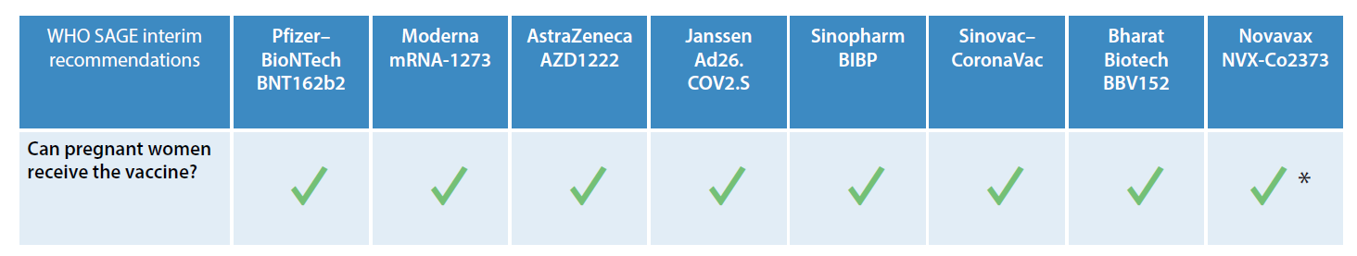
COVID-19 vaccination for pregnant women
I
COVID-19 risk and considerations for vaccination of pregnant women
Given the substantial risks from COVID-19 during pregnancy, it is critical to ensure pregnant women and those planning to become pregnant, have access to WHO EUL-approved COVID-19 vaccines as soon as available
Increasing evidence on the safety and effectiveness of COVID-19 vaccination during pregnancy suggests that the benefits of vaccination during pregnancy outweigh potential risks whenever there is ongoing or anticipated community transmission of the virus.
COVID-19 vaccines during pregnancy
Safety and efficacy in pregnant women
To date, animal studies, monitoring of pregnant women who have received the vaccines, and experience using vaccines with similar components have not identified any pregnancy-specific safety concerns.
Based on experience with other vaccines used during pregnancy, all of the WHO EUL-approved COVID-19 vaccines are expected to work as well in pregnant women as in nonpregnant people.
Studies have shown that pregnant women who get COVID-19 vaccines develop antibodies that are present in babies’ umbilical cord blood. This suggests that babies may receive protective benefits from the vaccine, in addition to the benefits for pregnant women.
Note: * Because of the limited experience with the MatrixMTM adjuvant of the Novavax NVX-Co2373 vaccine in pregnancy, the benefit-risk assessment for this vaccine includes considering whether any other WHO EUL COVID-19 vaccine with a more established safety record in pregnancy is locally available. Source: WHO, 15 February 2022. Questions and answers: COVID-19 vaccines and pregnancy. https://www.who.int/publications/i/item/WHO-2019-nCoV-FAQ-Pregnancy-Vaccines-2022.1

Slide 29
COVID-19 vaccination for children and adolescents
J
COVID-19 risk & considerations for vaccination
As children and adolescents tend to have milder disease compared to adults, unless they are in a group at higher risk of severe COVID-19, it is less urgent to vaccinate them than older people, those with chronic health conditions and health workers.
COVID-19 vaccines for children and adolescents
To date, none of the WHO EUL vaccines are recommended for children below 5 years of age.
Pfizer vaccine is safe to be used for those aged 5 and above. Moderna vaccine can be used for those aged 12 and above. The rest of the WHO EUL vaccines are recommended for adults.
mRNA vaccine primary series: two doses (2nd dose 4-8 weeks after the 1st dose, preferentially 8 weeks as a longer interval between doses is associated with higher vaccine effectiveness and potentially lower risk of myocarditis/pericarditis). A smaller dosage is required for children than for adults.
Safety and efficacy in children and adolescents
In Phase 2/3 trials for both mRNA vaccines, efficacy and immunogenicity were similar or higher compared to adults; safety and reactogenicity profiles in adolescents were similar to young adults.
A very rare signal of myocarditis/pericarditis has been reported with mRNA COVID-19 vaccines as some countries have started to use these vaccines in their COVID-19 programmes. The risk of myocarditis/pericarditis associated with SARS-CoV-2 infection is higher than the risk after vaccination.
Several COVID-19 vaccines are undergoing trials in younger age groups (including as young as 6 months of age), but results have not yet been published.
The need for, and timing of, booster doses for children aged 5-11 years has not yet been determined.
WHO SAGE. 24 November 2021. Interim statement on COVID-19 vaccination for children and adolescents: https://www.who.int/news/item/24-11-2021-interim-statement-on-covid-19-vaccination-for-children-and-adolescents

Slide 30
Co-administration of COVID-19 vaccines with other vaccines
K
Adults
  Based on several co-administration studies of COVID-19 vaccines and inferred from co-administration studies of other adult vaccines, COVID-19 vaccines may be given concomitantly, or any time before or after, other adult vaccines including live-attenuated, inactivated, adjuvanted, or non-adjuvanted vaccines.
  When administered concomitantly, the vaccines should be injected in separate sites, preferably different extremities.
Children and adolescents
  Evidence from co-administration studies is currently insufficient to make a recommendation for concomitant administration with COVID-19 vaccines.
WHO SAGE Interim recommendations

Slide 31
Persons with past SARS-CoV-2 infection or current acute COVID-19
L
Persons who have previously had SARS-CoV-2 infection
  Vaccination should be offered regardless of a person’s history of symptomatic or asymptomatic SARS-CoV-2 infection.
  Viral or serological testing for prior infection is not recommended for the purpose of decision-making about vaccination.
  Data from the pooled analyses indicate that the vaccine is safe in people with evidence of prior SARS-CoV 2 infection.
  With the emergence of Omicron, reinfections after prior infection appear to be more common. Hybrid immunity is superior to immunity induced by vaccine or infection alone.
  The optimal time interval between infection and vaccination is not yet known.
    Persons with laboratory-confirmed SARS-CoV 2 infection before primary series vaccination may choose to delay vaccination for 3 months.
    Persons with breakthrough infections following any dose could also consider delaying the next dose by 3 months.
Persons with current acute COVID-19
  Persons with acute PCR-confirmed COVID-19, including persons who are in-between doses, should not be vaccinated until after they have recovered from acute illness and the criteria for discontinuation of isolation have been met as per government advice.
  The optimal minimum interval between a natural infection and vaccination is not yet known. An interval of 3 months could be considered.
WHO SAGE Interim recommendations

Slide 32
Overview of COVID-19 19 vaccination costing models/tools
M
 | Global costing¹ | Gavi/UNICEF CDS Templates² | CVIC³ | HSRC⁴
Purpose | Costing for 133 LMICs for global resource mobilisation | CDS funding request. Estimates of 2022 national funding gap for COVID-19 vaccine delivery | National costing for strategic planning and global and domestic RM | National costing for operational country level planning and domestic RM
Primary target audience | Global stakeholders and donors | Gavi and UNICEF CDS funding application review committees | Governments, national and global stakeholders | Operational planners in EPI and Emergency units at national and sub-national level
Time horizon and reporting levels | 1-year global and national costs (in 2022) based expected vaccine supply and uptake. Model set up to estimate costs until end of 2023 | 1-year national costs (in 2022) based on expected vaccine uptake | 3-year annual national costs based on expected vaccine uptake | Monthly national and sub-national costs in 2022 (or in a year) based on expected vaccine supply
Break-down of costs | By 16 cost categories and by 4 delivery modalities | Gavi: 10 Gavi cost categories with mapping to 9 NDVP cost categories UNICEF: by 18 activities/items with mapping to 9 NDVP cost categories | By 9 NDVP cost categories and by 4 delivery modalities | By recurrent Vs capital costs and by staff (national), supplies, equipment and others (service contracts, pharmacovigilance and training)
Outputs | Total financial delivery cost estimates and per dose cost | Total CDS request | Total financial delivery cost estimates and per dose cost | Total financial delivery cost estimates and per dose cost
RM: resource mobilization
https://www.unicef.org/media/114216/file/Costs-and-Predicted-Financing-Gap-to-Deliver-COVID-19-Vaccines-in-133-Low-and-Middle-Income-Countries.pdf
https://www.gavi.org/news/document-library/gavi-covax-cds-budget and https://www.unicef.org/coronavirus/covax
https://www.who.int/publications/i/item/who-2019-ncov-vaccine_deployment_tool-2021.1
Forthcoming

Slide 33
4. COVAX demand planning (forecast) process

Slide 34
Updated March 16th 2022
Overview of the Demand Forecasting Process
GLOBAL
End of Month
Week 1
Week 2+3
Week 3+4
Week 5
Demand Planning Data Team(DPDT) collates information in into Country forecasting Template
DPDT validates data incl. quality checks with participant (if needed) + completes data analysis
Align with Demand & Supply SWAT
Allocation of COVAX doses by Joint Allocation Team
GAVI SCM sends link of
template to Participant Country
Submission to
Joint Allocation Team
1
Template uploaded to
Demand Planning SharePoint
2
Allocation
communicated
by SCMs
COUNTRY
Participant together with key country partners prepares and signs-off demand forecast for at least 6 months supplies from the COVAX Facility
Participants accept or refuse doses allocated and to update their demand outlook
UNICEF/PAHO COs to facilitate completion of demand forecast
Work done by COVAX
Work done by Participant
Touchpoints with country team

Slide 35
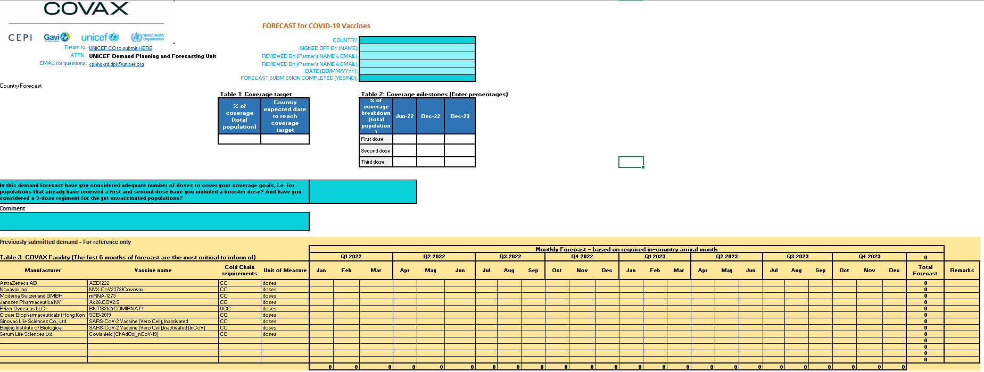
COVID-19 Vaccine Forecast Template -March 2022
Updated March 16th 2022
Table 1: Coverage Targets
Country expected date to reach coverage target
% of coverage (total population)
Table 2: Coverage milestones
% of coverage breakdown (total population) for 1st, 2nd and 3rd dose
Milestones: June 2022, December 2022 & December 2022
Table 3 ( in yellow) : Previously submitted demand
Includes countries previous demand requested and to be used as a reference toward updating current demand.

Slide 36
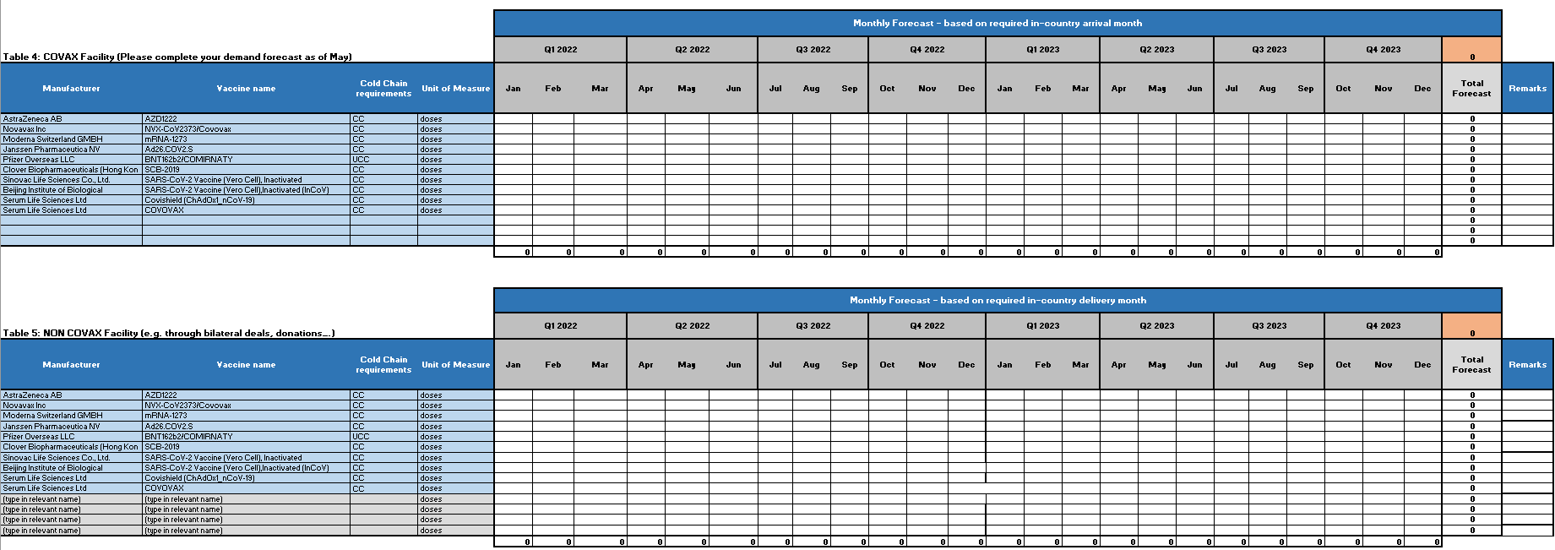
Updated March 16th 2022
COVID-19 Vaccine Forecast Template- March 2022
Table 4: COVAX Facility Forecast
Country forecast of COVID-19 vaccine through COVAX Facility with previous demand from Jan to April 22 locked.
Table 5 : NON COVAX Facility
Countries can specify any shipment of COVID-19 vaccine they plan to receive outside the COVAX Facility with the donor name in the comments

Slide 37
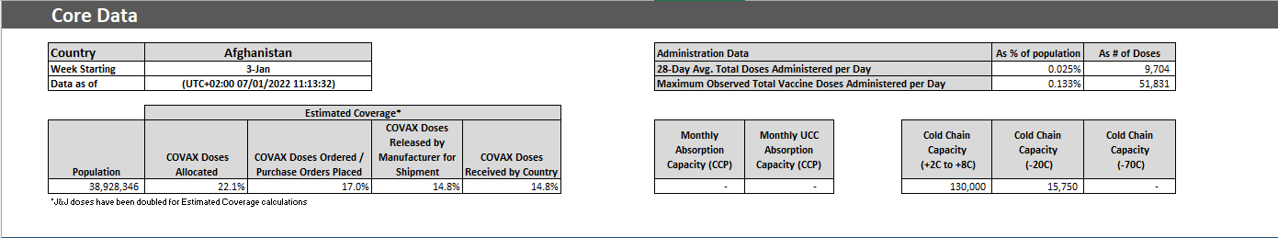
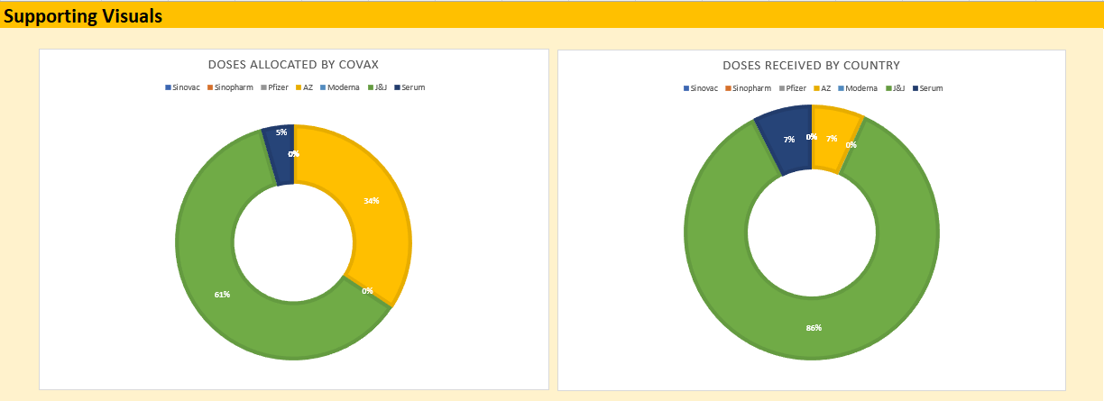
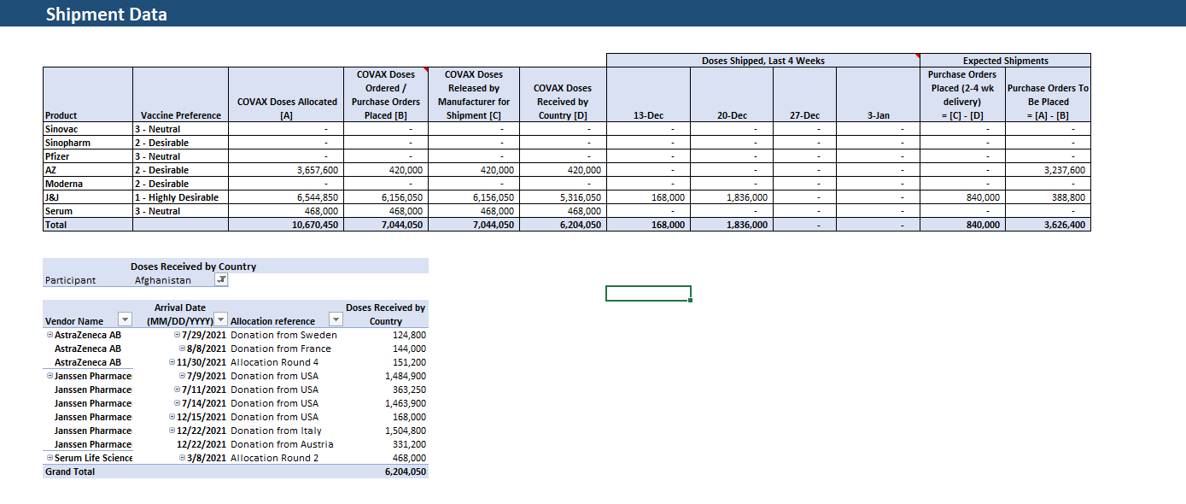
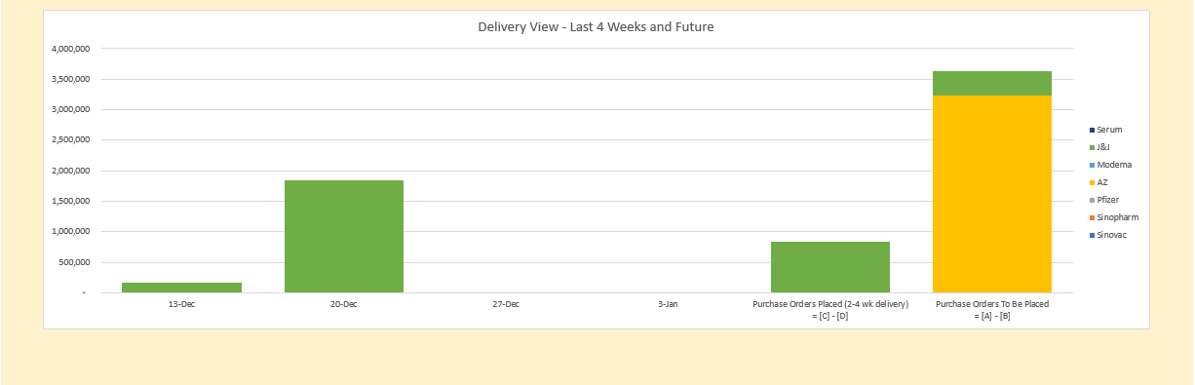
Country shipment view: overview
Core Data contains key supporting data related to the participant - name, absorption caps, and COVAX coverage. The sources for this section are CPP, CCP, and calculated values.
Shipment Data contains data for doses allocated, ordered, released, and received by a participant, as well as a four week historical view of doses received. A detailed table of doses received by country has been added to facilitate easier analysis. The sources for this section are CPP and calculated values.
Supporting Visuals contains graphs based on data in the two sections described above.
In case of any questions, please send them to cphhq-sd.dpf@unicef.org

