Slide 1
Jhpiego Support for COVID 19 Vaccination in Burkina Faso

Slide 2
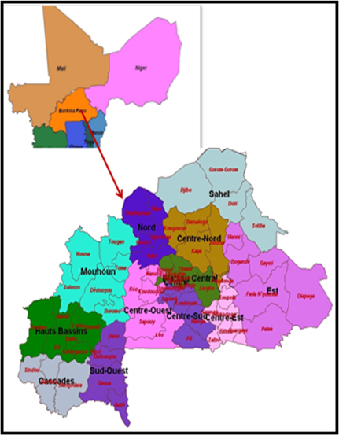
Burkina Faso Country Context
Sahelian country of 22, 184, 452 inhabitants in West Africa
1st COVID 19 case was notified in Mars 2020
COVID 19 data as of June 4th 2022:
Cases : 21, 055
Deaths: 378
Immunization started on June 2020
Target 18 Y and over (over 12 Y with parental agreement)
2 551 596 (11,5%) vaccinated with 1 dose
1 640 349 (7,39%) persons completely vaccinated

Slide 3
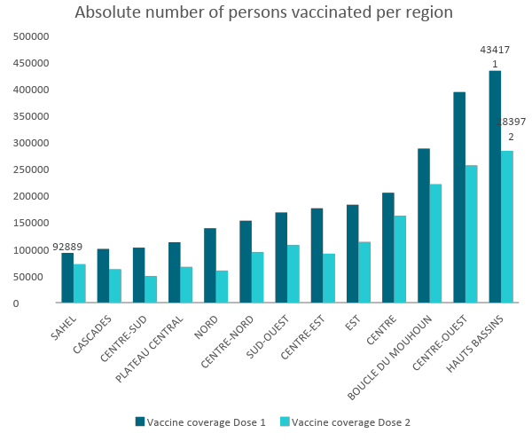
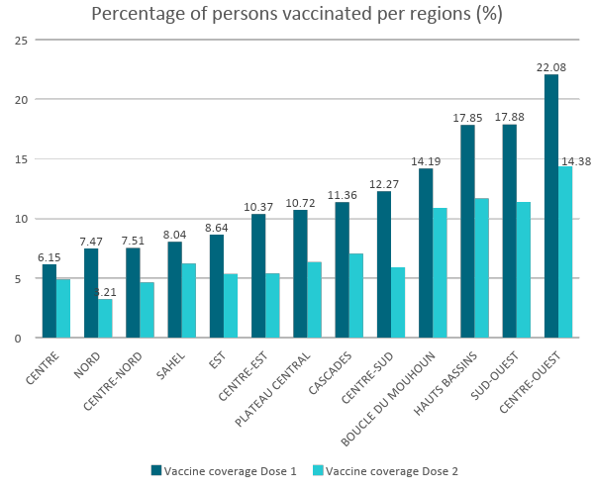
COVID 19 Vaccination Performance by Région

Slide 4
COVID Vaccination Performance by Vaccine Type and Gender
58.96%
Janssen
Sinovac
Pfizer
41.04%
1 dose: 1 057 289
1 dose : 28 233
2 dose : 6452
1 dose : 733 080
2 dose : 280 121
Vaccine Safety Summary
AEFI | Reports
Minor | 5492
Severe | 16
Astrazeneca
Moderna
Sinopharm :
1 dose : 92 027
2 doses : 55 693
1 dose 164 218
2 dose 7621
1 dose 475 810
2 doses : 232 234

Slide 5
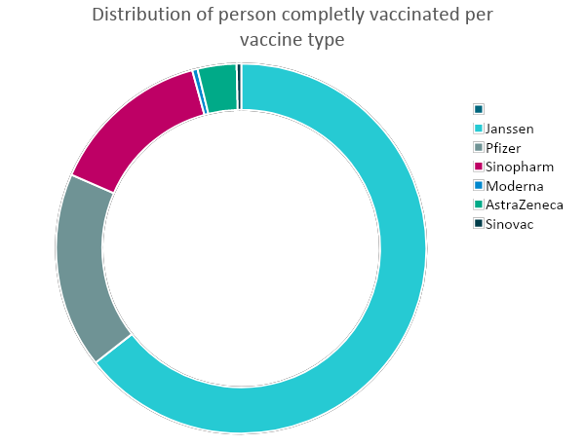
Distribution of person vaccinated by vaccine completeness
Vaccins | Vaccinees 1st dose | Full vaccination (primary schedule) | Total vaccinees
Janssen | 1058228 | 1053870 | 1058228
Pfizer | 733080 | 280121 | 1013201
Sinopharm | 475810 | 232234 | 708044
Moderna | 164218 | 7621 | 171839
AstraZeneca | 92027 | 55693 | 147720
Sinovac | 28233 | 6452 | 34685
Total | 2551596 | 1635991 | 3133717

Slide 6
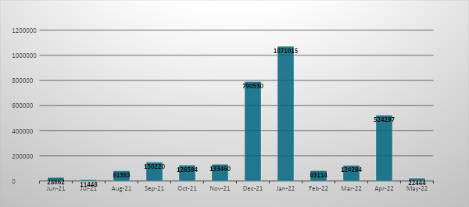
Monthly immunization performance: distribution of the number of doses administered per month ( 3 147 441 doses)

Slide 7
Country Challenges
Low vaccine demand
Insecurity and political and social crisis
8/13 regions facing important security challenges with closed or non-functional health center
1 902 150 internally displaced persons (April 30th 2022 CONASUR)
Change in leadership
Ressources
Delays in distribution of funds for immunization campaigns
Constraints :
Very hot Climate > 40°
Fasting time
Rainy season
Multiplicity of vaccines

Slide 8
CDC support through Jhpiego in Burkina Faso

Slide 9
Achievements realized through Jhpiego support
Outreach through Mosques: Jhpiego supported demand creation, social mobilization, and vaccination teams for these outreaches targeting muslims ahead of the fasting season in April 2022.
Outreach for Internally Displaced Populations (IDPs): support focused on communication and deploying vaccination teams to Centre Nord which has the highest number of IDPs
Outreach vaccination at the market places in Centre Region which had the lowest demand. Jhpiego supported with additional teams at the markets to reach more people at the market places
Printing electronic vaccination cards – Jhpiego supported Ministry of Health to print ~20,000 vaccination cards following the backlog in early 2022
Vaccination of healthworkers at the main hospitals, regional health facilities, and university hospitals
Development of the job aid for vaccinators given the multiple vaccine environment. Some times health workers would have up to 6 different types of COVID vaccines in their cold boxes during the vaccination sessions.

Slide 10
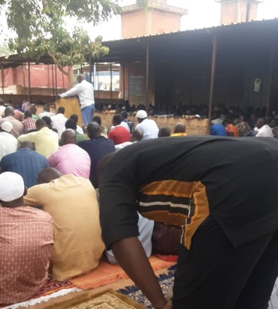
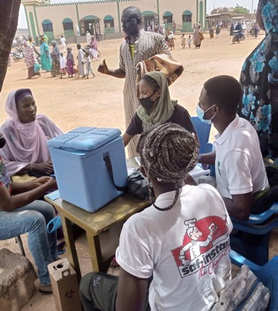
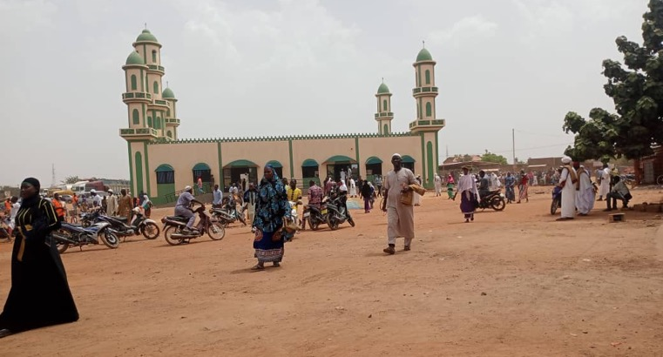
Immunization in front of Mosques during Friday prayers (a community outreach prior fasting time in Burkina Faso)
Intervention implemented prior the April COVID 19 vaccination campaign
352 Major Mosques selected nationwide
704 vaccinators and 704 volunteers deployed
170 supervisors (Regional and DS)
Advocacy session with religious leaders prior the intervention
More than 33000 persons vaccinated in 02 days.

Slide 11
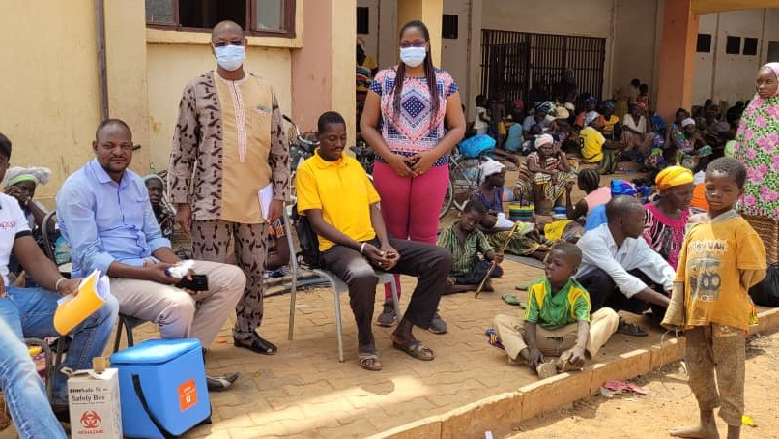
Support to immunization campaign in Centre and Centre Nord
Centre and Centre Nord 🡪 Lowest vaccine coverage (5% and 3% )
Centre Nord record 675 041 IDPs (17% of the country IDPs)
Centre (capital city) has a low vaccine demand
Jhpiego supported communication and vaccination team deployment

Slide 12
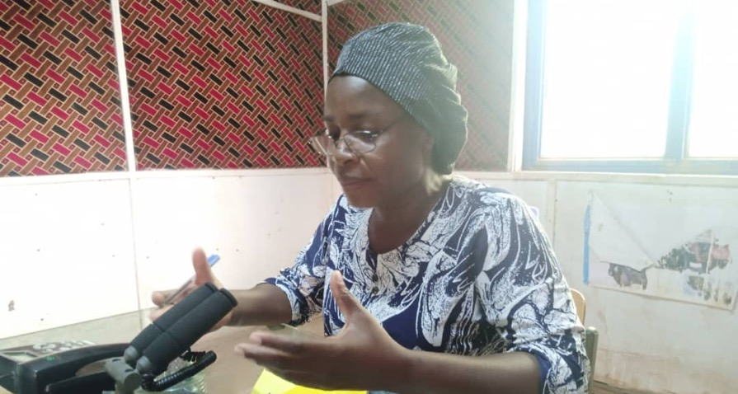
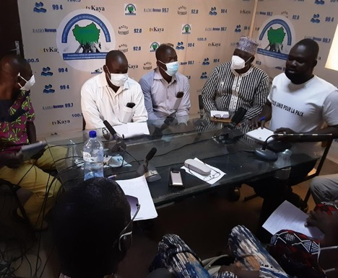
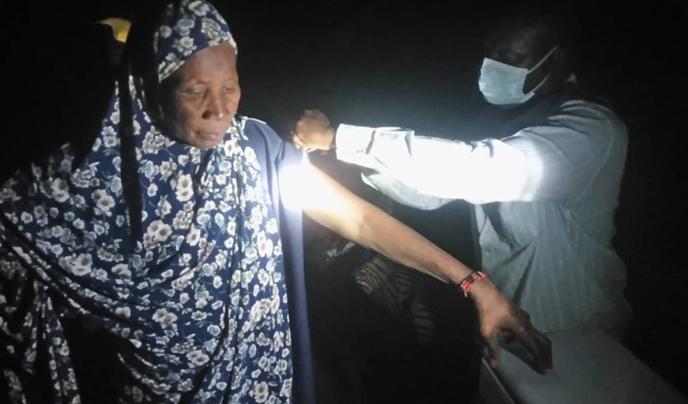
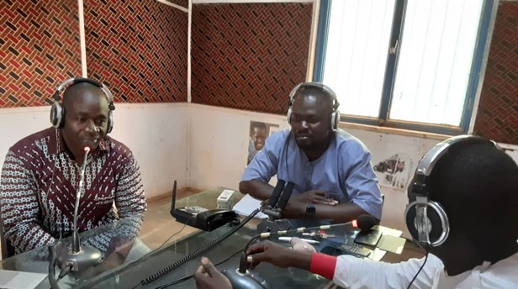

Slide 13
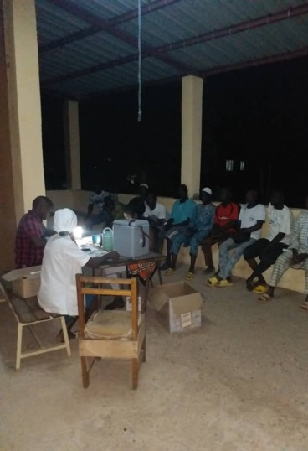
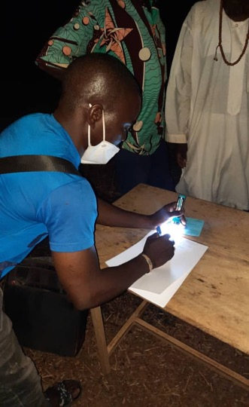
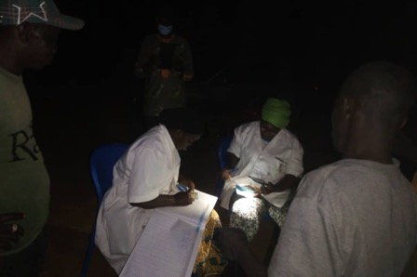
Sunset vaccination during April campaign

Slide 14
Advocacy with Community leaders
Notes:
I

Slide 15
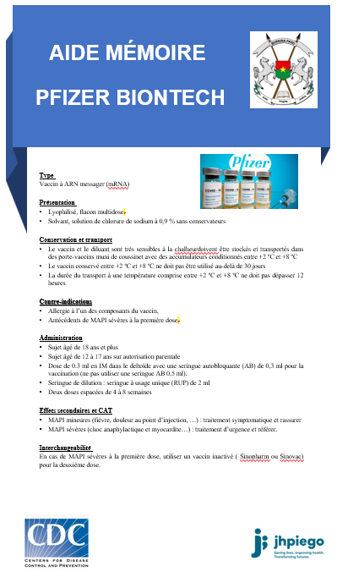
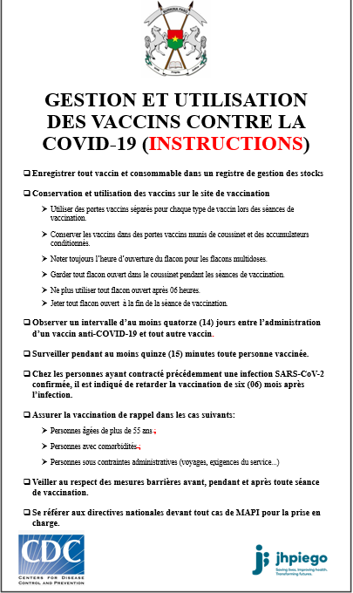
COVID 19 vaccination e-card
Burkina Faso has developed a secure electronic vaccination card since june 2021. Aside from being a monitoring tool, the e-card was instrumental in demand creation. Jhpiego supported the printing of more than 20 000 cards.
Job-Aid and memo for FHW
Jhpiego has developed in collaboration with the MoH Job -aid for frontline health based on the WHO and CDC recommendations to reduce storage and multiple vaccine managements in routine and during campaigns.

Slide 16
Lessons Learnt:
Routine immunization has not been very successful in Burkina (Health workers fatigue, impact on other activities)
75% of persons were vaccinated during a vaccination campaign : A cost effectivenes survey on vaccination strategy may orient the next intra-action review
April campaign success were hindered by fasting time , it is key implicate communities in planning
Availability of ressources prior organizing a campaign is essential
Extending vaccination session hours has been very instrumental to reaching and getting more people vaccinated.
Combination of multiple communication strategies is essential before and during the campaign
COVID vaccine may require some dedicated resources and innovative approaches with community participation as we move away from campaigns and outreaches

Slide 17
What next for Burkina
MoH Agenda of Immunization campaign
Jhpiego future engagements🡪 USAID, CDC funds
24 au 30 juin 2022
25 juillet 2022 au 31 juillet 2022 ;
23 septembre 2022 au 29 septembre 2022 ;
24 octobre 2022 au 30 octobre 2022 ;
25 novembre 2022 au 1er décembre 2022
Communication
Coordination
Vaccine team deployment
Data management (dashboard COVID 19 + Monthly Sitrep)

Slide 18
