Slide 1


COVID-19 Vaccine ESARO Gender related challenges
AGEI meeting
Sofia de Almeida
December 2nd , 2021
© UNICEF/UN0231204/Ramasomanana

Slide 2
Evidence highlights gender disparity in Covid-19 vaccine access/reporting/ uptake
When data is available, women represent 27% of vaccines administered in ESAR as of July
(source: WHO regional dashboard)
Women have higher risk perception but lower levels of acceptance due to concerns on vaccine safety and efficacy, limited tailored information and access-related challenges
Women are acutely affected by environmental and socio-economic barriers to accessing immunization services, they are also experiencing outsized secondary effects of the COVID-19 pandemic Advocate for disaggregated data collection and timely reporting Regional Data is not in line with National Data Undertake qualitative research to address specific needs for women and men
Notes:
11 Countries reported disaggregated data to WHO Regional Dashboard
Kenya 29% (WHO) ≠ 55% (MoH)
South Sudan 23% (WHO) - 25% (SSCO)

Slide 3
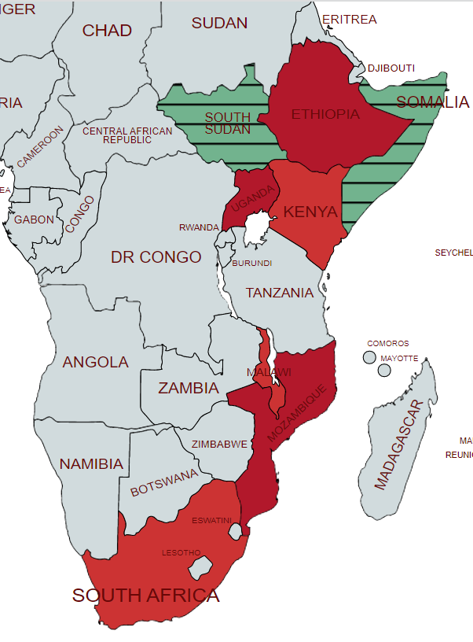
Concerns that COVID19 vaccine causes infertility and questions about pregnancy, breastfeeding and menstruation cycle across ESAR region
COVID-19 Risk perception is higher among women than among men (Malawi, Kenya, Uganda, Ethiopia, South Africa)
Women show higher levels of vaccine confidence in general, but they report being more skeptical when it comes to a COVID-19 vaccine (Malawi, Kenya, Uganda, Ethiopia, South Africa)
Women in ESAR are acutely affected by environmental barriers to accessing immunization services
Women have experienced outsized secondary effects of the COVID-19 pandemic in many areas, including job loss, income drops, gender-based violence, and missed education (Mozambique, South Africa and Kenya)
Gender related challenges for COVID-19 vaccination
Notes:
Concerns that COVID19 vaccine causes infertility and questions about pregnancy and menstruation cycle continue circulating in online conversations and also among communities across ESAR region (social listening report and through community feedback mechanisms, raid assessments, and data collection)
COVID-19 Risk perception is higher among women than among men (Malawi, Kenya, Uganda, Ethiopia, South Africa).
Women show higher levels of vaccine confidence in general, but they report being more skeptical when it comes to a COVID-19 vaccine (Malawi, Kenya, Uganda, Ethiopia, South Africa).
Women in ESAR are acutely affected by environmental barriers to accessing immunization services (e.g. distance to services, inconvenient times of services, long queues, unpredictability of health posts in areas with difficult access)
Women have experienced outsized secondary effects of the COVID-19 pandemic in many areas, including job loss, income drops, gender-based violence, and missed education (Mozambique, South Africa and Kenya).
In Rwanda, the utilization of Maternal and Child Health Care services in all four categories—antenatal care (ANC), deliveries, postnatal care (PNC) and vaccinations—significantly declined during the COVID-19 outbreak.²⁶

Slide 4
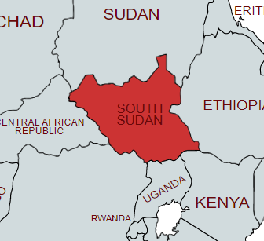
Reported challenges | Programmatic recommendations
Females trust the vaccine less than males and are more hesitant | Amplify new evidence as it becomes available to better address doubts due to the rapid development of vaccines; and myths and misinformation relating to e.g., breastfeeding and infertility. Partnering with women’s organizations and other community-based groups to ensure that gender perspectives is considered in planning, design, and monitoring, as well as ensure accurate information is available to communities. Enhance trust-building interventions such as: Showcasing female key influencers, religious and community leaders, political leaders, and HW getting the vaccine and positive human interest-stories. Provide safe discussion spaces so that hesitant (women and men) can share how they feel and think, their fears and questions. Address questions on vaccine safety, efficacy and AEFIs Collaborate with religious leaders, mother-to-mother support groups and other key community platforms
Social and work norm not well stablished | Publicize the prevailing social and work norm (the majority of HW are willing to uptake the vaccine) and showcase positive human-interest stories targeting both Women HW and general population.
Gender related challenges

Slide 5
Reported challenges | Programmatic recommendation
57% of female HW reported challenges to getting vaccinated Lack of time due to domestic responsibility/ lack of transport money to reach vaccination site/ long distances | With consideration to local dynamics, increase the number of vaccinators, female mobilizers and sites for vaccination. Also deploy community mobilizers to areas with low immunization rates and, particularly in settings where facility-based health services are not easily accessible (e.g., rural areas). Adjust service logistics that accommodate the differing needs of women and gender-diverse people (e.g., caregivers, women with young children, single parents and ensure acceptability of services for both mothers and fathers). Consider extended and flexible vaccination hours to accommodate working hours and caregivers’ responsibilities. Consider delivering vaccination services in places where women congregate (e.g., markets, churches).
Limited knowledge on the vaccination centers proximity /closeness to our areas | Provide clear information through trusted channels on how, where, when people will be vaccinated, on vaccine eligibility and priority population targets.
Gender related challenges
Notes:
43% of females report that it is not hard to get vaccinated v/s 60% of male respondents
A high percentage of females report that the greatest challenge is other – qualitative data was undertaken
Integrate COVID-19 vaccinations into existing service delivery that responds to gender specific needs, such as community-based sexual and reproductive health services, nutrition services and antenatal care.
Main reasons
Lack of time due to domestic responsibility
Women are unable to walk long distances to the vaccination site.
Some are willing but do not have transport money to facilitate their movement to vaccination site
43% of females report that it is not hard to get vaccinated v/s 60% of male respondents
A high percentage of females report that the greatest challenge is other (35% in females vs 16% in males). Qualitative data was undertaken.
Lack of time due to domestic responsibility/ lack of transport money to reach vaccination site/ long distances
Limited knowledge on the vaccination centers proximity /closeness to their areas

Slide 6
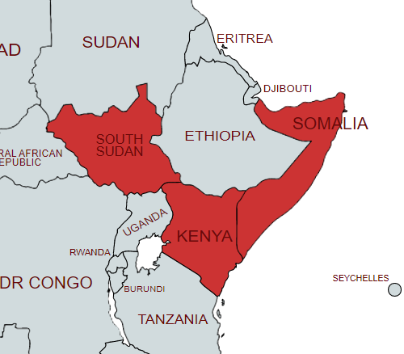
Actions taken by COs to address gender related challenges
South Sudan | Hesitancy among women (general population) and women (HW) | Qualitative research (FGD, interviews) undertaken to understand 'whys' with RO support on analysis and recommendations. Advocacy efforts to Government to implement recommendations.
Somalia | Hesitancy among women | Specific interventions to better understand and address vaccine hesitancy among women (general population and female HWs) are ongoing (Qualitative research – FGD, interviews)
Kenya | Gender disparity in COVID-19 vaccine uptake in some counties | Gender analysis ongoing to understand ‘whys’
Gender related challenges on COVID-19 vaccination
Notes:
SOUTH SUDAN - WOMEN
GENDER DIMENSION vaccine hesitancy among women (general population and female HWs) - Qualitative research (FGD, interviews) undertaken to understand 'whys' with RO support on analysis and recommendations. RO support the development of presentations with analysis and recommendation to inform planning and for advocacy purposes and also a development of 2 case studies on BeSD to HW and gender dimension.
BeSD qualitative assessment.
SOMALIA
Evidence shows hesitancy is not as high as thought earlier - 7 out of 10 people would take the vaccine and recommend to an elderly relative. Nationally run mobile campaigns over September will help to assess hesitancy as physical blocks will be overcome for those targeted areas (also COVID-19 hotspot areas).
FMOH is making mandatory vaccines for frontline workers with a letter to be sent to line ministries. This includes teachers and health workers who will have two months to take vaccine or be prevented from working. Mid-term strategy includes assessing effectiveness of vaccine discussion groups working through existing structures.
GENDER DIMENSION - Specific interventions to better understand and address vaccine hesitancy among women (general population and female HWs) are required and being prepared (Qualitative research – FGD, interviews) with RO support revising tools and unpacking interventions.
Mid- term budgets will focus more on activities to target women through local group capacity building.

Slide 7
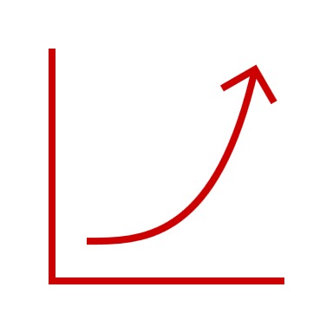


Women’s uptake in South Sudan
43% Nov.21
26% Sep.21
Covid-19 vaccines
Covid-19 uptake increased
From 26% to 43% as of November (National data)
From 26% to 59% as of December (WHO regional dashboard)

Slide 8
UNICEF ESARO support to increase Covid-19 vaccine uptake
When data is available, women represent 43% of vaccines administered in ESAR as of December 1
(source: WHO dashboard )
Social listening: Weekly report on C19 vaccine and Monthly report on impacts of Covid19 pandemic AIRA COVID-19 Infodemic Trends joint report Increase exchange and identification of COs best practices (Catch up calls, ESACREDT meetings) Tracker on Practices and Lessons Learnt on COVID-19 vaccine demand across ESAR countries DATA 4 ACTION Report Data collection efforts – Qualitative research to understand ‘whys’ (COs – ESARO support) Monthly COs monitoring tool (updated tool) to improve TA BeSD toolkit adapted to Gender (SOM) Regular analysis of disaggregated data (sex, age, target groups) Specific interventions (e.g. FGD, HCD, specific recommendations)

Slide 9
THANK YOU

