Slide 1
Community dialogue and microplanning with communities
Reaching the most vulnerable communities
Mbianke Livancliff
Senior Immunization Officer
Value Health Africa-Cameroon mbiankelivancliff@gmail.com/mbiankecliff@valuehe althafrica.org

Slide 2
The Problem
Situation overview
According to a WHO report dated December 19th 2021, less than 2% of Cameroonians were fully vaccinated against COVID-19 at the time of the report. Only 3.9% of Cameroonians had had a dose of COVID-19 vaccine.
Anglophone regions of the country had the poorest rates of COVID-19 Vaccine coverage with only about 0.8% of the population fully vaccinated in the SW and
0.67 in the NW at that time. Factors such as the ongoing armed conflict and the strained relationship between the population of Anglophone Cameroon and the government contributed to the low vaccine uptake.
VAHA carried out several community strategies to improve COVID-19 Vaccine demand with the landmark being the creation of Community dialogue structures and the integration of HCD and micro-planning at community level.
Problem statement
Despite there being some gains from the aggressive action of Value Health Africa and other CSOs to improve COVID-19 vaccine uptake in Anglophone Cameroon( vaccination coverage grew from 0.8% from November 2021 to 3.9% in April 2022 in the SW and from 0.67% in November 2021 to 9.1% in April 2022), limited resources and government engagement in these regions has made it difficult to scale interventions and thus immunization coverage in these regions still remains the lowest across the entire country. Of the 1,245,7800 Cameroonians fully vaccinated, only 90,458 are from the two anglophone regions which has a population of over 8 million people.
84

Slide 3
The Solution
Actions
Integrate RI HCD and Microplanning in Covid-19 vaccine demand
Divide population into vulnerable groups ( Elderly, people with
comorbidities, frontline healthcare workers, IDPs)
Using KII, gather information about C-19 vaccines from the
different groups.
Develop a SBCC specific for each group
Hold focus group discussions about C-19 vaccine in diabetic clubs, UPEC centers, fitness clubs, elderly homes, social groups.
Created community dialogue structures in selected communities divided into Adolescent/youths, elderly and use
existing patient groups such as diabetic clubs.
Developed sensitization materials( posters, fliers) in local pidgin- English to address prevalent misinformation and myths about covid-19 vaccine within the communities.
Instituted a health personnel C-19 Vaccine discussion forum
VAHA developed a confidence meter tool used to understand the confidence level progression of participants within the community groups.
Measurement
At the community dialogue groups, a confidence meter tool was used to track the progression of participants confidence in COVID-19 Vaccine.
Reports from community groups and from the vaccine deliver center showed the number of persons from the community groups who later became vaccinated.
Reports from the district data showed a massive improvement in vaccine coverage in the selected communities.
85

Slide 4
Outcomes and Key Learnings
Outcomes and Impact
We have observed a steep increase in the number of people vaccinated per day since launching this our community strategy in January 2022
Key Learnings
Our greatest success have come from allowing the people share what they think and giving them the power to design strategies and changes they want to see happen.
Treating each community as an individual context has helped us tailored strategies specific to the given community.
Integrating other tools used for Routine
immunization such as the HCD and micro- planning tools have great gains in improving COVID-19 Vaccine uptake.
3.9% in April
2022 for SW
9.1% in April
2022 for NW
0.8% in Dec 2021 for SW
0.67% IN Dec 2021 for NW
86

Slide 5
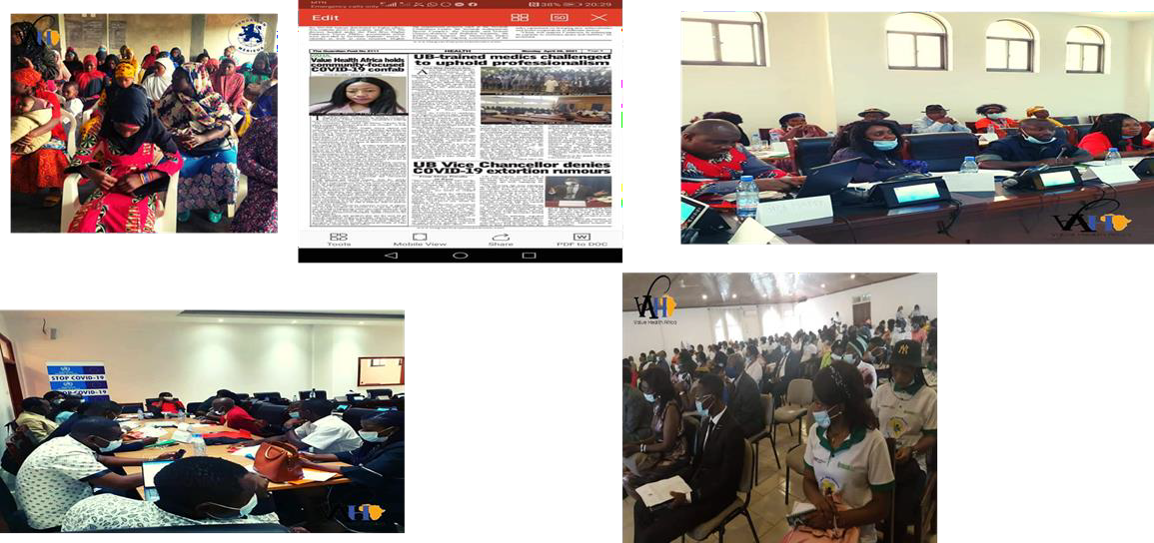
THANK YOU

