Slide 1
Hackathon in Cote
d’Ivoire
Innovative and effective strategies of enhancing vaccine confidence and uptake and risk communication and community engagement with an emphasis on high-risk and vulnerable groups
Charlotte Mbuh
Member of the Movement for Immunization Agenda 2030
The Geneva Learning Foundation

Slide 2
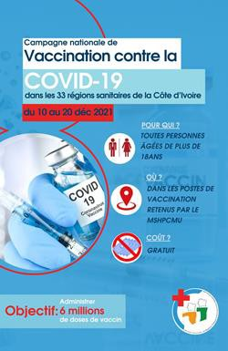
The Problem
“I was so afraid of the vaccine that I refused to get vaccinated even though I was encouraging communities to do so. After three months of observing my colleagues who had already been vaccinated, I took my courage in both hands and vaccinated myself. I now feel comfortable again to continue community outreach.”
Situation overview
Problem statement
How to rapidly strengthen INHP-EPI and partner staff HRH capabilities based on “what works”, ahead of a national COVID-19 vaccination campaign (10-20 December
2021) to vaccinate 6 million
people in Côte d’Ivoire.
National team planned COVID-19 vaccination campaign for December 2021
Health workforce COVID-19 vaccine hesitancy is a potentially significant hurdle to role as “trusted adviser” to communities
Health workforce (HRH) capabilities are obviously key to success, but time is not available for traditional capability development processes.
Lessons learned need to be shared rapidly, especially how to adapt national guidance to local contexts, but existing mechanisms are primarily vertical (top-down)
35

Slide 3
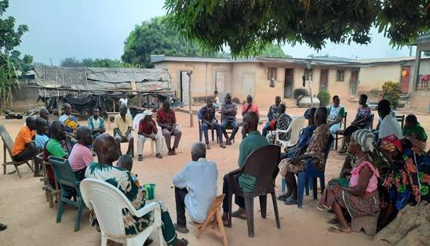
The Solution
Actions
IN 7 DAYS: TGLF’s fully-digital Hackathon package was deployed by a country-based team of alumni volunteers with EPI and INPH
support to connect >500 country and health workers who developed
165 context-specific action plans to accelerate COVID-19 vaccination.
Capability development embedded into activities focused on urgent priorities, rather than requiring stakeholders to set aside priorities in order to learn.
The Hackathon involved the following process:
Work in small groups to problem-solve context-specific COVID-19 vaccination challenges.
Develop action plans focused on a local challenge or barrier to
COVID-19 vaccination.
Peer review action plans developed by colleagues.
Revise own action plan based on feedback from peers.
Measurement
Outcomes measured by national EPI through actual vaccination uptake during national campaign matched to implementation of Hackathon action plans.
Hackathon participants self-reported implementation; shared photos of actual implementation of their action plans.
Village head meets health workers to reassure availability of the population and management of cases of refusal, Csr Lengbre / Bouaké Sud 2, Ivory Coast, December 11 2021 (Tuo Désiré)
36

Slide 4
Outcomes and Key Learnings
Outcomes and Impact
Key Learnings
Country and health worker ownership | Led by the TGLF alumni network in Côte d’Ivoire embedded in national EPI team, with participation from all system levels and peers from 20 other countries.
Speed | In 10 days, TGLF developed the hackathon with the Côte d’Ivoire Alumni team. Over nine days, without stopping their daily work, participants developed 165 peer-reviewed context-specific action plans, primarily to overcome COVID- 19 vaccine hesitancy.
Scale | In five days, 501 applicants were recruited.
Diversity | Ivorian participants represented 96 health districts (85% of total) in Côte d’Ivoire: 51% district, 21% facility, 15% national, 11% regional.
Impact | If implemented, action plans estimated to vaccinate 3.5M people with a funding gap requiring an additional 0.26 USD per vaccination. 71% of participants implemented their action plans during the national vaccination campaign. 82% of respondents reported having found a solution to better conduct the COVID-19 vaccination campaign.
Sustainability | 78% of respondents felt “capable” of using the methodology for their own needs, and 82% want to organize their own hackathon with their colleagues.
1. Hackathon participants found local solutions that they were able to integrate and use in the campaign to anticipate, prevent, mitigate, and respond to COVID-19 vaccine hesitancy
1. Health workers’ own confidence in COVID-19 vaccine and their vaccination status is consistently reported as one of the most important factors in successfully engaging communities.
1. Country-wide digital peer learning networks connecting different system levels foster motivation to share what is learned, accelerate problem-solving, and adapt national guidelines to local contexts.
“[During the Hackathon], I realized that it was essential to involve business leaders. If I hadn’t participated, I would have stayed focused on traditional methods, going to markets and places of worship.” (MoH staff, Gbeke-Bouaké Nord-Ouest)
37

Slide 5
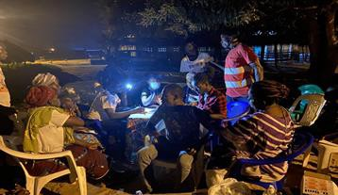
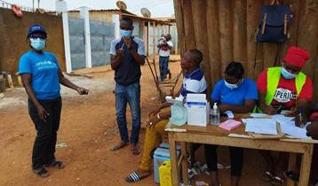
Owl strategy or night vaccination, MADAM Village,
Sandégué Health District, Gontougo Region, Côte d’Ivoire, 11 dec 2021 (Elysée Mlan)
Vaccination in one of the markets of Gagnoa,
Côte d’Ivoire, December 13 2021 (Emma Jocelyne BOSSOH)
THANK YOU
Charlotte Mbuh
Member of the Movement for Immunization Agenda 2030
The Geneva Learning Foundation

