Slide 1








Using rumor management system data to develop adaptive COVID- 19 vaccination strategies in Cote d’Ivoire: the Breakthrough ACTION experience
Jorie Larson Nana
Breakthrough ACTION - Johns Hopkins Center for Communication Programs

Slide 2
The Problem
Situation overview
Since the debut of Côte d’Ivoire’s vaccination campaign in early 2021, progress has been evident but slow, with coverage falling well short of the WHO-identified target of 70% of the population vaccinated.
A 2021 KAP survey conducted in Abidjan suggested that there are multiple reasons that Ivorians remain hesitant to get vaccinated, from fear of the vaccine’s presumed effects on fertility to lingering low risk perception attributed to COVID- 19.
Problem statement
Information about COVID-19 vaccines is ever- evolving. New rumors and misinformation proliferate quickly, further fueling vaccine hesitancy. Risk communication stakeholders need access to timely, focused information on public sentiment and rumors. They must be able to use this information to roll out messaging that addresses people’s real concerns, particularly during times of high risk for COVID-19 transmission when vaccination can be especially powerful in reducing potential spread.

Slide 3
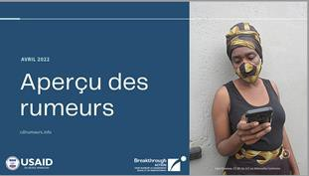
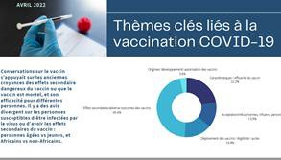
The Solution
Actions
Analyzed data from the KAP survey and Rumor Management System -- which aggregates and summarizes rumors sourced from community informants, social media, and the national hotline each month -- to identify key rumors, and then planned an intensive public communication effort to address them.
Trained journalists to counter specific rumors and misinformation related to the COVID-19 vaccine, and to publish accurate information.
Developed an intensive national radio campaign around the December holiday period addressing misinformation and encouraging continued prevention behaviors.
Created TV spots responding to prevalent public concerns, including the fear of side effects.
Measurement
Success of this effort is measured by the total number of people vaccinated. In late October 2021, the number of vaccine doses administered was over 3.2 million. By the end of the year, over 52 million Ivoirians, or 36 percent of eligible adults, had received at least one dose compared to an average of 14 percent on the African continent.
Examples of a monthly rumor brief, used by the TWG to review perceptions from the hotline, social media and community networks and adapt messaging.

Slide 4
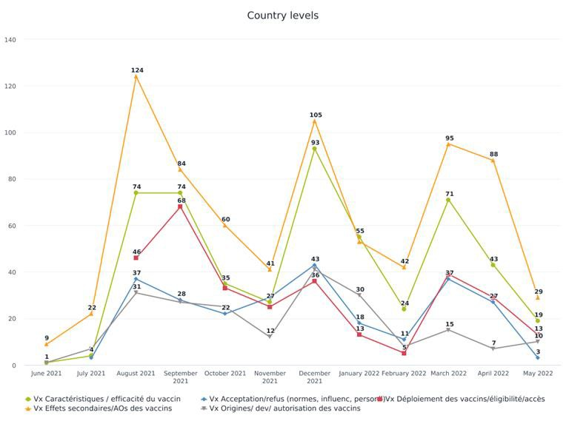
The Solution
Actions
Measurement
At right: Summary of thematic
analysis of vaccine-related rumors collected by the Côte d’Ivoire RMS by month from June 2021-May 2022.
Entries from hotline calls, social
media monitoring, and community informants are coded thematically and then synthesized into briefs for decision-makers, which inform communication actions.

Slide 5
Outcomes and Key Learnings
Outcomes and Impact
The data-driven communication effort supported an increase in the vaccination rate by the end of 2021:
  36% of the eligible population received at least one dose (vs 22% prior to the campaign)
  15% fully vaccinated (vs. 10% prior to the campaign)
  Among priority groups, 87% of health workers, 99% of military and 85% of the elderly received at least one dose.
Continued impact is evaluated through regular monitoring of increase in vaccination coverage over time, as the vaccine campaign is ongoing.
The RMS data continues to inform adaptive messaging to counter specific misinformation and concerns as the vaccine campaign moves towards a more intensive outreach strategy and begins targeting new groups, including adolescents 12-17.
Key Learnings
Perceptions evolve over time–iterative feedback systems provide stakeholders with up-to-date information on rumors to adjust messaging. It is important that data generated by these systems is disseminated, discussed, and regularly fed into risk communication and community engagement (RCCE) action plans.
Intensive RCCE efforts planned around high-traffic holiday periods can achieve good results. This approach around the New Year holiday was successfully replicated for Easter in Côte d’Ivoire.
Mass media and community engagement approaches are both important in curbing misinformation. In Côte d’Ivoire, campaign messaging was oriented towards the broader vaccine-eligible public but coupled with efforts that address concerns of specific populations, such as health workers, transport operators, and adolescents through direct engagement of strategic influencers within these groups.

Slide 6











Jorie Larson Nana
Breakthrough ACTION - Johns Hopkins Center for Communication Programs
mnana@jhu.edu
THANK YOU

