Slide 1
Enhanced advocacy and social mobilization and use of mixed service delivery strategies to increase uptake of COVID-19 vaccination in an urban setting Field visit experience during 2nd round vaccination campaign support to Sidama region
JSI case study presentation
April 8, 2022
CoVDP Implementer’s Forum: Ethiopia

Slide 2
JSI’s COVID-19 Support in Ethiopia
JSI is providing support at national level and in multiple regions, in the areas of:
Service delivery and planning/coordination
Communication/RCCE
Data systems and data use

Slide 3
2nd Round Campaign: Partner Visit Findings in Sidama
Sidama region visit: February 15-25, 2022
Pre-campaign activities conducted in most districts (e.g. training, microplanning, advocacy and social mobilization)
Intra-campaign evaluation:
Campaign progressing in most districts
Very low uptake was observed in some cities in the region, especially in Hawassa city administration.
Achievement was stagnant for consecutive seven days (<30 % vaccine utilization) in Hawassa city; in contrast, most rural woredas were achieving their target.
Some prioritization of COVID-19 vaccination over routine immunization occurring, leading to decreased focus for routine immunization and some session interruption for routine immunization

Slide 4
Actions taken
National supervisory team with RHB EPI experts conducted frequent visits to HH, health facilities, vaccination team, industrial parks, schools, and colleges → to identify the root causes for low vaccine uptake
Advocacy was conducted at lower levels/community level, including at: Industrial park management (has with 30k+ employees), and university & colleges
Targeted social mobilization conducted with standardized key messages.
Multiple temporary vaccination sites were opened, especially in areas like: busy marketplaces, schools, offices, bus stations, and the Central Business District (CBD)

Slide 5
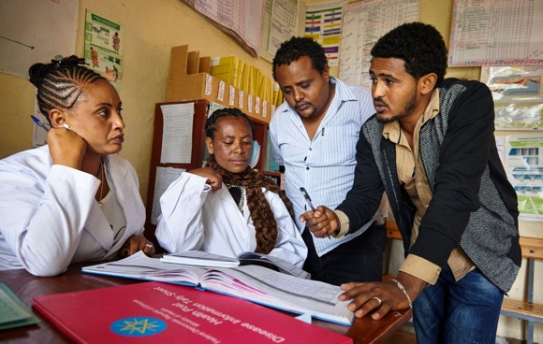
Result
By the end of the visit (10 days), the Hawassa city administration had utilized 98% of COVID-19 vaccines allocated

Slide 6
Lessons Learned and Recommendations
Lessons Learned
Recommendations
High-level advocacy had been conducted, but influential local advocacy (sub city administration, school leaderships, college and industrial park leaders, etc.) was not included.
Social mobilization activities were not properly planned and monitored.
E.g., Audio-mounted mobilizers have no clear area to cover. Special areas needing mobilizations were not properly identified, and messages used were not standard or linked with vaccination team.
Vaccinating teams could not reach daily targets in fixed and outreach sites
Planned outreaches did not consider where urban communities could best be found (e.g., did not consider working areas like CBD or other business areas)
COVID-19 campaign efforts were prioritized, resulting in decreased focus for RI and session interruption
Advocacy should occur at lower levels (conduct local advocacy): local business associations, industrial parks, schools/colleges, etc…
Social mobilization activities (e.g. audio mounted vehicles) in urban areas should be clearly planned and strategic to reaching priority populations, using standardized key messages
Need additional outreach sessions/strategies to reach target populations in urban areas
Use every COVID-19 vaccination opportunity for RI program strengthening; ensure campaign planning also includes planning to maintain RI services

Slide 7
Thank you

