Slide 1
Listen. Innovate. Reach.
Fiji National RCCE Working Group
Kshitij Joshi
Chief SBC, UNICEF Pacific MCO

Slide 2
The Problem
Situation overview
March 10, 2021, Fiji launched its COVID-19 vaccination drive for frontline workers.
Fiji reported its first community COVID-19 case on April 19, 2021, due to a breach in protocol.
Shift in vaccine roll-out strategy to include everyone over 18 years.
Problem statement
Low vaccine uptake despite intensified RCCE targeting people over 60 years and people living with disabilities.
Misconceptions and misinformation on vaccination for pregnant women at the peak of community transmission.
66

Slide 3
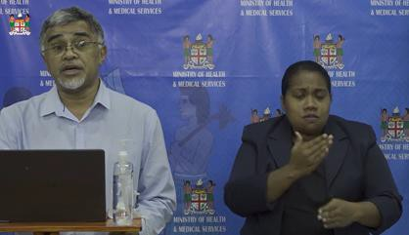
The Solution
Actions
Establishment of dedicated Social Listening Subgroup under multi-partner RCCE Working group
Triangulated feedback from online and offline sources
National 158 hotline
Talkwalker – social media monitoring
Meltwater – news portal monitoring
Community feedback gathered by ‘Whole of Government’ mobilizers
Updated RCCE messaging framework and approaches
Daily briefing to Incident Management Team (IMT) - COVID-19 command centre – to coordinate with the work of other response pillars.
Measurement
Changes in operational strategies based on feedback to the Incident Management Team (IMT)
Concerns addressed by Principal Secretary, Health in his daily address to the nation
Vaccine uptake by people over the age group of 60, pregnant women and people living with disability
67

Slide 4
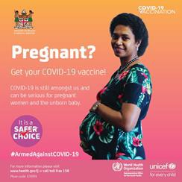
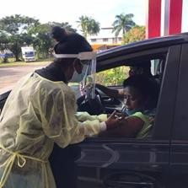
Outcomes and Key Learnings
Outcomes and Impact
Key Learnings
Social listening is equally critical to inform operational strategies as RCCE messaging and approaches.
Monitoring, analyzing and triangulation of offline and online information sources increases the chances of obtaining a more nuanced
understanding of what people are saying and the reality on the ground.
Drive-thru vaccination sites to facilitate access for older people and PLWD
Integration of vaccination with routine ANC services
Timely, transparent, and regular communication are effective in building trust in a constantly
evolving context, such as COVID-19.
95% 18 years and older
^{One Year} fully vaccinated
68

Slide 5
Kshitij Joshi
Chief SBC, UNICEF Pacific MCO kjoshi@unicef.org
THANK YOU

