Slide 1









Using 2-way SMS communication to address rumours, gather insight and support communities: Malawi Red Cross in partnership with Katikati
Joseph Mwase
Help Desk Team Lead, Malawi Red Cross Society, Malawi
Arnav Kapur
Chief of Staff, Katikati, Kenya

Slide 2

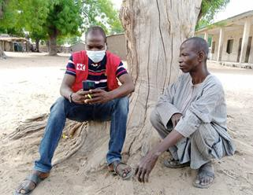



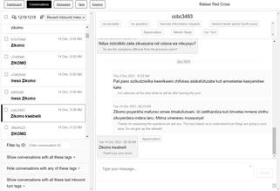



Situation overview: explosion of rumours, volunteers struggling to address this
Problem statement: need for a remote, fast, trusted and two- way dynamic channel of communication to better inform volunteers and communities
Katikati provides communication software for MRCS:
Two-way channel
Toll-free SMS shortcode (1134) for Malawi
Contact volunteers by area, ask questions, respond
Tag their responses to analyse this live

Slide 3
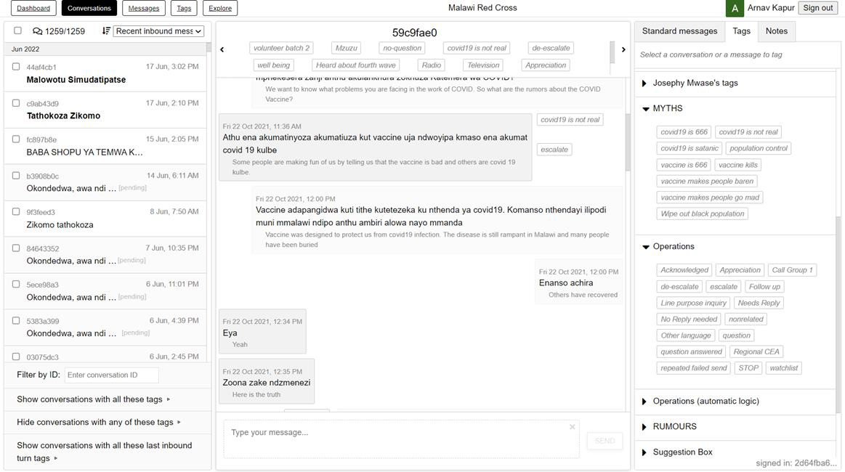

Slide 4

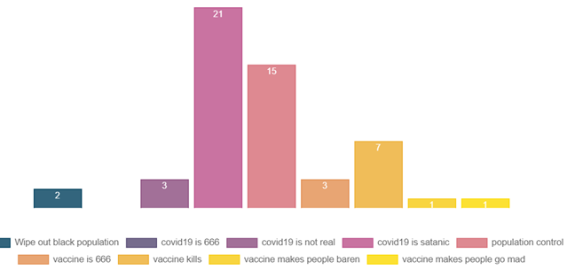
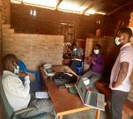

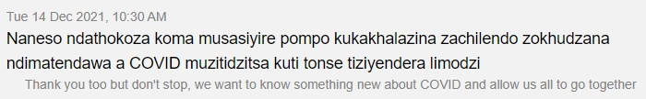
Key Results and Learnings
1. Information voids
2. Rumours and Misinformation
1,196
Volunteers
1,272
Comments, Questions
30
Minutes per day
3. Trusted health guidance

Slide 5










Joseph Mwase - Malawi Red Cross Society - https://www.redcross.mw
Arnav Kapur - Katikati, arnav@katikati.world - www.katikati.world
THANK YOU

