Slide 1
NIGERIA: COVID-19 Operation
Learnings and Best Practices

Slide 2
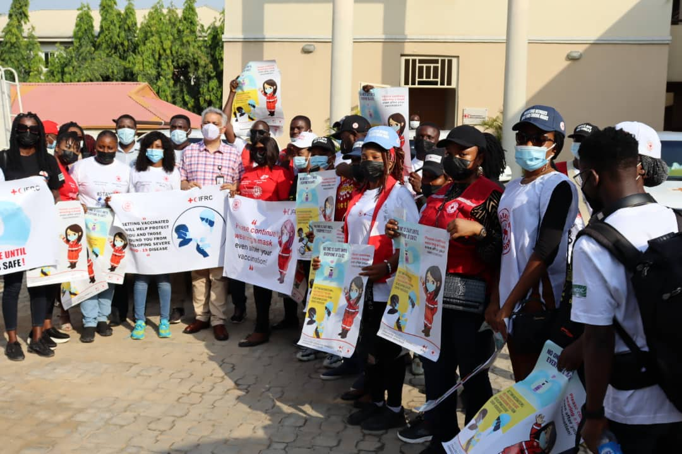
35 Branches
June 2020 - December 2021
Volunteers: 1,390
Staff: 153
Supported by
IFRC
ICRC
BRC
NRC
GRC
Novarits

Slide 3
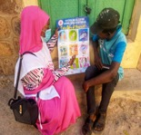
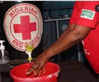
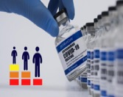
Donation of PPE Treatment Centres
5 Branches
RCCE
2m
11,456,090
Intervention pillars
PSS
IPC:
Ambulance services
Health facilities, orphanages
162,857
Contact Tracing
17,721
840 Hand Washing Stations
COVID-19 Vaccination campaign
Safe burials and supportive referrals
10,625,615

Slide 4
COVID-19 VACCINATION
Implementation Strategies
House to House sensitization and social mobilization
Street campaign (Road walk)
Live call-in Radio show
Psychological First Aid for vaccine hesitancy

Slide 5
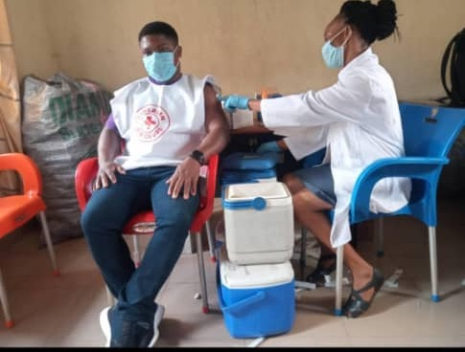
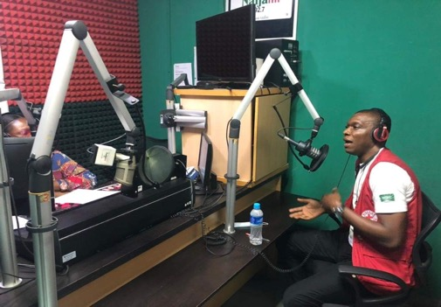
Success Stories
465, 131 persons reached through house-to-house awareness (between October & December 2021)
445, 239 registered and took the vaccine with the help of RC volunteers
191, 248 persons reached with PFA for vaccine hesitancy
10,625,615 reached through call -in radio shows
Recognition by Government and other partners; and willingness to work with the RC
Increased membership drive and visibility

Slide 6
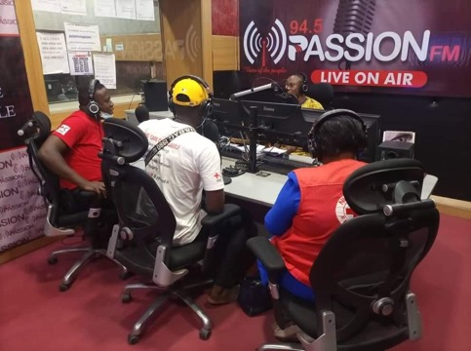
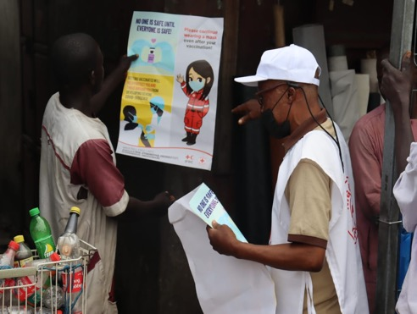
Blockages to COVID-19 vaccination
Infodemic on COVID-19 vaccines
Lack of public trust in Government
Lack of funding to reach the underserved/hard to reach population
Poor follow -up system
Misconceptions around the use of different vaccines
Conflicts and insecurity

Slide 7
Recommendations
A holistic and timely planning, fast execution of plans
Rigorous community involvement, and a robust multi-sectoral approach
Establish follow - up system for subsequent doses
RC volunteers to support registration of beneficiaries

