Slide 1
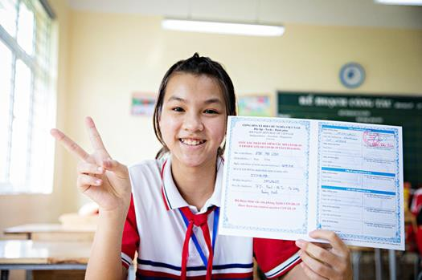
Hearing and addressing people's vaccine-related concerns in Viet Nam
Giap Nguyen
Communication Consultant, UNICEF Viet Nam

Slide 2
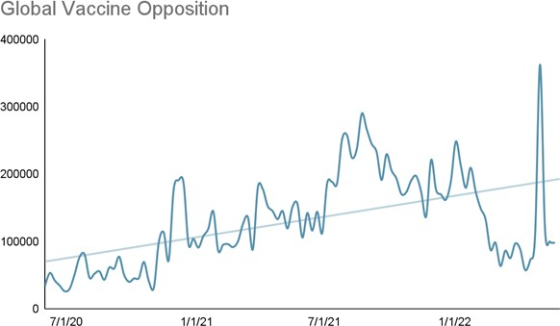
The Problem
Situation overview
Globally, vaccine opposition is on the rise. Since June 2020, the Vaccination Demand Observatory (VDO) has collected over 13 million English-language references to vaccine opposition, with a generally steady rise over time.
In early 2022, 15% of survey respondents in Viet Nam believed the COVID-19 vaccine is unsafe 13% of
believed the vaccine is ineffective.
Currently there is slow COVID-19 vaccination progress for children from 5-12 years old and for the booster doses for adults.
Misinformation about these topics is on the rise.
Problem statement
Vaccine hesitancy, fueled in part by misinformation and information gaps, continues to threaten vaccination efforts.
“Pfizer documents” released
FDA Approval of Comirnaty
FDA’s EUA for
COVID-19
Vaccines
61

Slide 3
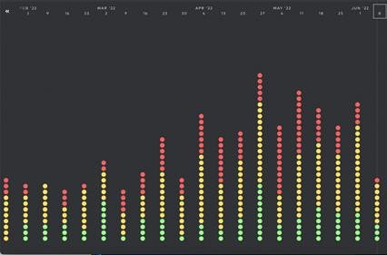
The Solution
Actions
Measurement
The VDO equips countries with customized social listening programs to boost vaccine demand and address misinformation.
The VDO monitors local language online public conversation, identifies vaccine misinformation within the country, provides vetted messages and creative assets to respond to the misinformation and works 1:1 with country staff to build capacity and provide rapid response technical assistance.
UNICEF Viet Nam is collaborating with the MoH on a three year work plan including the “Safe Journeys" media campaign, which includes a focus on debunking myths about COVID-19 vaccines.
The VDO is being used to refine campaign materials to ensure that the campaign is responsive to current information gaps and misinformation.
Since launching in Viet Nam, the VDO has analyzed 1.3 million social listening results in the country, including 800k references to misinformation.
49 misinformation alerts, including context, fact checking, and suggested responses.
Dashboard screenshot. VDO alerts are organized by risk. High Risk (red), Medium Risk (yellow), Low Risk (green).
62

Slide 4
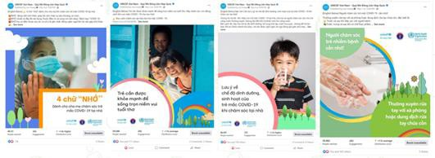
Outcomes and Key Learnings
Outcomes and Impact
Key Learnings
This is an unprecedented way of campaigning in UNICEF Viet Nam.
Before the VDO, UNICEF Viet Nam had not used social listening to inform a vaccination media campaign like Safe Journeys.
Safe Journeys reached ~25 million people in phase 1 of the campaign.
Integrating with ongoing national efforts to address misinformation is more effective than stand-alone interventions.
Dashboards alone are not enough. Human analysis, insights, and consultation provide tangible value.
More support is needed to equip UNICEF teams to respond to misinformation and support national partners.
Close collaboration with country staff is essential to making sure the VDO is responsive to country needs and useful in real- world context.
Local and ethnic minority language social listening is needed to understand online conversation.
63

Slide 5
Giap Nguyen
Communication Consultant, UNICEF Viet Nam
trnguyen@unicef.org
THANK YOU

