Slide 1
Dry run for
Covid-19 Vaccination
Dr Danish Ahmed
NPO Immunization; WCO-India

Slide 2
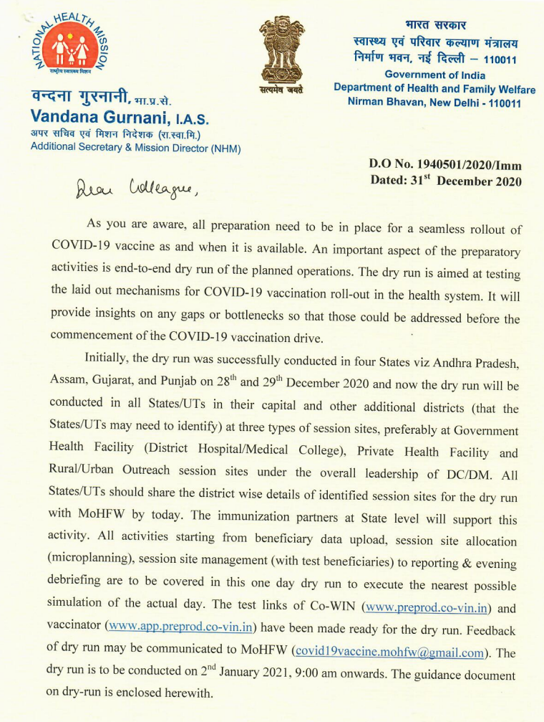
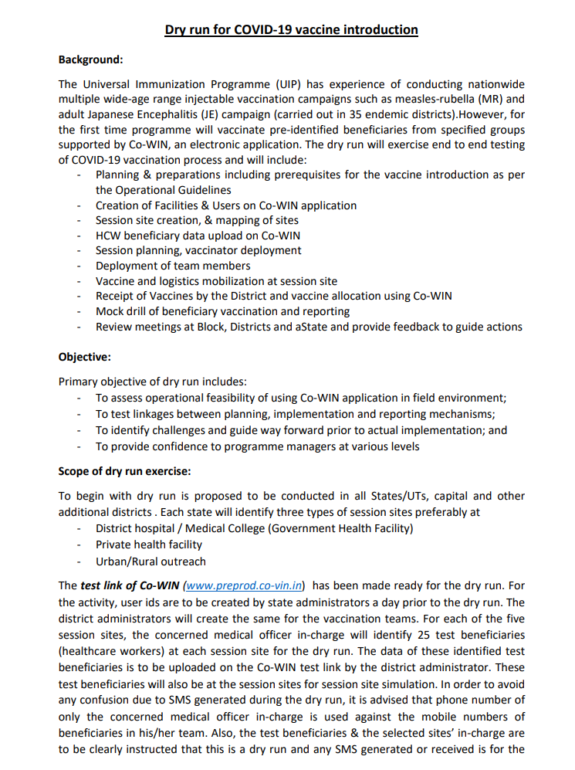

Slide 3
Objectives of Dry Run
(2 Jan 2021)
Assess operational feasibility of using Co-WIN application in field environment;
Test linkages between planning, implementation and reporting mechanisms;
Identify challenges and guide way forward prior to actual implementation; and
Provide confidence to programme managers at various levels

Slide 4
Scope for Dry rum
Conducted in all districts with objectives to:
  Assess operational feasibility of using Co-WIN application in field environment;
  Test linkages between planning, implementation and reporting mechanisms;
  Identify challenges and guide way forward prior to actual implementation; and
  Provide confidence to programme managers at various levels
End to end planning tested during dry run
Beneficiary Registration
Microplanning
Vaccination at planned site
Look for dry run learnings to identify bottlenecks

Slide 5
Conducting the Dry Run – 2 January 2021
One-day exercise at district followed by review at State Task Force
Activities will include Session planning (Co-WIN and field), deployment of all logistics, teams and beneficiaries, and vaccination drill
Teams engaged in dry run should be trained on Operational Guidelines & Co-WIN
State administrators will create district users
District administrators will create facilities Cold Chain Points, Session, and Vaccinator
Medical officer in-charge will identify 25 test beneficiaries (healthcare workers) for each session site for the dry run
District administrators will upload data of test beneficiaries in the Co-WIN test link
  These test beneficiaries will also be at the session sites for simulation
  Mobile number of medical officer in-charge will be used against the mobile numbers of beneficiaries to avoid confusion due to SMS generated during the dry run
  Test beneficiaries & medical officer in-charges should be briefed that SMS generated or received are only for the dry run purpose.
Test Call Centre 104 / 1075 during the dry run

Slide 6
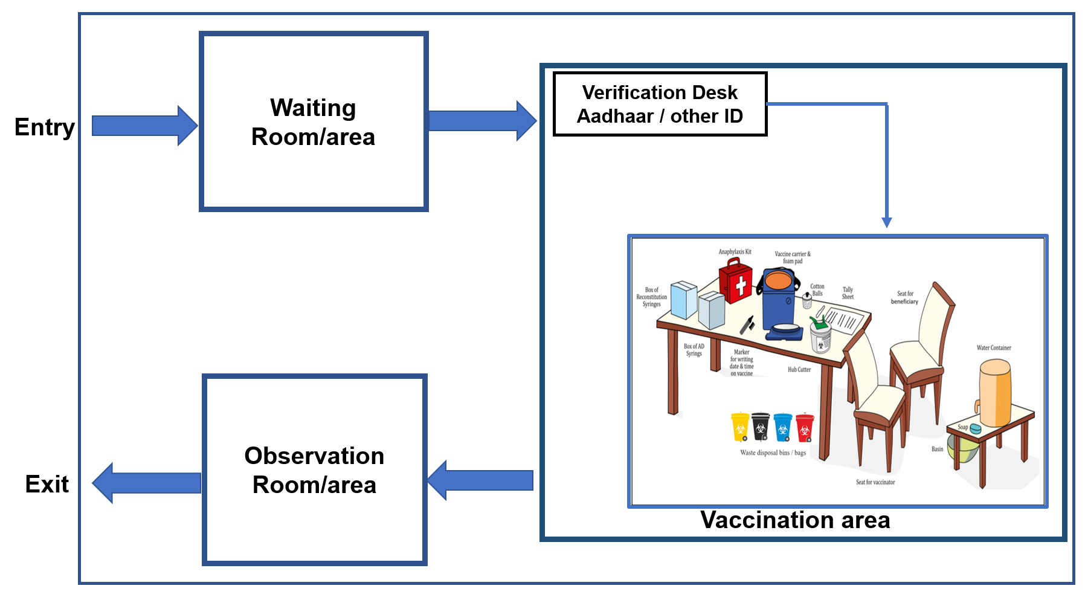
Layout Planning for Vaccination Site
Separate entry and exit if possible
3 separate rooms or areas
  Waiting room
  Vaccination Room
  Observation Room
Adequate physical distance between chairs/ seats in waiting rooms
Friendly to people with special need
Arrangement of drinking water for beneficiaries at session site

Slide 7
Assess Session Flow with Dummy Beneficiaries (HCW)
25 HCWs visit session site in 2 hour time slot
VO-1: Matches beneficiary names from list and allows entry
VO-2: Verifies beneficiary using Co-WIN application
Vaccinator officer follows SoP of vaccination (without vaccinating)
Vaccinator officer inform VO-2 about vaccination
VO-2 report vaccination in the Co-WIN app
VO-3 & 4: Manage crowd, IPC messaging, support Vaccinator, 30 min wait after vaccination
VO-2 report 2-3 AEFIs in Co-WIN application at session site

Slide 8
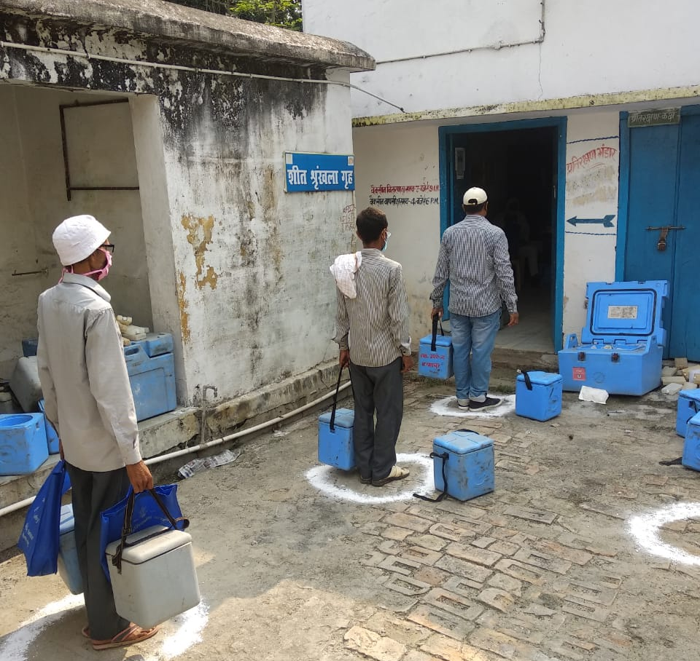

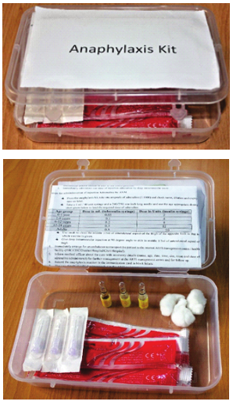
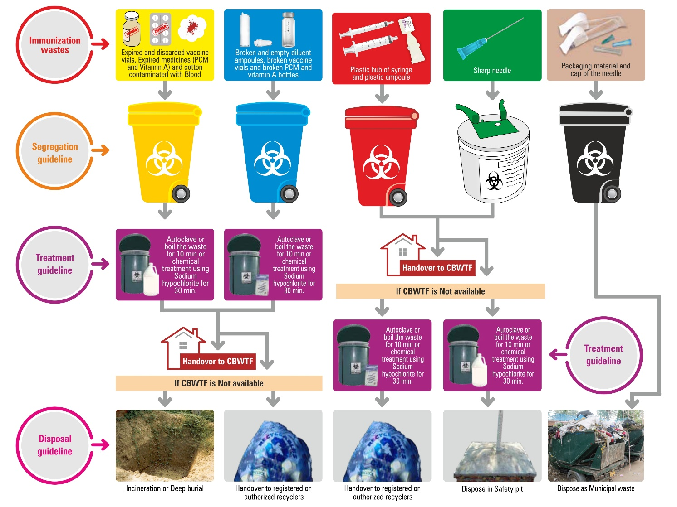
Organize all Logistics at Session Site

Slide 9
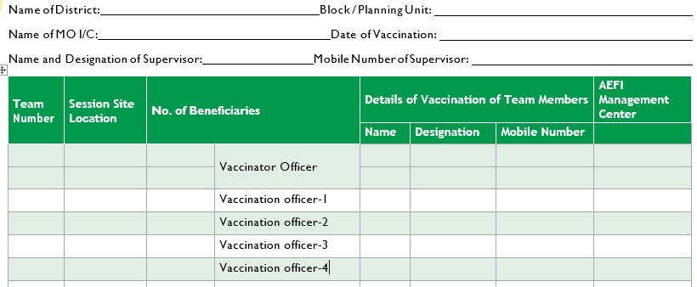
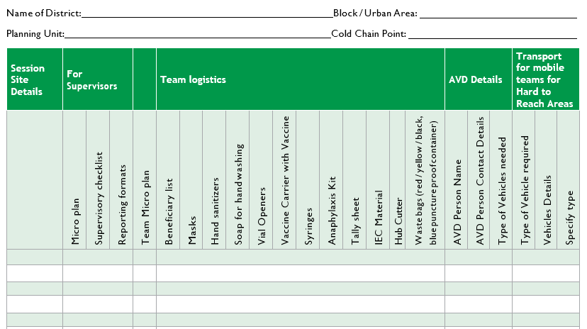
Use Session and Logistic Planning Format from Op Guidelines

Slide 10
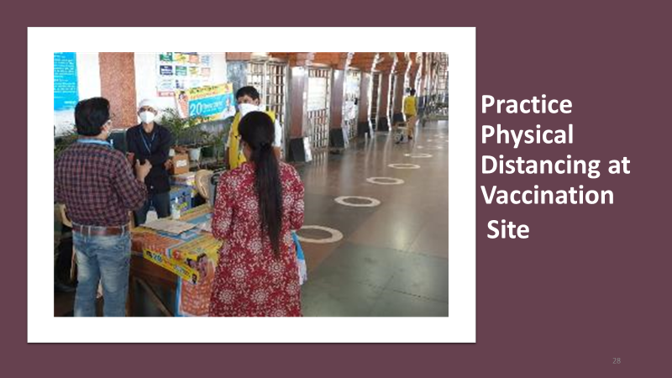
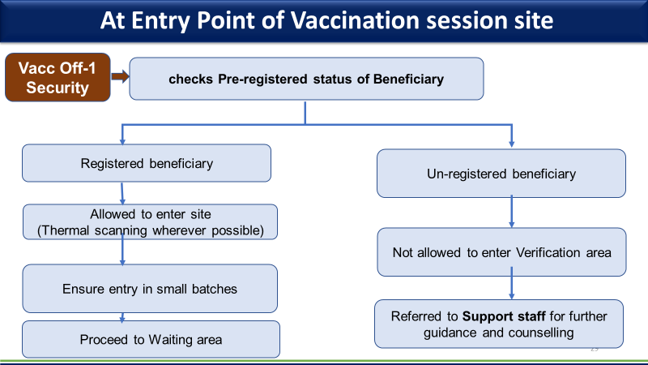
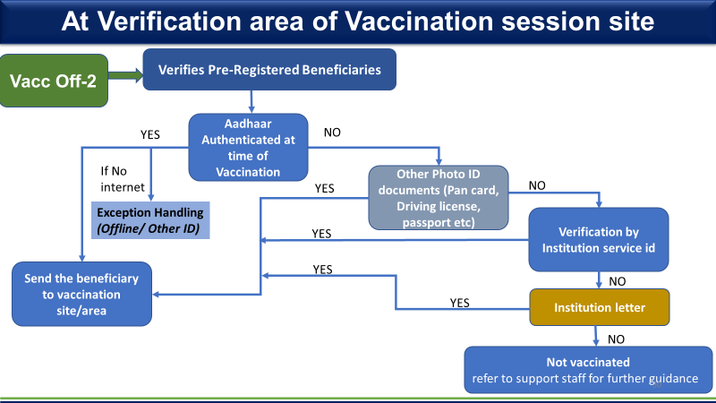
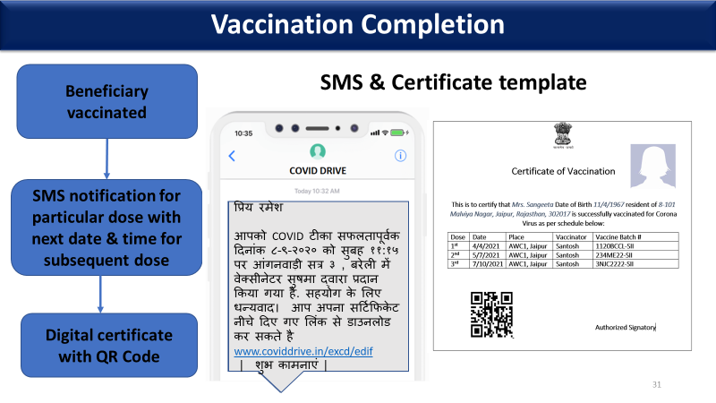
Follow all Processes for Vaccination at Session site

Slide 11
Use Supervision Format from Op Guidelines

Slide 12
Dry Run Activities – 2 January 2021
State Administrator create user id for district | State Administrator
District Administrator create facilities & user id for teams | District Administrator
District identify 25 test beneficiaries for each session | DIO & concerned MO I/C
Session site creation, Beneficiary data upload, Allocation of session (beneficiary / vaccinator) and vaccine, Information to CCP and Vaccinator about session site date / timing | District Administrator
Inform Vaccination Officers 1-4 and Supervisor | BTF / MO I/C, DTF
AVD planning at CCP and Mustering (bundling) of vaccine logistics | MO I/C, DTF, CCH
Team members / Supervisors reaches session site, responsibilities allocated to Vaccination Officer 1-4 and Session site prepared | Team Member/ Supervisor
Beneficiary mobilization (25 HCWs) for session site | BTF & DTF
Conducting session as per guidelines | BTF / Supervisor
Evening review meeting at Block | BTF
Evening review meeting at District | DTF

Slide 13
Summary
Dry run is an opportunity to test of COVID-19 vaccination planning and processes
DTF and BTF of blocks where sessions being planned are responsible for this exercise
STF will review feedback, guide further actions and provide feedback to MoHFW
Exercise will generate critical information on further refinement and provide confidence
Email your feedback to MoHFW covid19vaccine.mohfw@gmail.com

Slide 14
Thanks

