Slide 1
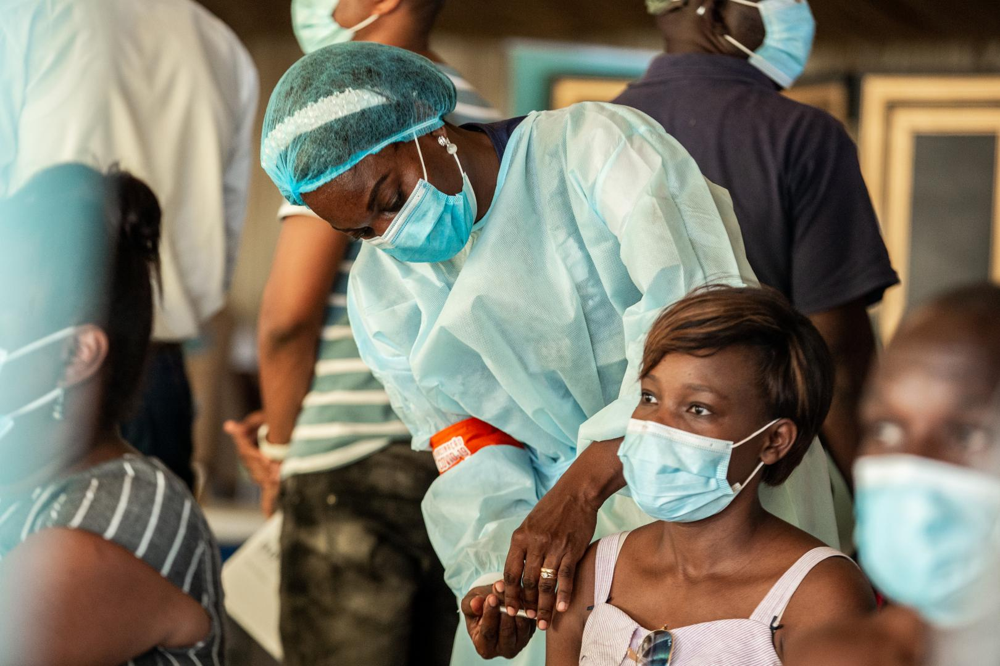
A Rapid Review of COVID-19 Vaccination Roll-Out
Lessons learned on service delivery and integration
September 2022
Image courtesy: https://www.afro.who.int/news/moving-forward-science-covid-19-vaccine-effectiveness-africa

Slide 2
Acknowledgements
A systematic review of COVID-19 vaccine roll-out experiences and lessons learned is being undertaken by the World Health Organization (WHO), the U.S. Agency for International Development (USAID) MOMENTUM Country and Global Leadership project, and COVID GAP, to produce learnings for program audiences at all levels—global, regional, country, and sub-national. This slide deck is the first in a series of multiple rapid review products, highlighting learning, best practices, and recommendations for one of the eight selected themes.

Slide 3
Contents
Executive Summary
Background and Objectives
Methods
Results
Recommendations
Appendix

Slide 4
Executive Summary
Background
Three Service
Delivery Models
Key Takeaways
Recommendations
Spearheaded by WHO, USAID’s MOMENTUM Country and Global Leadership project, and COVID GAP, this systematic review on the COVID-19 vaccine roll-out experience provides early findings from the first rapid review on the theme of service delivery and integration.
Mass vaccination sites require multi-disciplinary teams of clinical and administrative staff to run effectively.
Adapt Strategies to Current Context
Mass Vaccination
Emphasize walk-in opportunities
Pursue partnerships – community volunteers, students, private sectors
Frequent, evidence-based communication
Service Delivery & Integration
Mobile vaccination clinics typically employ varied community mobilization strategies to bring in people to the clinics for vaccination.
Mobile Vaccination
Methods
Generate Demand with Trust
We combined the rigors of a systematic review with the time-bound delivery of a rapid review learning product. Limitations: Most studies conducted in early phase of COVID vaccine roll-out and in high-income countries.
Fixed-post vaccination sites require the least amount of spatial adaptation because they are purpose-built, however, mobilization is critical.
Fixed-Post Vaccination
Deploy diverse, inter-personal communication strategies
Cultivate leaders and champions for vaccination
First round of rapid review
25 studies analyzed
25

Slide 5
Background
COVID-19 vaccination efforts are faced with challenges around the distribution, delivery, and demand for the vaccines. The COVID Vaccine Delivery Partnership is shifting country assistance towards the scale-up of vaccinations, particularly for high-priority populations (such as health care workers, elderly people, people with comorbidities, pregnant women, etc.) and towards integration of COVID-19 vaccination into immunization programs and primary health care (PHC).
Learning from experiences, best practices, and innovative solutions can help countries in their efforts to scale-up and optimize COVID-19 vaccine delivery
The systematic literature review will cover eight thematic areas on COVID-19 vaccine rollout and produce rapid reviews:
Political Will & Financing
Supply & Logistics
Planning & Coordination
Demand & Uptake
Service
Delivery & Integration
Adverse Event
Monitoring &
Management
Health
Workforce
Monitoring &
Evaluation
This presentation provides early findings from the first rapid review on the theme of service delivery and integration

Slide 6
Objectives of Service Delivery and Integration Rapid Review
Describe the different service delivery models for COVID-19 vaccine rollout.
​Describe adaptations made for integrated service delivery and for reaching different priority groups in different contexts.
Synthesize the best practices and lessons learned from these rollout strategies.

Slide 7
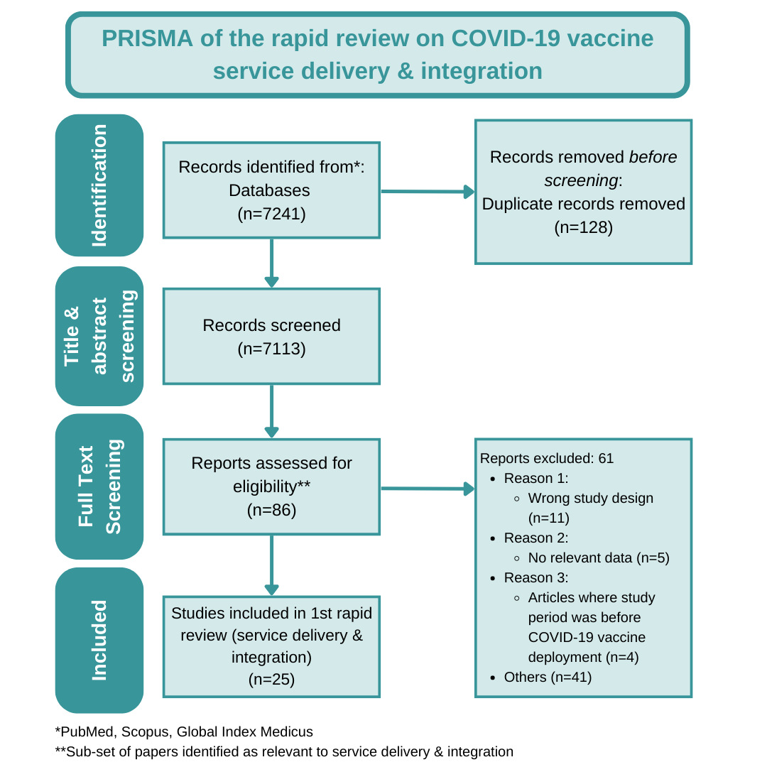
Methods
We combined the rigors of a systematic review with the time-bound delivery of a rapid review learning product
Conducted the search in: PubMed, Scopus, GIM Text, GIM numeric using developed search criteria
Two persons independently screened each title and abstract and full text in COVIDENCE
An initial title and abstract screening of a sample of 1,000 papers was done to inform domain specification, development of the abstraction tool, and refinement of search strategy
Inclusion and exclusion criteria were pre-specified
Data was abstracted on Excel and analyzed on Dedoose
First round of rapid review on service delivery and integration consists of 25 papers
Synthesis was by vaccine delivery models

Slide 8
Results

Slide 9
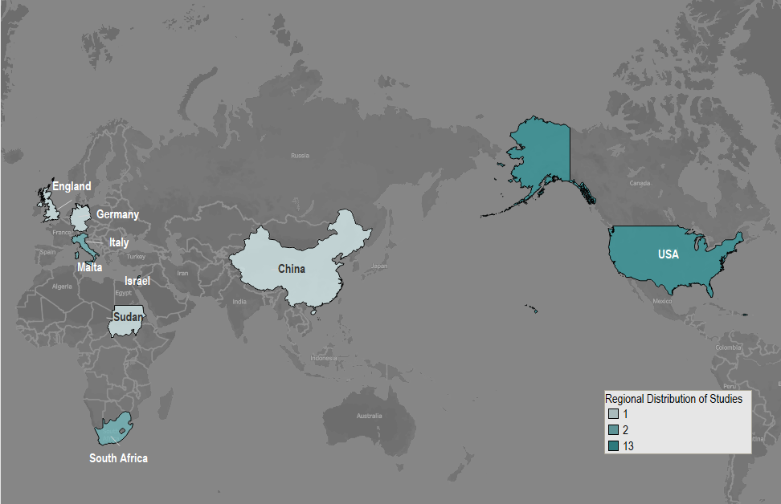
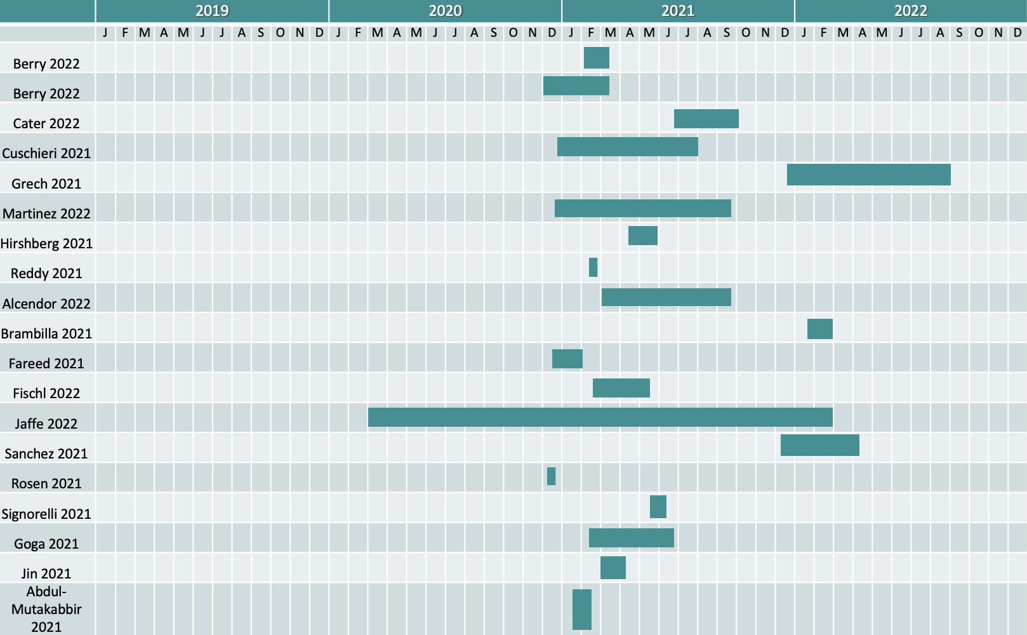
Overall, 25 papers were analyzed. These were largely from high-income countries, had short duration, and commenced in the early phase of the COVID-19 vaccine rollout.
Majority of studies (84%) are from high-income countries
Median study duration was 2 months; 13 (56%) studies began within the first 4 months of COVID-19 vaccine rollout in Q1 of 2021
USA (13), Italy (2), Malta (2), South Africa (2), Israel (2), Germany (1), Sudan (1), England (1), China (1)

Slide 10
Results showed three main service delivery models:
Mass vaccination
High-volume, high-speed vaccination activities, typically conducted in non-health care settings for rapid vaccine delivery during health emergencies.
Mobile vaccination
Mobile vaccination is an umbrella term to describe various initiatives to bring vaccination services closer to communities in need on a small scale. Typically targets rural areas, underserved minorities and socially marginalized populations.
Fixed-post vaccination
Vaccination services that are provided in a purpose-built or adapted permanent/semi- permanent physical structure, usually within health care settings, like an immunization clinic in a hospital or primary health care facility. It could also refer to non-traditional health care settings, such as school health clinics.

Slide 11
Mass vaccination sites were observed to have five functional steps with adaptations made for different contexts.
Each site requires a multi-disciplinary teams of clinical and administrative staff to run effectively.
Appointment & mobilization
Facility-initiated appointment system with flexibility to reschedule [SA⁹]
User-initiated, centralized system for qualifying prioritized groups [USA¹⁵]
Registration & screening
What?
COVID-19 vaccine info sheets in multiple languages and translators on site to overcome language barriers [USA¹⁵]
History taking
Adaptations
Inoculation
Observation
What?
Infrastructure back-up with oxygen cylinders, crash carts, and stretcher for emergencies [USA^{15,}USA ²⁴, Italy¹³]
What?
Pre-registration through web-portals, phone, etc.
Adaptations
Verification, symptom screening, consenting
Adaptations
What?
Documenting history of anaphylaxis/ allergies/co-morbidities
Unified history taking and inoculation steps to reduce time wastage, increase convenience [SA²²]
Process of getting the shot
In batches according to the number of stations available [SA⁹] or one-by-one as people walked or drove in [USA¹⁵]
What?
Precautionary post-vaccination observation
Adaptations
15-min mandatory waiting for those without history, [USA¹⁵, SA⁹, SA²², Malta⁵], 30 mins for those with prior history of allergies [Malta⁵, SA²², USA¹⁵]
Adaptations
Lessons learned
 | Challenges | Enablers
Pre-vaccination/ mobilization | Lack of a system to categorize potential clients by their risk-level [SA⁹] Inability of system to optimize appointment slots with HCWs availability [SA⁹] | Partnerships with private sector partners, local hospital systems for scheduling support, planning, inventory management, and set-up and maintenance of data systems
At vaccination | Compromise in regular clinical care in order to meet staffing needs of mass vaccination sites [SA⁹] | Partnerships with local medical groups for infection prevention and control, site security, supply of medical equipment [USA²⁴] Partnerships with local community and university for volunteer support [SA²²]

Slide 12
Mobile vaccination clinics employed various strategies to execute the three main functional steps.
Mobile vaccination clinics typically employ varied community mobilization strategies to bring in people to the clinics for vaccination.
Community Mobilisation
Strategies
Appointment / Registration
Religious/faith leaders managed registration and appointment lists for their communities to show their support and encouragement for COVID-19 vaccines. [USA²⁵]
Inoculation
Integrated/single window service provision of COVID-19 vaccines along with other valuable services to the community [USA¹⁷]
Catalysing events brought together a wide range of experts and stakeholders to address questions, concerns, myths and misconceptions. [USA²⁵]
Incentives (financial and non-financial) to encourage vaccine uptake [USA¹⁷]
Multilingual mobile apps to facilitate conversation between providers and patients who don’t speak the common language [China²³]
Information, education and communication (IEC) campaigns delivered through channels/people trusted by the target population and who have an existing rapport with the community. [USA²⁵]
Strategies
Strategies
Lessons learned
 | Challenges | Enablers
Pre-vaccination/ mobilization | Historical mistrust of the formal health care system created challenges in mobilizing the people to take the vaccine. [USA²⁵] Inequity and lack of transparency in the vaccine allocation process for disadvantaged communities created challenges of sufficient vaccine availability for socially marginalized populations. [USA²⁵] | Forming and leveraging partnerships with groups/people who have an existing relationship, rapport and trust of the target population [USA¹⁷] Consistent engagement and frequent presence of the clinic/team with the community [USA¹⁷] Serving everybody who came to the clinic and not turning them down propagated trust within the community [USA¹⁷]
At vaccination | Cultural and language barriers create differences in the way the disease is explained, and in the rapport of doctor–patient relationship. [USA¹¹, USA²⁵] | Providing COVID-19 vaccines as an add-on service with other services valuable to the community [USA¹⁷] Counseling that helped clear doubts about the COVID-19 vaccine [USA¹⁷]

Slide 13
Fixed-post vaccination sites required the least amount of spatial adaptation because they are purpose-built, however, mobilization is critical.
At vaccination
Strategies
Incentives (financial/non-financial) for encouraging vaccine uptake [USA¹, USA², USA⁸, USA¹⁰]
Flexibility in the parental consenting process for students through online or over-the-phone provisions [USA⁸]
Pre-vaccination/mobilization
Strategies
IEC campaigns with a difference
Contextually relevant communication [SA²²]
Risks vs benefit approach to adverse event (AE) discussions [SA²²]
Targeted messaging [USA¹⁰], high frequency education and communication efforts tailored for target communities, parents and family (for students) [USA¹⁰, USA⁸]
One-on-one counseling for real-time update on vaccine effectiveness for under-represented groups in clinical trials [England³]
Declination forms for awareness of consequences of not taking the vaccine [USA¹]
Engaging vaccine champions and opinion leaders to advocate for the vaccine
Medical and political leadership at the forefront in active conversations with target populations [Engald³, USA^{1,} USA¹⁰]
Leveraging community voices and radically diverse viewpoints for consensus-building [USA¹⁰], dispel myths, misconception, and rumors
Practical appointment systems reduced barriers to accessing the vaccine
Walk-ins for those with no pre-plans of taking the vaccine/missed appointments [SA²², England³]
Multi-lingual appointment portals to overcome language barrier. [USA¹⁰]
Lessons learned
 | Challenges | Enablers
Pre-vaccination/ mobilization | Distrust of the fast-paced vaccine development [USA²] and historical distrust in the formal health care system [USA¹⁰] Logistical constraints for vaccines with short shelf life [USA¹²] Lack of timely data on COVID-19 vaccine safety and efficacy for pregnant women [England³] Long waiting time during the early phase of the pandemic [SA²²] | Identifying people facing barriers and removing barriers to access by arranging transportation, providing internet for booking, and offering walk-ins. [USA¹⁰]
At vaccination | Language barriers in understanding vaccine information sheets and consent forms for non-English speaking populations [USA⁸] | Partnerships with the private sector for efficient vaccine sourcing, staffing, running data systems, etc. [USA¹⁰, USA⁸] Partnerships with community and civil society organizations to mobilize human resource support for vaccine distribution and operations management. [USA⁸]

Slide 14
Summary of challenges and potential solutions, by delivery model, as seen in this review
S/N | Challenge | Potential Solution | Delivery Model
Pre-vaccination/mobilization | Pre-vaccination
1. | Difficulty in prioritizing patients based on risk levels (South Africa⁹) | Creation of a database with history/risk levels of those expected to take the vaccine at the facility
2. | Barriers to appointments, especially for socially vulnerable populations (South Africa⁹) | Option for walk-in shots (SA²², England³), flexible appointment bookings by scanning QR code (USA¹²), appointment by invitation (USA¹⁹), arranging internet access for those who need it [USA¹⁰]
3. | Cultural and language barriers in securing appointments and navigating vaccine clinics (USA¹¹, USA²⁵) | Multilingual and special needs app for those who don’t speak the common language (Germany²³, USA¹⁰),
4. | Myths, misconceptions, and mistrust in formal health system/the vaccine (USA²⁵, Berry², USA⁸, USA¹⁰) | Deliver IEC through trusted channels (USA²⁵), organize community catalyzing events with a variety of stakeholders (USA²⁵), maintain repeated clinic presence to build trust in the community (USA¹⁷), work with trusted partners who have a rapport with community (USA¹⁷), provide COVID-19 vaccine as integrated service with other essential services (USA¹⁷), offer incentives—cash/in-kind (Berry², USA¹⁴, NASN¹⁰)
5. | Inequity in vaccine allocation (USA²⁵) | Strong advocacy for vaccine availability irrespective of insurance status, immigration status, etc. (USA⁶)
6. | Lack of info on COVID-19 vaccine for pregnant women (England³) | Q&A sessions with leadership of OB/GYN and midwifery departments, one-on-one counselling of real-world vaccine efficacy data (England³)
At vaccination | At Vaccination site
7. | Logistics—timely coordination of vaccines (USA¹²) | Interactive vaccine dose prediction sheet to coordinate stock, need, etc. (Italy¹³)
8. | Challenges in consenting process (USA⁸) | Allow consenting over phone (USA¹⁰), multilingual app providing translation of consent form (Germany²³)

Slide 15
Key service delivery challenges and learnings related to priority populations, as seen in this review
S/N | Priority population | Challenge | Learnings | Delivery Model
1. | Health care workers | Distrust of vaccine-development process Myths, misconception, and rumors | Frequent, relevant IEC efforts to address doubts on rumors and misconceptions, and clarification on the rigor and legitimacy of the vaccine development process
2. | Elderly people | Age-related illnesses and mobility issues making it difficult to navigate the mass vaccination site | Unify history-taking and inoculation steps to reduce inconvenience and time spent (Italy²¹)
3. | Pregnant women | Lack of clear guidance on vaccinating pregnant women due to non-inclusion in clinical trials resulting in concerns about safety and risk of vaccinating pregnant women (England³) | Counseling and service delivery should be by providers women regularly interact with (England³) Update and disseminate real-time data and insights on COVID-19 vaccine safety and efficacy for pregnant women
4. | Socially marginalized populations (injecting drug users [IDU], undocumented migrants, traditionally vaccine-hesitant people, etc.) | Distrust in the formal health care system Myths, misconception, and rumors Language and cultural barriers Barriers to access owing to geographic, racial and ethnic marginalization | Approach IEC campaigns with utmost sensitivity Targeted messaging addressing concerns to the population (USA⁸, USA¹⁰) Provide COVID-19 vaccine as an add-on service with other services of interest to the community (England³, USA¹⁷) Provide incentives (cash/in-kind) (Berry², USA¹⁴) Provide walk-in options (USA¹⁰) Address social determinants of health, which restrict access (lack of transportation, internet access for bookings, etc.) (USA¹⁰)

Slide 16
Examples of COVID-19 vaccine integration as seen in this review
S/N | Target Population | Integration | Delivery Model
1. | Injecting drug users | Point of care tests for HIV, syphilis, and Hep C, and needle exchange programs along with COVID-19 vaccines (USA¹⁷)
2. | Pregnant women | COVID-19 vaccines with ultrasonograms and check-ups in antenatal clinics (England³)
3. | Students | COVID-19 vaccines with flu-vaccine shots (USA¹⁰)
4. | General population | COVID-19 vaccines offered at blood donation camps (Israel¹⁶)

Slide 17
Key findings from the literature and recommendations
Limitations
Gaps in literature warrants contextualization of findings
Most studies were done in the early part of the global COVID-19 vaccine roll-out when cases were rising, vaccine supply was short, and demand for shots was high.
Adaptations
Tweaks to early pandemic phase strategies are needed today
Demand generation
Multidisciplinary collaboration and confidence building approaches are key to drive uptake
Programs should invest in interpersonal communications, e.g., one-on-one conversations for some groups with high distrust of the health care system.
More studies from LMICs are needed. Global partners should support LMIC researchers to document and share their lessons learned.
Programs should cultivate leaders and influencers—medical, political, religious, community leaders—as champions for vaccination.
Communication strategies should engage diverse voices with the goal of building consensus, not just to convince.
Requiring pre-visit visit appointments is no longer necessary with more vaccine supply available. Mobilization messages should emphasize walk-in are welcome​.
Risk/benefit messaging for AE following immunization concerns was fit for the early phase. Today’s messaging should address falling risk perception and vaccine confidence.
For priority and socially marginalized populations, invest in trust-building and provide tailored approaches, like incentives, add-on/ integrated services, push delivery.
Tailored communication is required. Strategies and messaging should address current concerns, be evidence-based and frequent.
Update literature review in the future when more countries have published their experiences.
Most studies were from high-income countries, so literature review findings should be contextualized and strategies adapted for low- and middle-income country (LMIC) settings.
​Pursue partnerships—community volunteers, students (nursing, pharmacy, or medical students)—for extra hands; private sector for logistics​ support.
Limitations and next steps
Targets of recommendations | Immunization community | Country programs | Global/regional partners/donors | Researchers

Slide 18
Appendix

Slide 19
Theory of change: Elements of the COVID 19 vaccine deployment, delivery and demand
Geo-political, economic, epidemiological, and health systems context
Leadership and governance
Operational inputs for service delivery
Intermediate outcome
Program outcome
Financing
Health workers availability, skill, and motivation
COVID vaccine services available, assessable, and convenient
Increase in COVID-19 vaccine coverage and utilization
Political will
Bundled COVID-19 vaccines supply: quantity and type
First and last mile logistics for vaccine and service delivery
Positive norms, confidence and trust about COVID-19 vaccination
Coordination
Planning
Performance management/ monitoring & evaluation
Reduction in COVID-19 vaccine wastage
Cold chain adequacy and penetration
Behavior change communication and interventions
Intention to uptake COVID-19 vaccination
Color key
Context
Vaccine & vaccination data, disease surv. & AE following immunization monitoring systems
Supply side
Demand side
Outcome

Slide 20
Overview of study design, countries, and data sources
Study Design | No. of Studies (N=25) | Countries | Data Sources
Case studies | 7 | USA (4), Italy (1), Israel (1), China (1) | Program implementation process data (4), facility registers (2), secondary sources (websites) (1)
Observational study (1 time assessment, no control group) | 5 | USA (4), Italy (1) | Web-based survey (1), state database (1), facility registers (2)
Pre – post study | 1 | England (1) | Facility registers (1)
Retrospective program evaluation | 7 | USA (4), Malta (2), South Africa (1) | Facility records (2), primary qualitative data (2), government. database, published research reports, internal reports (2), grey sources: newspapers, websites (1)
Cluster randomized trial | 1 | USA (1) | Electronic medical record (1)
Others (integration ideas, lesson learned from an open-label study, app pilot testing) | 4 | Israel (1), South Africa (1), Germany (1), Sudan (1) | E-registries (1), program implementation process data (1), unspecified (1)

Slide 21
Number of studies*: Delivery models and target population
Target population | Mass vax | Mobile vax | Fixed vax – health care settings | Fixed vax – non health care settings | System-level delivery insights | Row total
HCW | 1 |  | 5 |  |  | 6
Pregnant women |  |  | 2 |  |  | 2
Students & affiliates |  |  |  | 2 |  | 2
Socially marginalized pop (e.g., IDU) |  | 1 | 1 |  |  | 2
Gen population | 5 | 4 |  | 1 | 4 | 14
Column total | 6 | 5 | 8 | 3 | 4
*Some papers reported more than 1 model. Hence, the row and column totals don’t add up to 25

Slide 22
Studies extracted – 1/4
S/N | Author_Year | Country/s of study | Geographic setting | Health care context | Implementer | Study design | Scope of intervention | Target age group | Target population
1 | Berry_2022 | USA | Rural |  |  | Observational study (no control group) with only one time assessment |  |  | Specific occupational group
2 | Berry_2022 | USA |  | Others (e.g., workplaces, educational institutes, markets, supermarkets, social gathering, worship centers) | Private | Intervention and control group with random assignment | Pilot | Adults | Nursing home residents
3 | Cater_2022 | England | Rural | Tertiary, community | Public | Pilot before and after study | Pilot | Young adults 18–24, young professionals 25–34, adults 35–49, older adults 50–64 | Pregnant & lactating women
4 | Cuschieri_2021 | Malta |  |  | Public | Retrospective program evaluation | Routine national | Adults | General population
5 | Grech_2021 | Malta | Urban & islands | Tertiary, community | Public | Retrospective program evaluation | Routine | Adults | Specific occupational group: HCWs, community pharmacy staff, teachers, elderly (+60y), medically vulnerable groups
6 | Martinez_2022 | United States (Mexico border counties) | Urban | Community | Public | Retrospective program evaluation | Routine sub national | Adults | General population

Slide 23
Studies extracted – 2/4
S/N | Author_Year | Country/s of study | Geographic setting | Health care context | Implementer | Study design | Scope of intervention | Target age group | Target population
7 | Hirshberg_2021 | USA |  | Primary | Private | Observational study (no control group) with only one time assessment | Pilot |  | Pregnant & lactating women
8 | NASN_2021 | USA | Urban | Community | Public | Retrospective program evaluation | Routine sub-national | All ages | General population
9 | Reddy_2021 | South Africa | Peri-urban | Tertiary | Public | Retrospective program evaluation | Routine sub-national | Adults | HCW
10 | NASN_2022 | USA |  | Others (e.g., workplaces, educational institutes, markets, supermarkets, social gathering, worship centers) | Civil society organization | Retrospective program evaluation | Routine national | Not stated | General population
11 | Alcendor_2022 | USA | Urban, rural, security challenged | Community | Academic institution | Retrospective program evaluation | Pilot | Adults | People in vulnerable situations
12 | Andrade_2021 | USA | Urban | Community | Academic institutions | Case studies | Pilot | Adults | Frontline health care worker
13 | Brambilla_2021 | Italy | National | Mass vaccination in non-health care setting | Public | Case study | National | All ages | All population groups attending mass vaccination

Slide 24
Studies extracted – 3/4
S/N | Author_Year | Country/s of study | Geographic setting | Health care context | Implementer | Study design | Scope of intervention | Target age group | Target population
14 | Fareed_2021 | USA | Urban | Community | Academic institutions | Observational study (no control group) with only one time assessment | Pilot | Adults | Frontline health care worker
15 | Fischl_2022 | USA | Urban | Community | Public | Case studies | Pilot | Adults
16 | Jaffe_2022 | Israel | All | Others | Public | Other | Routine national | Not stated | Working adults
17 | Heidari_2022 | USA | Urban | Community | Academic institutions | Case studies | Pilot | Adults
18 | Mohamed_2022 | Sudan | All |  |  | Commentary |  | Adults | People in vulnerable situations (e.g., IDPs, conflict-affected locations, disaster-affected areas)
19 | Sanchez_2021 | USA | Urban | Tertiary | Academic institutions | Case studies | Pilot | Adults | Frontline health care workers

Slide 25
Studies extracted – 4/4
S/N |  | Country/s of study | Geographic setting | Health care context | Implementer | Study design | Scope of intervention | Target age group | Target population
20 | Rosen_2021 | Israel | National | Primary | Academic institutions | Case studies | Routine national | Adults | People with co-morbidities
21 | Signorelli_2021 | Italy | Urban | Mass vaccination in non-health care setting | Private | Observational study (no control group) with only one time assessment | Pilot |  | General population
22 | Goga_2021 | South Africa | Urban | Primary | Academic institutions | Main objective: phase 3B open label, but secondary objective focuses on 10 lessons learned | Pilot | Adults | Specific occupational group
23 | Noack_2022 | Germany | Urban | Tertiary | Private sector | Pilot testing of an app | Pilot | Adults | Immigrants
24 | Jin_2021 | China | Urban | Community | Public | Case studies |  | Adults | General population
25 | Mutakabbir_2021 | USA | Urban | Community | Academic institutions | Observational study (no control group) with only one time assessment | Pilot | Not stated | General population

Slide 26
Thank you
This review is made possible by the generous support of the American people through the U.S. Agency for International Development (USAID) under the terms of the Cooperative Agreement #7200AA20CA00002, led by Jhpiego and partners. The contents are the responsibility of MOMENTUM Country and Global Leadership and do not necessarily reflect the views of USAID or the United States Government.

