Slide 1
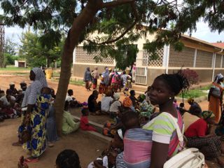
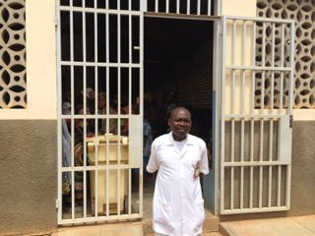
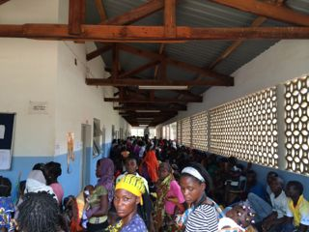
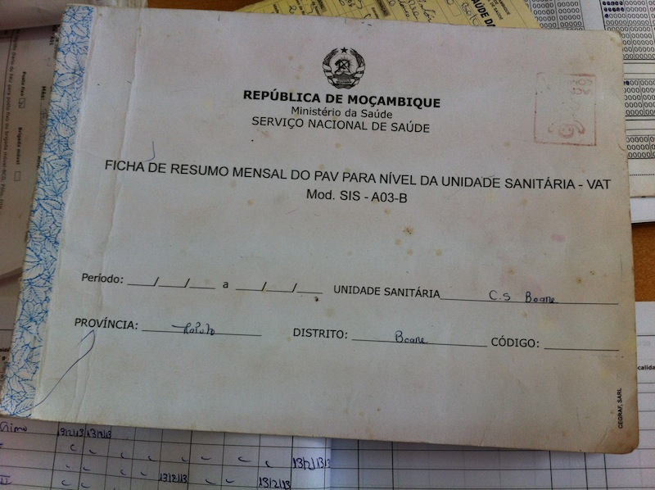
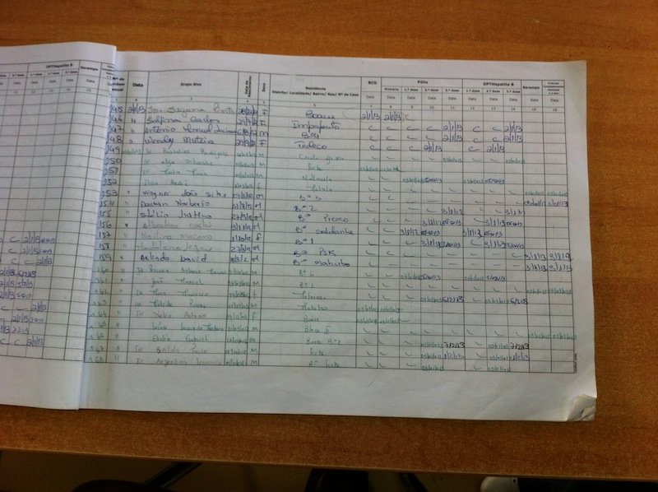
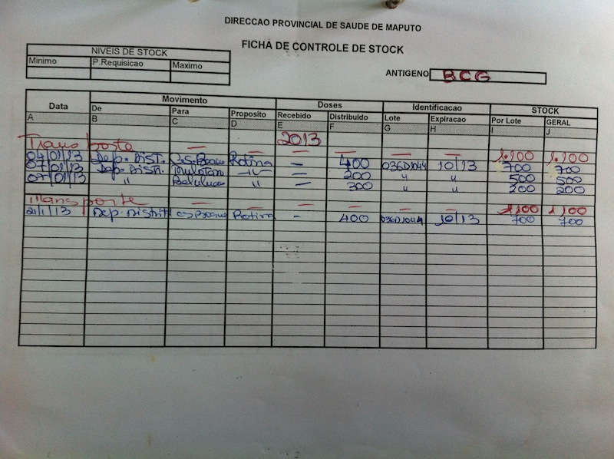
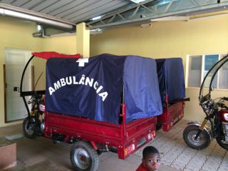
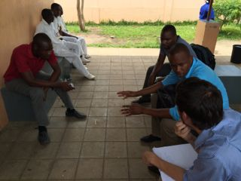
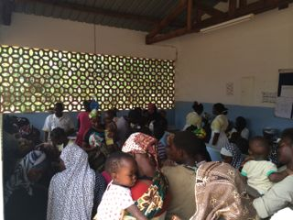
Vodafone :
Mobility,
Visibility, and
Access
To quality healthcare
11 November 2014

Slide 2
Agenda
An mHealth platform approach
Stock visibility through to the last mile
mVacciNation
Cross-referencing indicators
Dynamic reporting through relevant channels

Slide 3
Web/Mobile applications delivered through Mezzanine
Building mHealth solutions since 2005, including mobile and web applications and server installations.
5,000+ daily users of uniquely created workforce management applications across urban and rural landscapes.
Active deployments and local hosting in 4 (shortly 5) African countries
    Tanzania, Kenya, Mozambique, South Africa (shortly Nigeria)
Four broad solution clusters:
  Workforce Management
  Patient Reminders and Support
  Stock visibility
  Cold chain monitoring
  mLearning

Slide 4
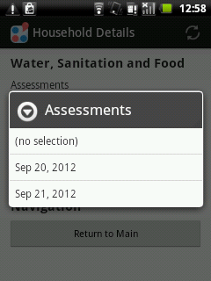
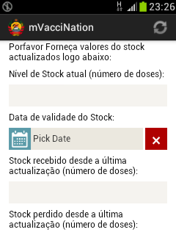
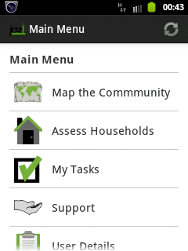
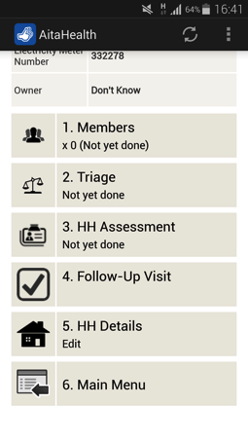
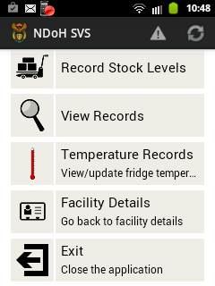
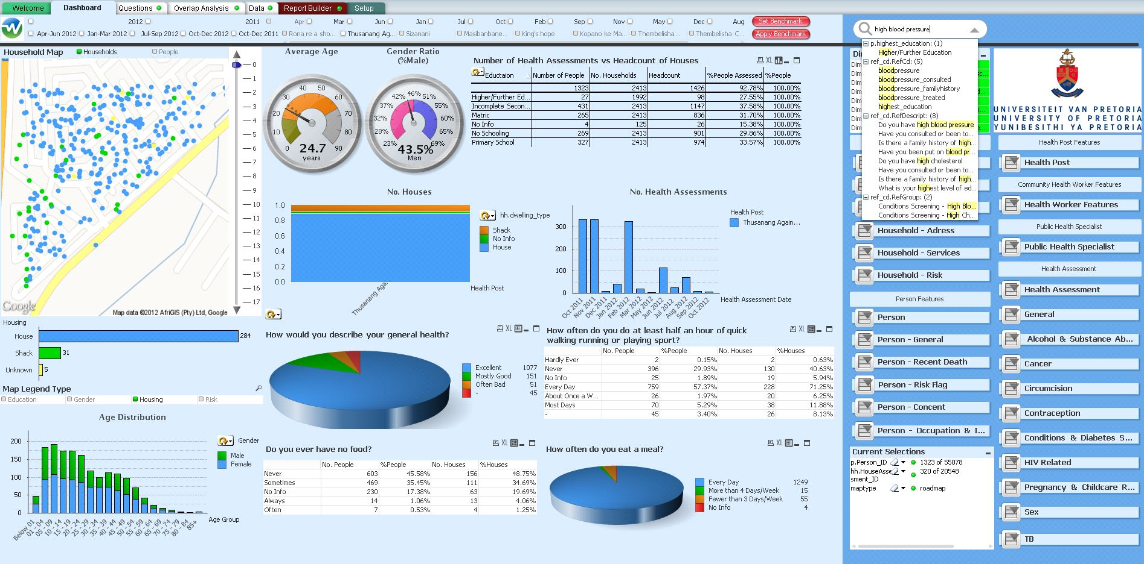

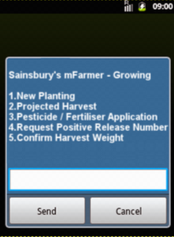
Multiple solution configurations sharing the same platform
Jamii Smart
mVacciNation
Jozi COPC
AitaHealth
KZN SVS
UP COPC
HELP
mFarmer

Slide 5











An mHealth platform enables the sharing of infrastructure
Mobile Learning
Security
Identity
Reporting
Data Collection
Event-driven payments
Task Scheduling
Intelligent Workflows
Client Interaction

Slide 6
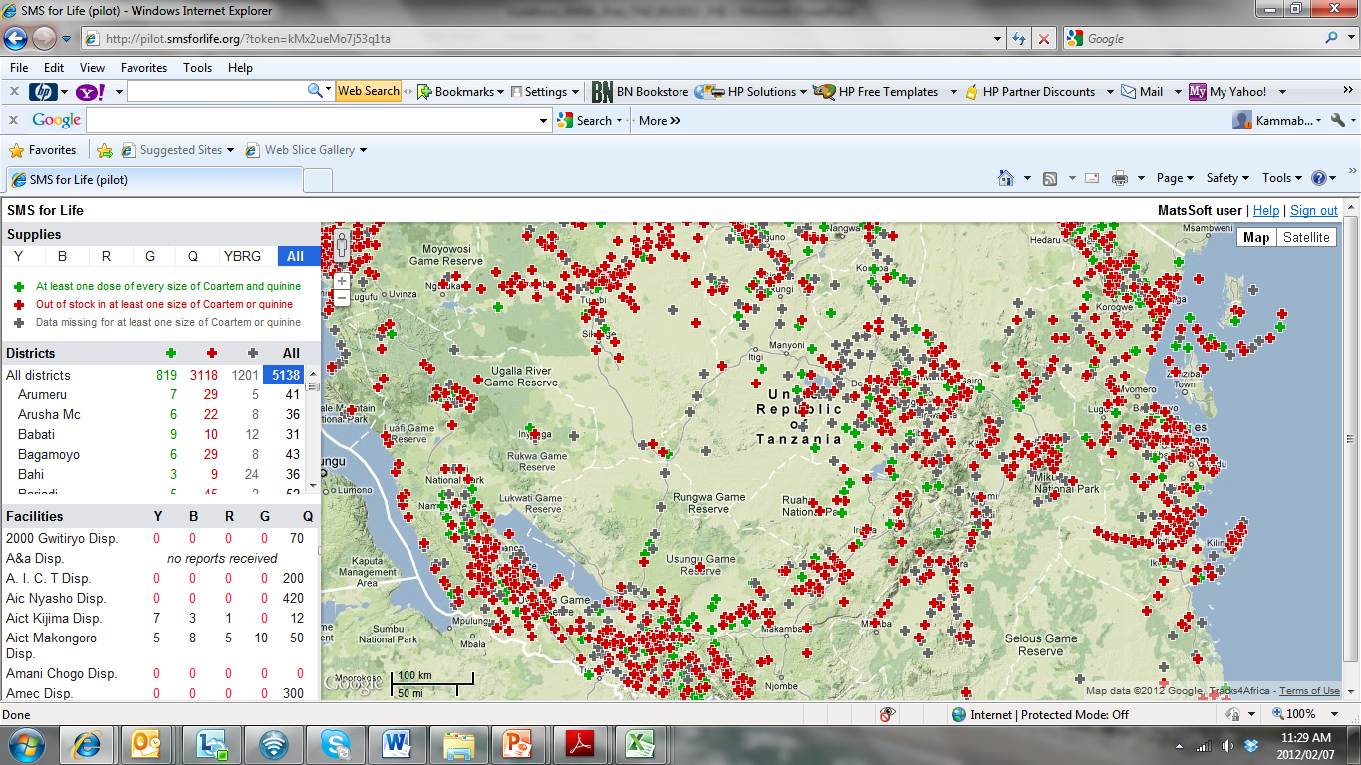
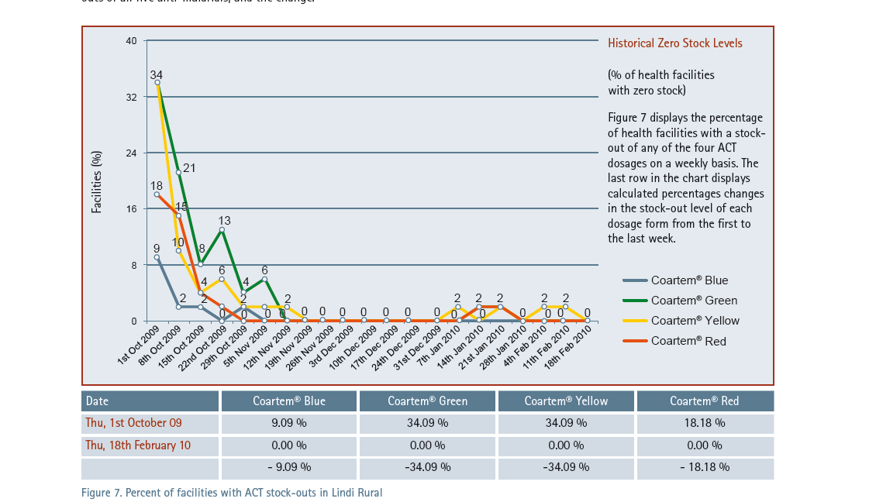

From 2008 : Stock Visibility
A large scale, national deployment
Nurses at dispensary level submit stock levels for key Malaria drugs via SMS – in return for an incentive
Significant reduction in drug stock-outs, improved availability of critical medicines
Quick, SLA-driven deployment based on Vodafone’s managed service capability
Full commercial roll-out to 5,100 public health facilities in Tanzania in 2011
Added TB, anti-Leprosy RX and Rapid Diagnostic Tests in 280 facilities in 2011.
Notes:
From 2008
Used incentives to nurses
Reduced stocks outs from high 80-90% to <10%
84% response rate
4% error rate

Slide 7










From 2013 : mVacciNation
1
Caregivers are registered in the system and receive relevant health notifications and vaccination records via SMS.
Caregiver/Mother
2
Health Workers use smartphones at facilities and during outreach visits to register caregivers and vaccination events.
Mobile Network
MoH Vaccination Backend Platform
Health Worker
3
Facilities report stock levels of vaccination stock on a regular basis in real-time.
Supply and demand are matched through graphic, real-time maps.
Service Delivery (Facility)
Supply Chain Service Provider
4
Notes:
From 2013

Slide 8
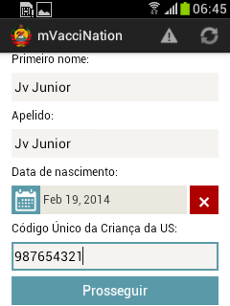
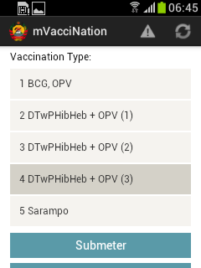
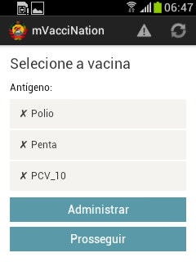
Register children, vaccination visit and antigens received
The human cost of a stock out

Slide 9
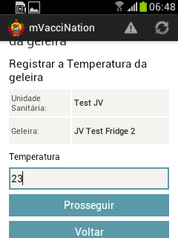
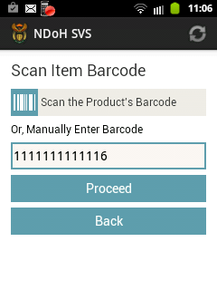
Register fridge temperature and stock level, expiry, wastage

Slide 10

Cross-referencing data indicators for optimal accuracy
Issued = Stock Intake – (Stock On-hand + Wastage + Transferred)
Or cross-referenced with aggregated or individual treatment indicators,
Eg number of vaccinations performed

Slide 11
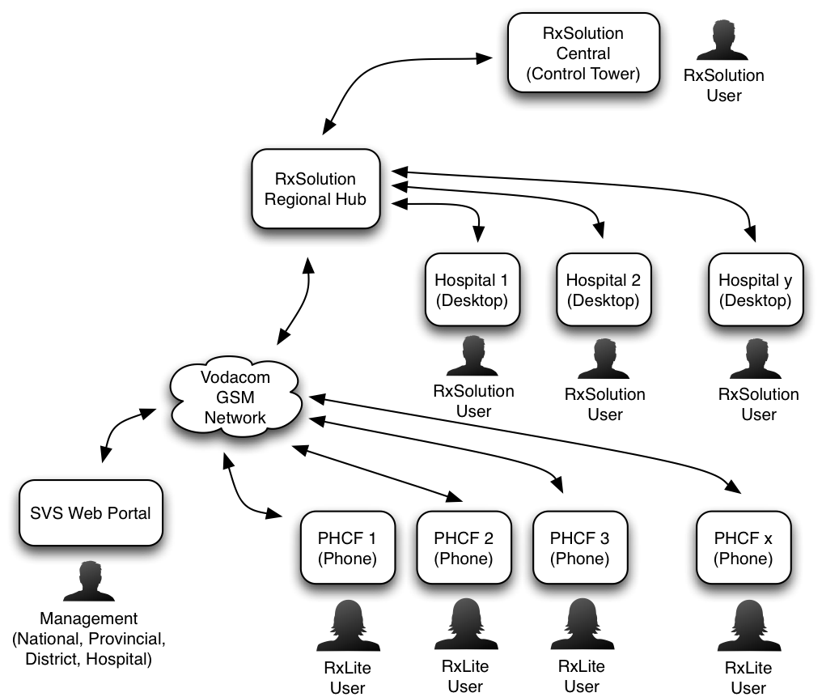
System stakeholders access

Slide 12
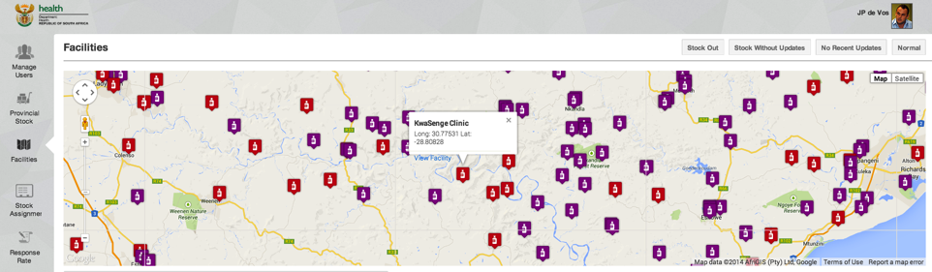
Reporting via a web dashboard

Slide 13
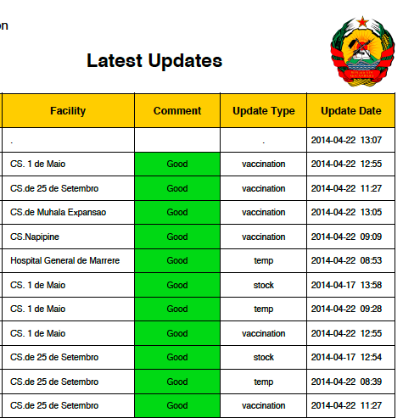
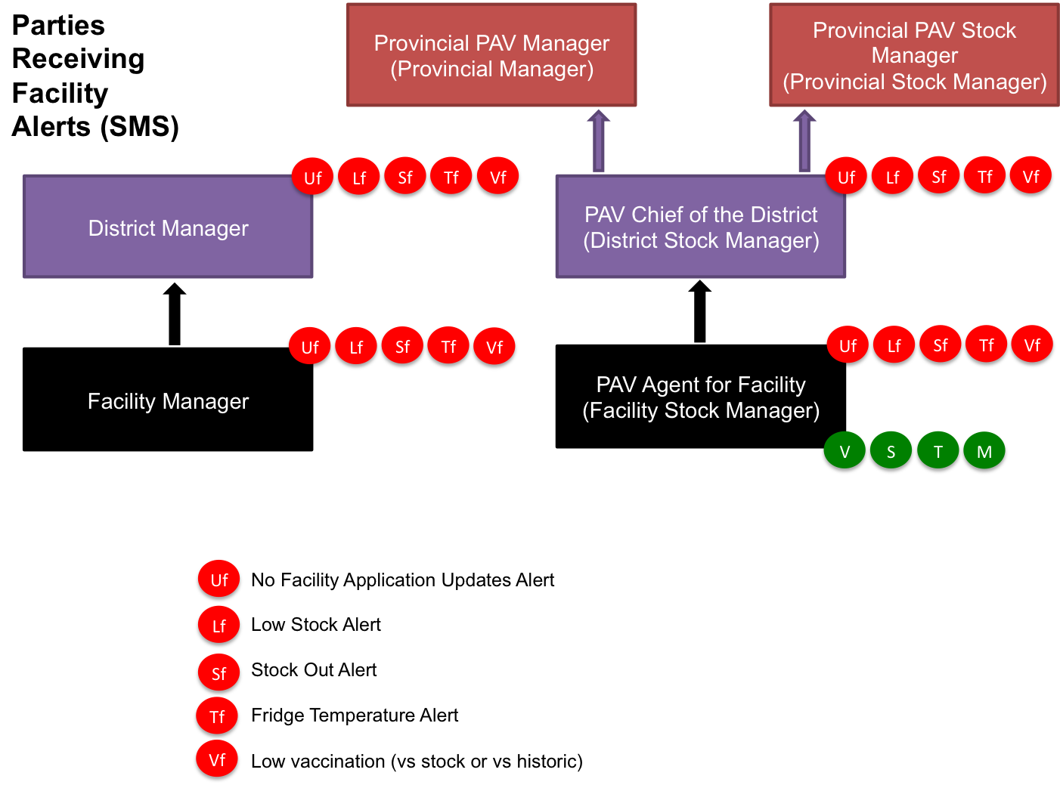
Reporting via XLS, PDF and SMS

Slide 14
Real-time reporting to all stakeholders as appropriate
Data reports are filtered and relayed to stakeholders to enable decision-making, for example:
District and facility managers receive immediate alerts when fridge temperatures are out of range or stock levels run low as per configurable “requisition points” per facility
Facility PAV agents receive daily and weekly summaries of clinic activity captured through mVacciNation
Certain facility summaries (eg weekly stock levels) are circulated to all facility staff throughout the district to ensure facility co-operation in managing stock levels.
If a facility does not submit updates every 48 hours, that triggers a warning to district management.
Comparing stock level movements with vaccination numbers allows the system to check for data integrity in daily or weekly cycles.
Notes:
From 2008
Used incentives to nurses
Reduced stocks outs from high 80-90% to <10%
84% response rate
4% error rate

Slide 15
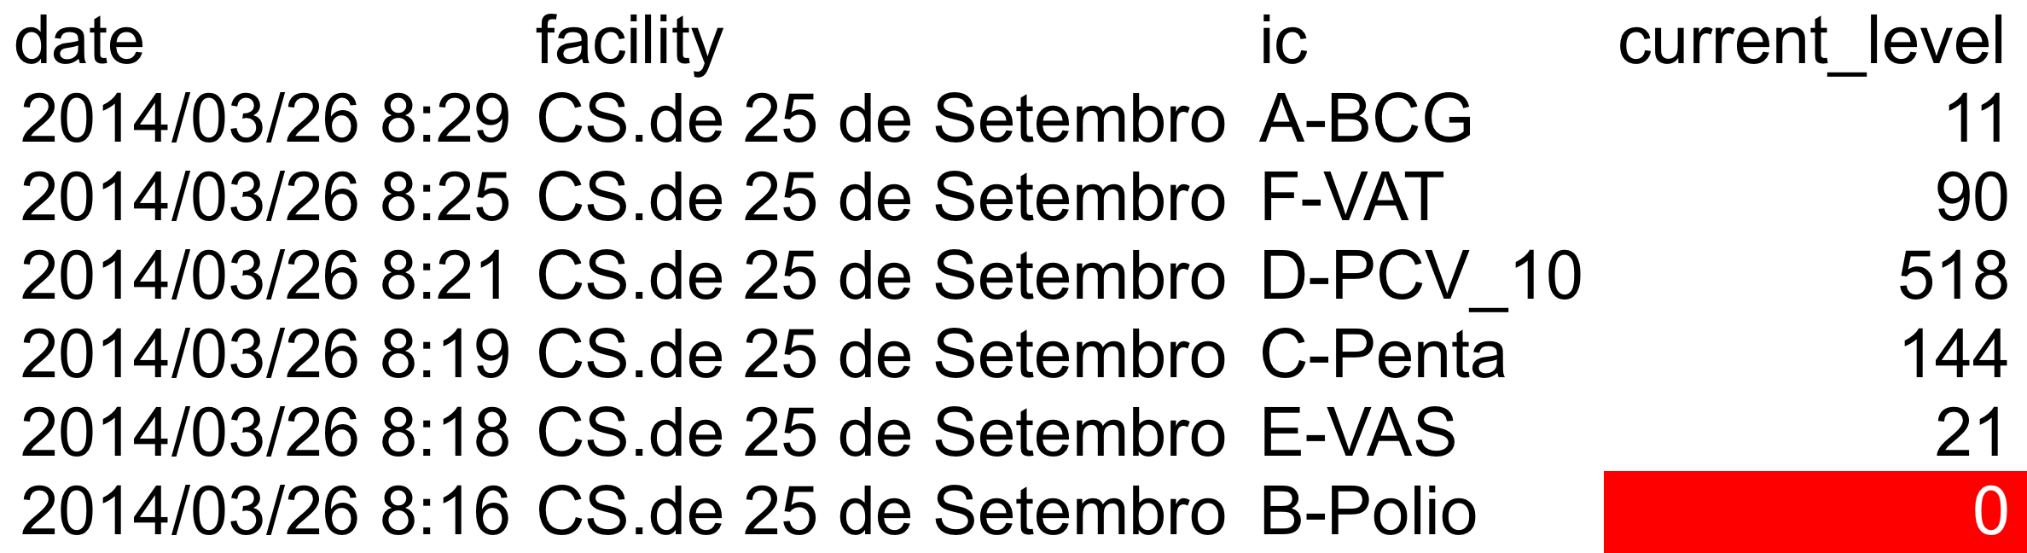
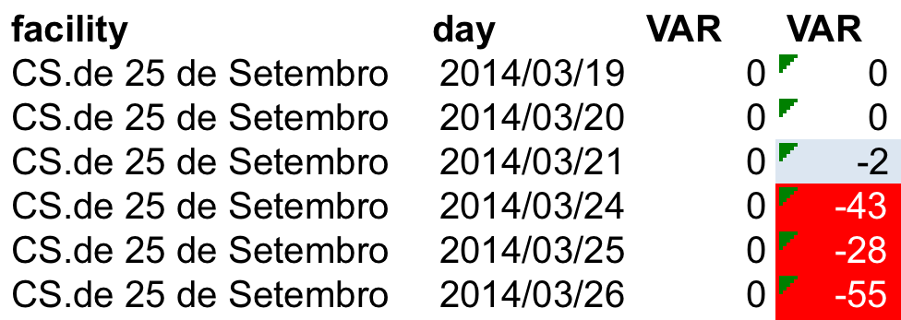
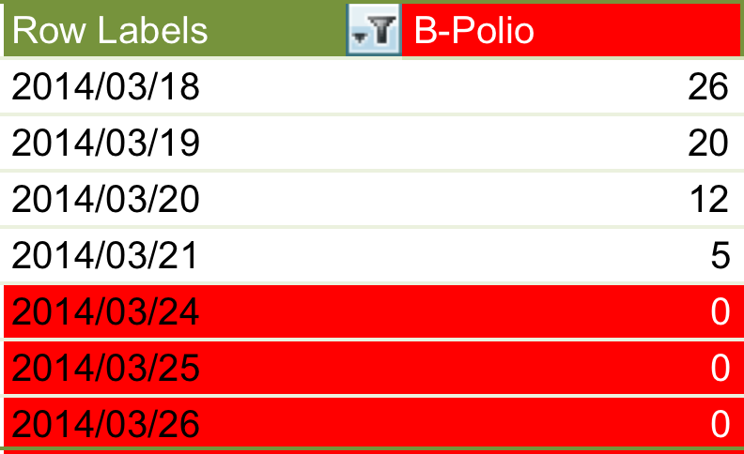
Examples of cross-referenced reporting
Month | Total_Stock_Reports | Low_No_Stock | %
April | 35 | 25 | 71%
May | 44 | 13 | 30%
June | 59 | 35 | 59%
July | 90 | 28 | 31%
August | 83 | 26 | 31%
Low Stock
Month | Low Stock Reports | No Stock Reports | %
April | 25 | 14 | 56%
May | 13 | 7 | 54%
June | 35 | 26 | 74%
July | 28 | 10 | 36%
August | 26 | 5 | 19%
No Stock
Notes:
From 2008
Used incentives to nurses
Reduced stocks outs from high 80-90% to <10%
84% response rate
4% error rate

Slide 16
Provincial roll-out will follow according to an RCT evaluation
Initial clinic usage numbers from 5 clinics, live since December 2013, confirm the system is robust enough to work in a live environment. The following extract shows data collection since 1 March 2014:
Child records created : 22,052
Child vaccination visits recorded : 35,472
Child vaccinations recorded by antigen received : 77,740
Stock update sessions registered : 527
Average number of stock update sessions per facility per week registered : 3
Notes:
From 2008
Used incentives to nurses
Reduced stocks outs from high 80-90% to <10%
84% response rate
4% error rate

Slide 17
Vodacom
Thank You
11 November 2014

Slide 18
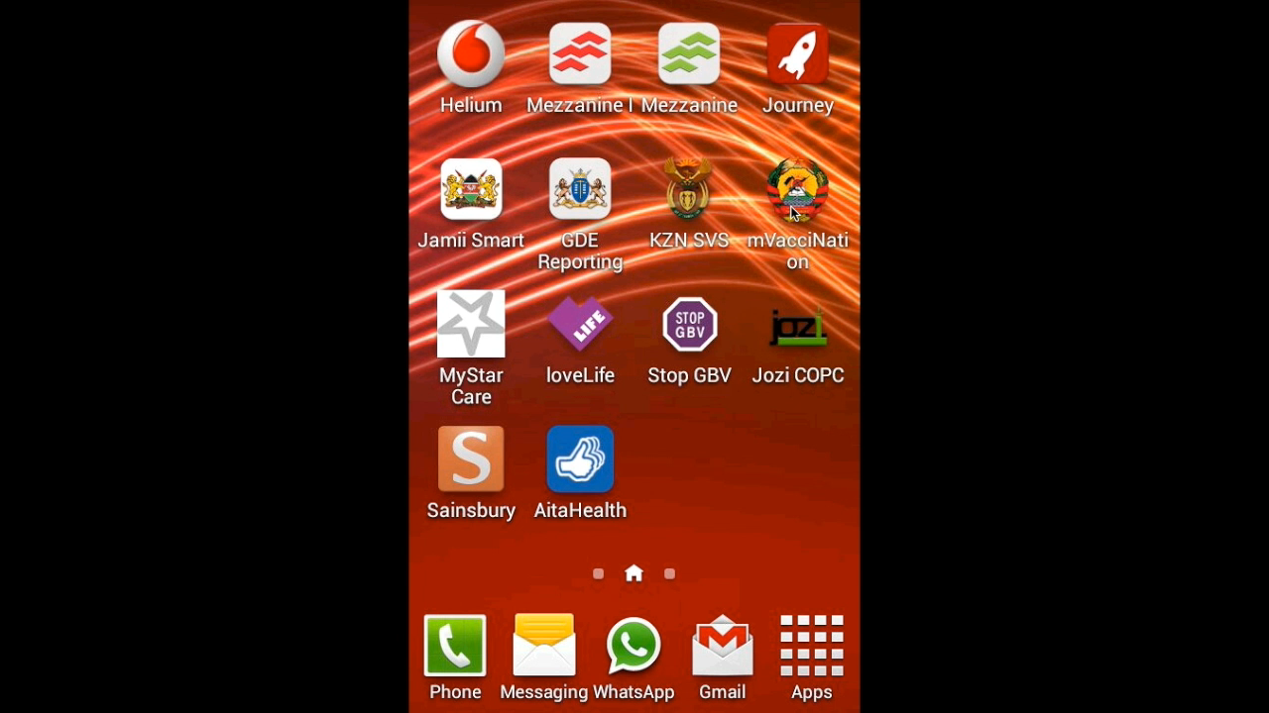
Video

Slide 19
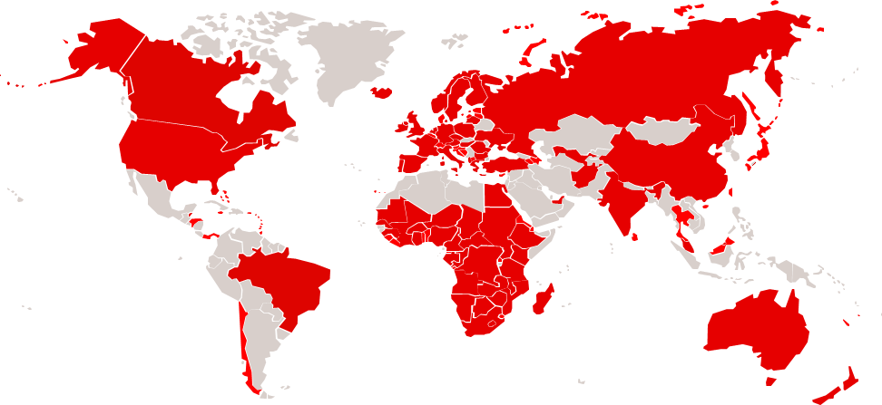
Vodafone’s Global Footprint and Vodacom Business Africa:
The world’s leading mobile telecommunications company…
Through branded local Operating Companies and Partners
Notes:
80% of audience is already part of the Vodafone family somewhere across the globe…

Slide 20
Vodacom Business Africa (VBA)
Established a Vodafone Global Enterprise (VGE) hub in South Africa in 2009.
Has a physical presence in over 20 and provides services across 40 countries.
Now proudly commands:
  The most comprehensive fixed data network coverage in the region.
  A strong mobile footprint, supplemented by local partners.
  Specialized knowledge in order to deal with the highly complex and risky regulatory, tax and licensing requirements.
  The tools necessary to deliver a consistent, centralized managed service including billing, ordering and reporting across the region.
We are establishing two new regional hubs in Nairobi and Accra,
To support 600 VGE Multi-National Customers who require business services in Africa.

Slide 21









Journey to business growth
Evolution toward industry solutions and platforms
Business Growth
Personal Productivity
Business
Management
Vodafone Communication Services
Work on
any device
Help me manage
my comms
Help me operate
more effectively
Email, Fixed Network, Mobile, Collaboration
Work the way
you want
Help me operate globally
Keep me ahead
of the game
CORE COMMUNICATIONS
MANAGED SERVICES FOR ENTERPRISE
INDUSTRY SOLUTIONS

Slide 22
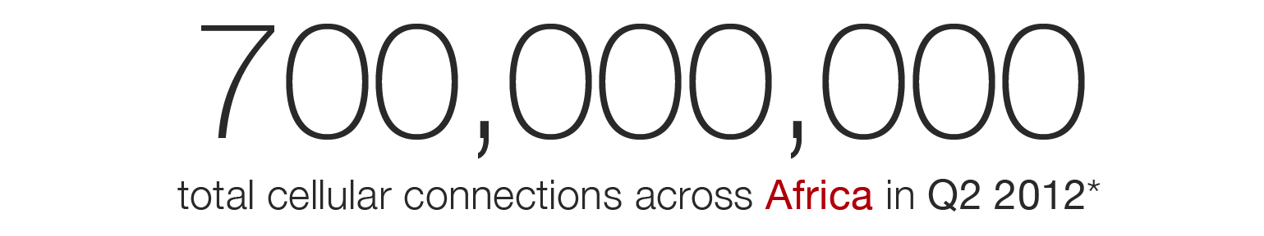
mHealth is a major growth platform
At the intersection of mobile innovation and health transformation
TRENDS
CHALLENGES
Chronic Disease Epidemic
Poor information mx: paper based
Ageing Demographic
Poor infrastructure & human capital base
Cost pressures on providers
Lack of patient compliance
Increased Patient Empowerment
Inequality in access to services & Rx
Genericisation of markets
Demand for better quality of care
Notes:
Very simply, mHealth is the use of any type of mobile platform to transform how health is delivered, consumed and experienced
mHealth is a component of the delivery of healthcare services and is not meant to entirely replace legacy systems
In a nutshell, mHealth speaks to efficiencies in workflow (enabling e.g. CHW’s to capture the right data at the right time – ultimately means they increase their productivity), process (e.g. it takes up to 9 weeks for paper based immunisation records to get to the National or Policy level) and information management (a system can be automated, eg, sending customised messages via sms, voice or email to patients regarding their condition, compliance etc).

Slide 23







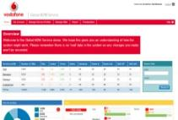


Vodacom empowers people and machines (M2M) in mHealth
Global M2M Platform
Automatic data collection from wireless sensor devices
Dedicated global data network
Types of applications
Chronic disease management
Patient Engagement
Assisted Living
Clinical research
Health system workflow
Manual
data
collection software
Device/ Data Management
Versatile software platforms

Slide 24
Making mHealth matter in Africa
Direct benefits of visibility into daily primary healthcare management
Primary healthcare facility monitoring in real-time improves individual health-worker performance (Quality of Care).
Ability to simultaneously monitor stock levels and communicate with patients will expand the demand for pharmaceutical products in a responsible fashion (Increased Adherence).
Ability to cross-reference data points (eg patients treated vs stock usage) increases data quality (Quality of Data).
Visibility on stock levels at dispensing level ensures better supply chain planning (Access to Care / Availability of Product).
  Received, Issued, Transferred, Wasted, Expired, Available
Notes:
RCT!

Slide 25

From 2008 : CHW management in Kenya and South Africa
Mobile based workforce management solution for Community Health Workers (CHWs).
Supports CHWs to provide better quality and more efficient health and social care services.
Enables lower-skilled health workers to perform part of the workload currently assigned to higher-skilled workers.
Increases access to quality care
  Captures clinical data
  Facilitates basic triage at point of care
  Enables automated and real-time reporting.
Notes:
From 2008
Healthcare in emerging markets is usually NOT delivered by Doctors, rather by Nurses and usually by Community Health Workers or even lower level clinical workers, who often have very little formal training & education
To enable them to not only do more but also to reduce the workload on higher skilled workers

Slide 26
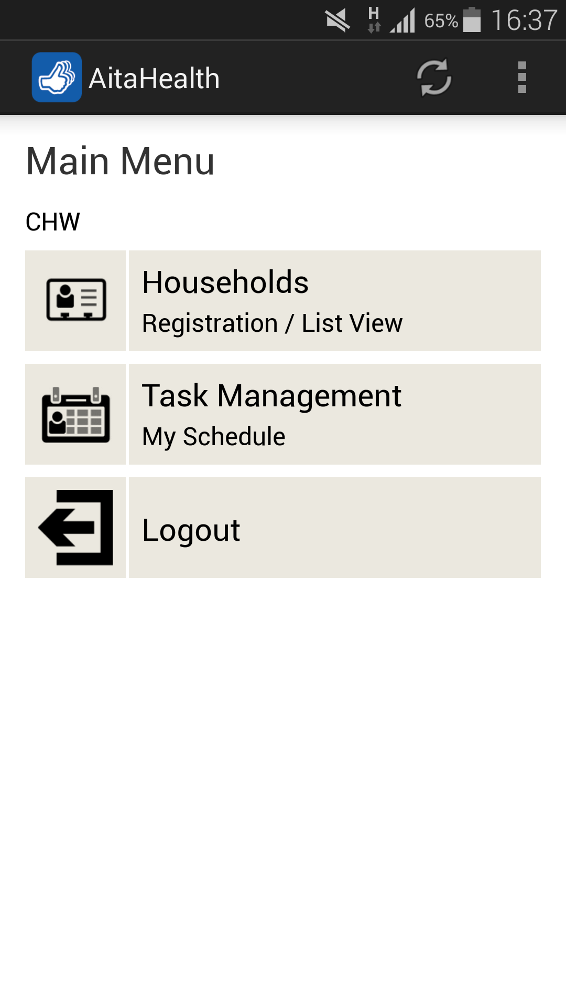
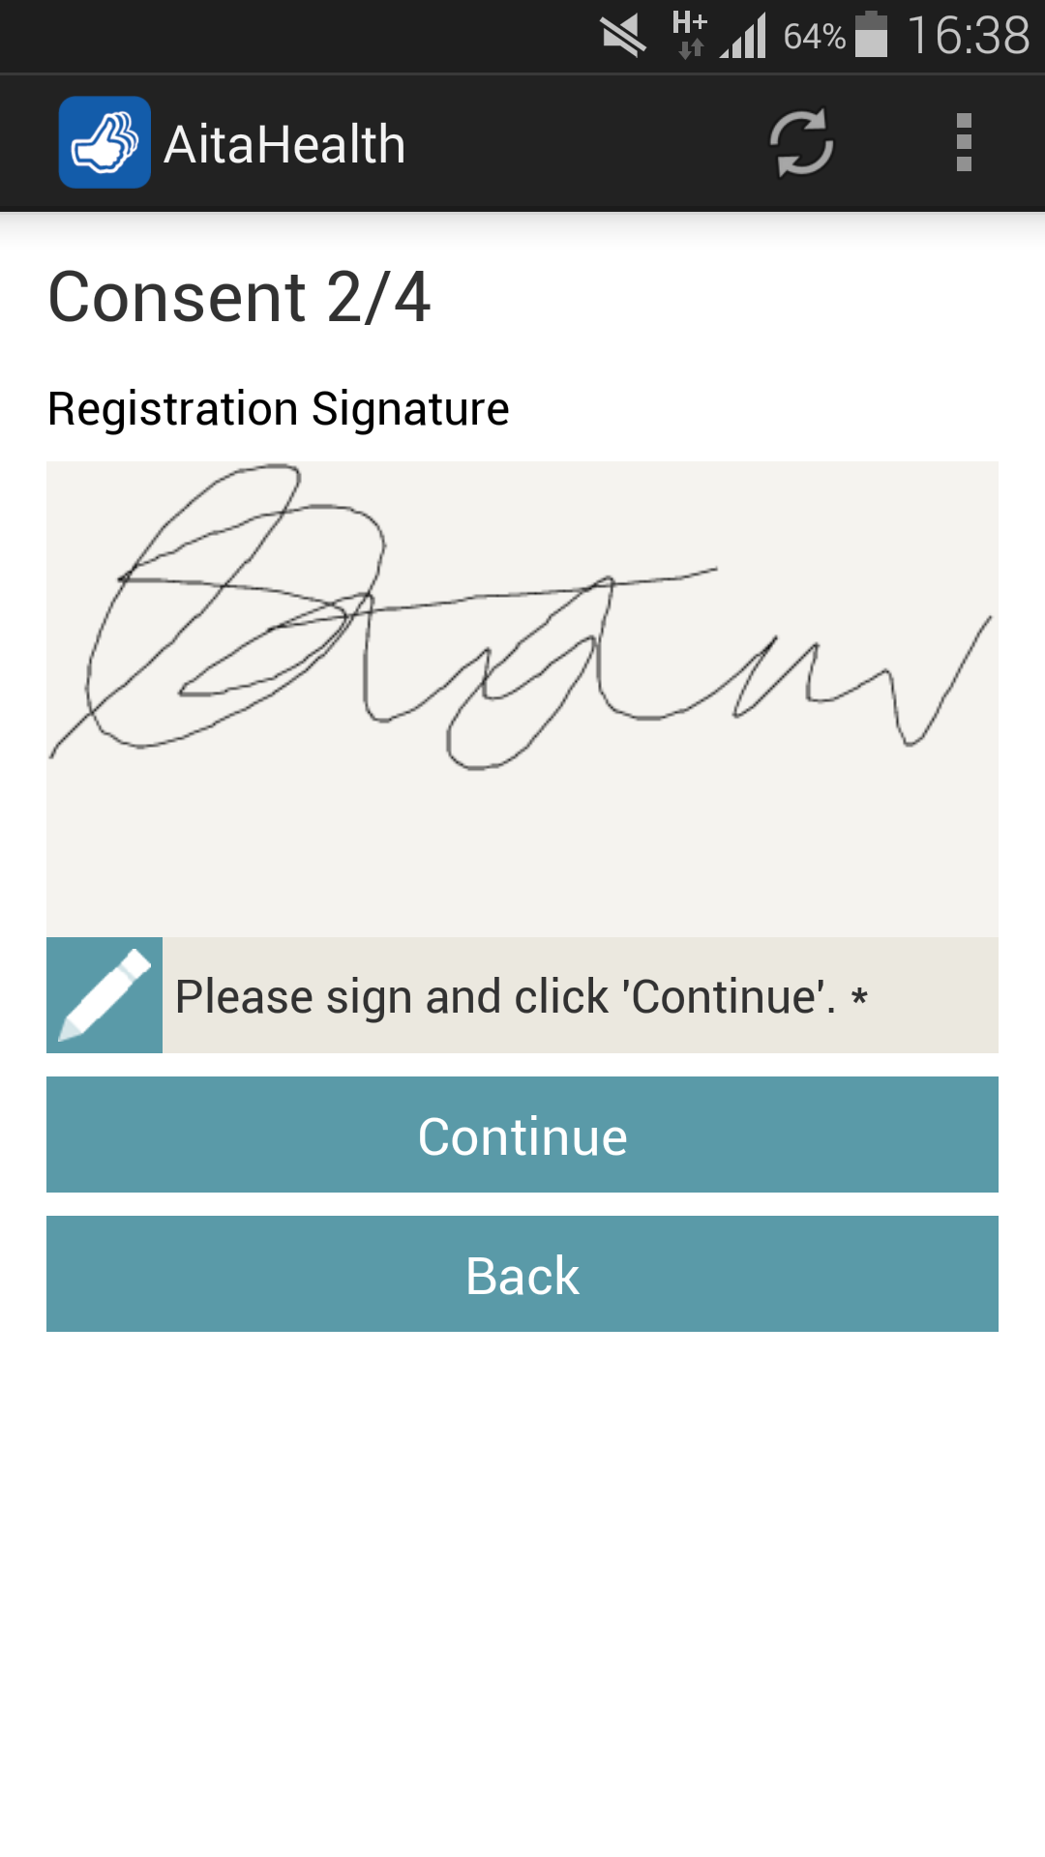




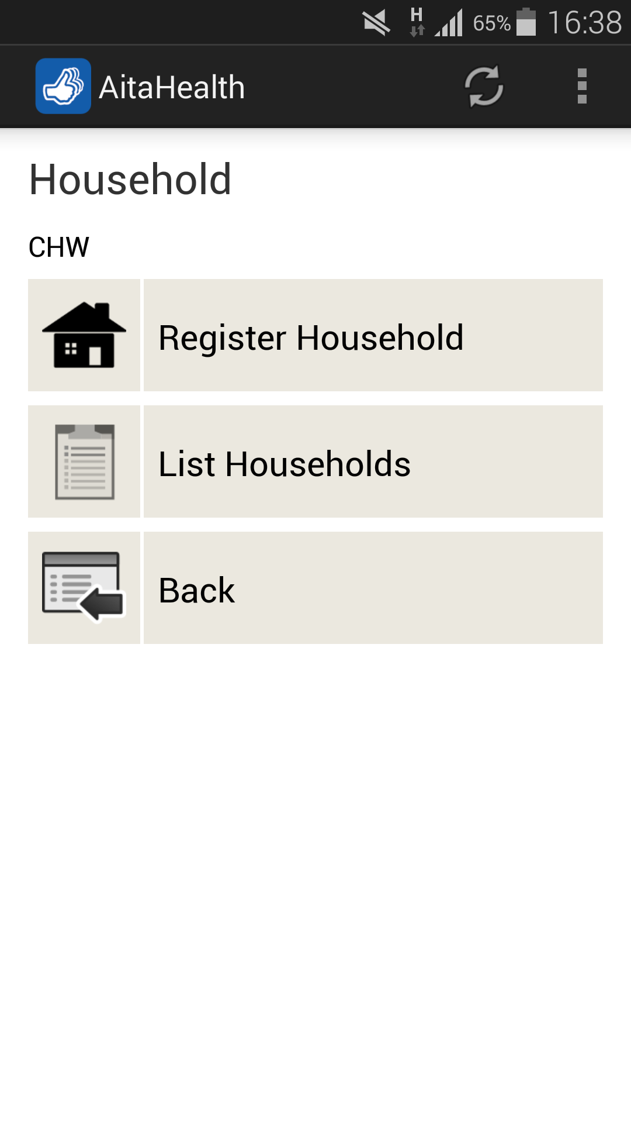

Managing mother-and-child health through CHW workflows
Community
Caregiver
Mobile
app

Slide 27

Scaling mHealth in Africa
Securing the right tool-kit with which to make mobility matter in healthcare
Know the environment and use the right channels to communicate with stakeholders.
CHWs - Volunteers. Uneducated. Unstructured home visits.
Primary Health Facilities - Dedicated. Under-resourced.
District/Provincial Staff - Experts. Better resourced. Internet access.
Ensure adequate life-cycle support for application development and iterative improvement.
Offer remote access to secure hosting and data back-up in all footprint countries.
Manage devices and data connectivity on behalf of clients – especially the public sector.
Provide multi-tenant ICT infrastructure to ensure compliance with patient data regulations.
Support external integration options to make optimal use of legacy systems.

